Slide 1
Quantifying incidence of predation on salmonids and other species of interest using high-throughput qPCR found in gut contents
Scott Brandl, UC Davis
Gregg Schumer, Cramer Fish Sciences
Brian Schreier, Dept. of Water Resources
J. Louise Conrad, Dept. of Water Resources
Bernie May, UC Davis
Melinda Baerwald, UC Davis
Notes:
my goal was to not get into the minutia of the genetic techniques but to explain three things
Introduce a new high-throughput genetic technique
What can we do and what can’t we do?
How do we interpret the genetic data?
How do we control these experiments?

Slide 2
Effects of Striped Bass on Chinook
A bioenergetics model for striped bass has been created(Loboschefsky et al., in review)
A potential limitation is the relatively low detection rates of predation on juvenile outmigrating smolts; however, our use of the genetic assay will make this approach feasible
Delta Passage Model (DPM, Cavallo et al., 2011) examines spatial and temporal processes between striped bass predators and Chinook salmon prey in the delta

Slide 3
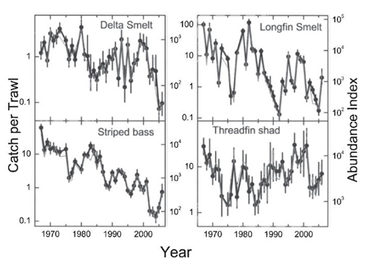
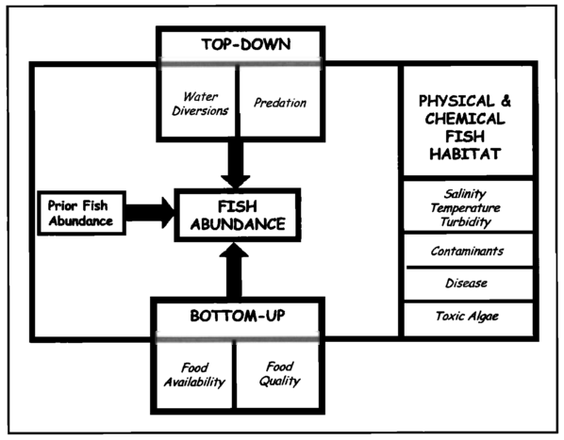
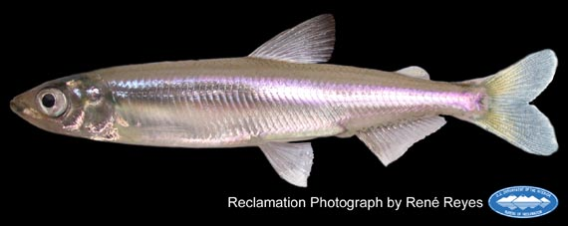
Pelagic Organism Decline
Habitat loss
Increased water diversion
Predation
Notes:
Put graph of fish decline or fish pic

Slide 4
Predation on Pelagic Fishes
Quantify incidence of predation in the North Delta region.
Find spatial or temporal trends in undesirable predation
Find correlations between predation and habitat condition (water temperature, salinity, turbidity, pH, density of submerged aquatic vegetation and others).
Notes:
Primarily due to habitat loss, but it is hypothsized that

Slide 5
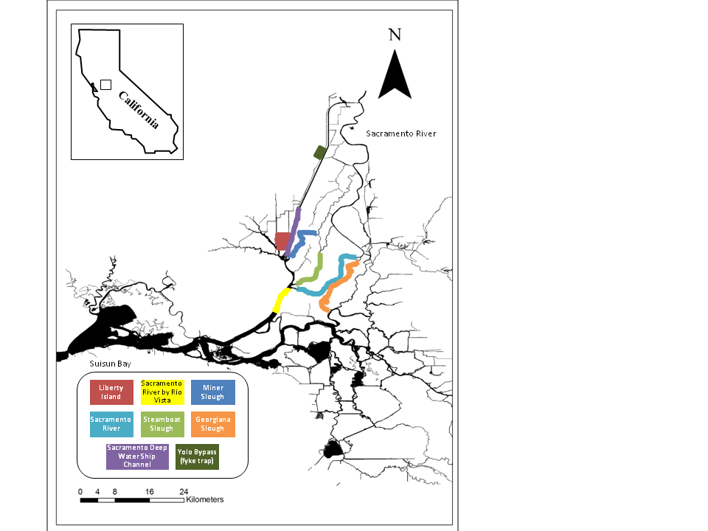
Location and Target Species
Predators sampled
Striped bass
Largemouth bass
Smallmouth Bass
Pikeminnow (native)
Prey detected
Chinook
O. mykiss
Green Sturgeon
White Sturgeon
Mississippi silverside
Wakasagi smelt
Delta smelt
Longfin smelt
Splittail
Threadfin Shad
Notes:
Again community-scale is where we’re heading.
Up to 1400 predators
Winter and spring sampling
Emphasize that we are scaling this thing up big time (community predator-prey interactions)

Slide 6
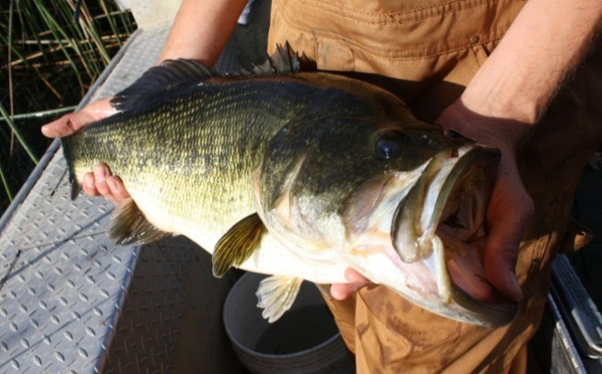
Assay design, characterization and validation
Sequence as many local species as feasible Taqman assay
“in silico” validation
Empirical validation
Notes:
Sequencing local speciemens is key because we are often relying on a small number of snps

Slide 7
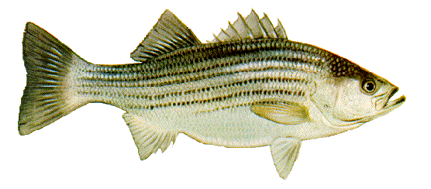
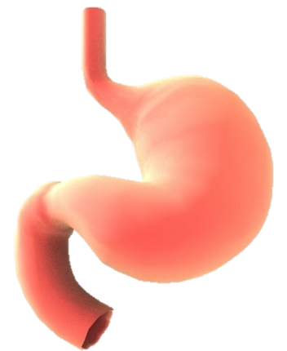
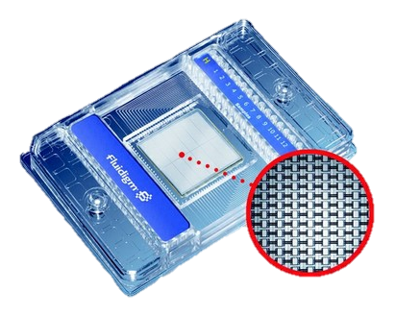
Our workflow
Predator euthanization and GI tracts preservation
Gut homogenization and DNA extraction
Detection on Biomark 96.96 IFC
TPWD

Slide 8
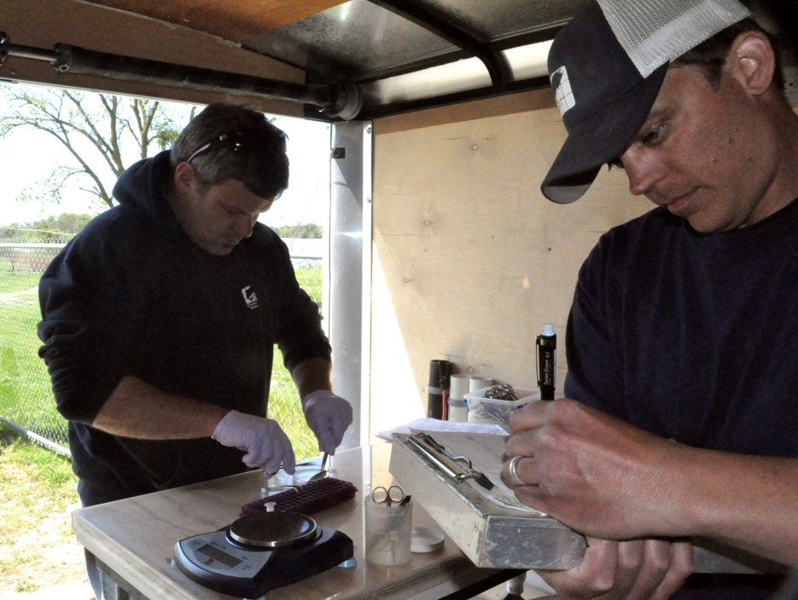
Challenges of genetic work in the field
Sample preservation
Contamination
Lab control: Extraction controls
Lab control: PCR controls
Notes:
Talk about the gsp here

Slide 9
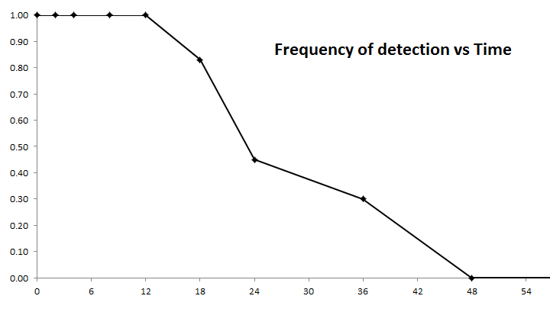
Persistence of detectable DNA in silverside guts.
Hours post ingestion
Brandl et al. unpublished
Notes:
inform the bioenergetics modeling component, it will be necessary to determine the rates of detection in striped bass stomach contents over a digestion time course

Slide 10
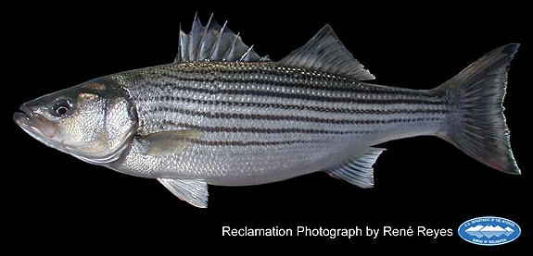
Striped Bass
n = 130

Slide 11
Striped Bass
Notes:
There were 100 stripers with 0 or 1 gut fullness
This is a lot of natives!

Slide 12
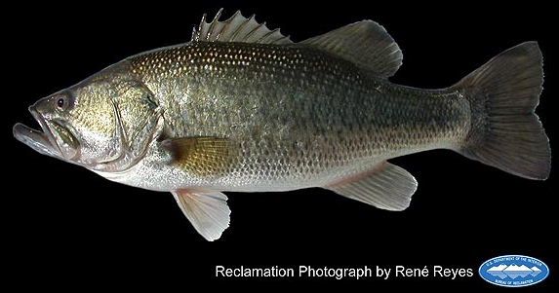
Largemouth Bass
n = 28

Slide 13
Largemouth Bass

Slide 14
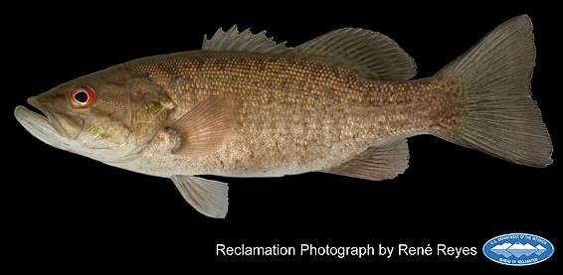
Smallmouth Bass
n = 9

Slide 15
Smallmouth Bass

Slide 16
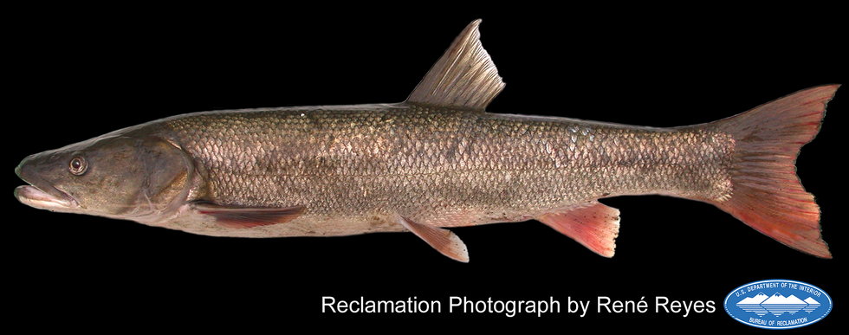
Sacramento Pikeminnow
n = 16

Slide 17
Sacramento Pikeminnow

Slide 18
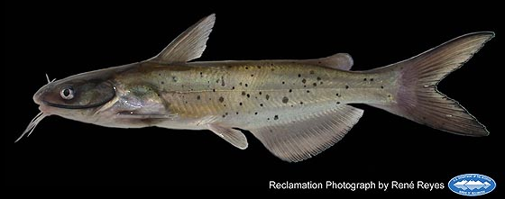
Channel Catfish
n = 19

Slide 19
Channel Catfish

Slide 20
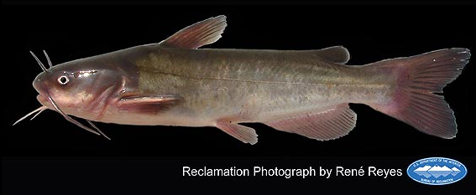
White Catfish
n = 42

Slide 21
White Catfish

Slide 22
Upcoming Direction…
After completion of sampling, address questions of correlations between POD species and biotic and abiotic factors
Apply the Delta Passage Model with chinook data
Total diet composition via “Meta-barcoding”

Slide 23
Acknowledgements
Thanks to:
Bernie May
Melinda Baerwald
Gregg Schumer
Funding:
Ecosystem Restoration Program (Grant No. E1183009)
Interagency Ecological Program
State and Federal Contractors Water Agency
Brian Schreier
J. Louise Conrad
Others:
FCCL, CABA
TJ O’Rear
Rene Reyes
USFWS
Notes:
SFCWA and IEP?
Thank USFWS and CABA, FCCL! thank the groups generally since we arent really using the feeding trial data yet

Slide 24
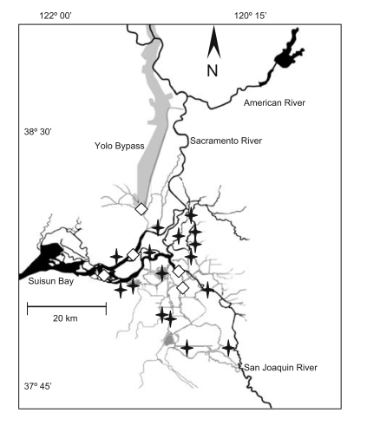
Visual ID vs Genetic
Study Location:
Nobriga and Feyrer (2008)
Stevens (1966)

Slide 25
Visual ID vs Genetic
 | 1963-1964 (n=4087) | 2001 (n=202) | 2003 (n=154) | 2013 (n=132)
Threadfin Shad | 8 | 8 | 8.4 | 15
unspecified shad | NA | 4.5 | 5.8 | NA
Mississippi Silverside | NA | 7.4 | 3.9 | 6.8
Chinook | 0.4 | 0.5 | 0 | 1.5
Delta Smelt | 0.4 | 0 | 0 | 0
Largemouth Bass | 0 | 0.5 | 0 | 0.76
Splittail | 0 | 0.5 | 0 | 5.3
Striped Bass | 8.9 | 2.5 | 0.7 | NA
Smallmouth Bass |  |  |  | 2.27
Wakasagi Smelt |  |  |  | 2.27
*Stevens (1966 ) Nobriga and Feyrer (2008)

