Slide 1
Your 2018 Hunter Education Instructor Correspondence Course
Welcome!
We are sorry you could not attend one of the four regional conferences last spring, where we had some great presentations on ducks and duck hunting and heard a sobering first-person account of a duck hunter’s near-fatal hunting accident.
We have put together some of the highlights for you to learn from and hopefully pass on to your students. You can download and print out the questions from the HEI Resource Page, and fill in the answers as you read thru the following pages. Then, transfer those answers to the quiz in the on-line HEI Correspondence Course.
Thank you again for helping Pass On The Tradition.

Slide 2
A Life-Changing Duck Hunt
Begin the course by watching A Life Changing Duck Hunt by Jerry Carroll. There are several questions you will be asked based on the video.
Make sure your computer is connected to the Internet then click here (https://youtu.be/tTMocsK4JTc) to be taken to the video.
Pay attention to the lessons he learned and pass them on to your students.

Slide 3
2017 Hunter Casualties
11 total
0 fatal
11 non-fatal

Slide 4
Major Factors of Casualty
Victim covered by shooter swinging on game – 5
Careless handling of firearm – 3
Victim mistaken for game – 2
Victim out of sight of shooter – 1

Slide 5
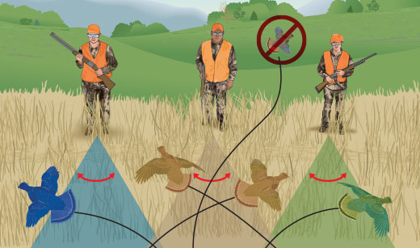
Victim covered by shooter swinging on game
5 incidents
1 Duck / Geese hunting
2 Pheasant hunting
2 Quail hunting
Zone-of-Fire Issues

Slide 6
Careless handling of firearm
3 incidents
1 Duck / Geese hunting
Shotgun in gear cart fired
1 Deer hunting
Self-inflicted gunshot wound to leg while holstering handgun
1 Pigeon hunting
Shooter getting out of chair
Trigger caught on something (clothes, chair)

Slide 7
Victim mistaken for game
2 incidents
Bear hunting:
shooter shot at movement about 200 yards away, thinking it was a bear
Victim (12 year old boy) was dressed in dark clothing with hood on
Squirrel hunting:
Shooter shot at movement, thinking it was a squirrel
Victim was leaning against a tree

Slide 8
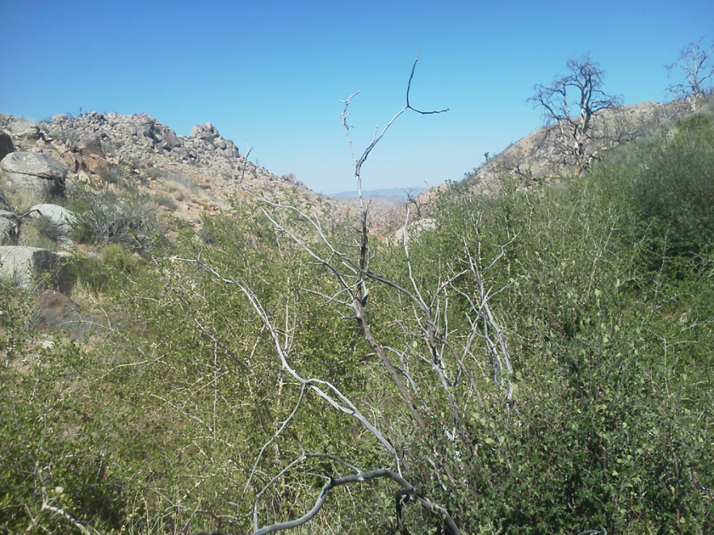
Victim out of sight of shooter
1 incident
1 pheasant hunting
Thick brush between shooter and victim

Slide 9
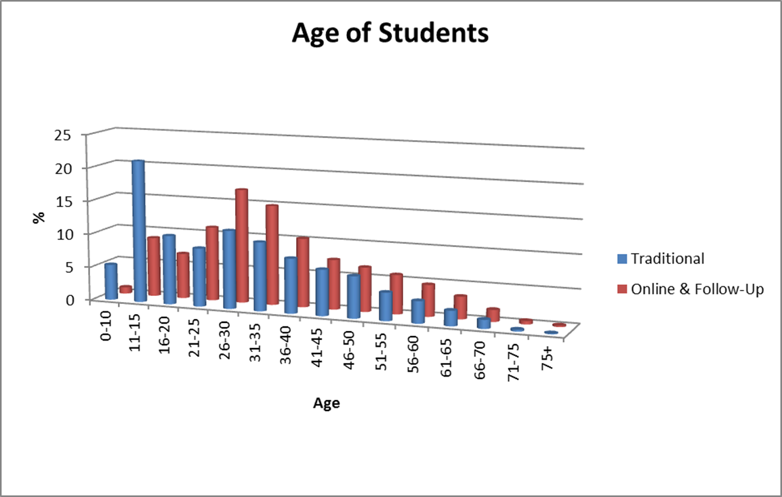
Hunter Education Statistics

Slide 10
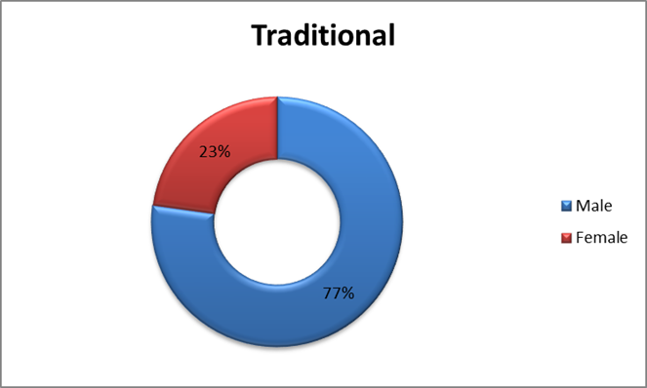
Gender

Slide 11
Numbers reported to USFWS

Slide 12
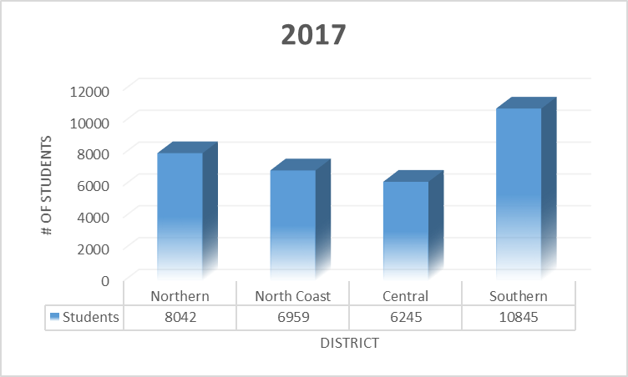
By District

Slide 13
THANK YOU FOR PASSING ON THE TRADITION

Slide 14
The Art of Waterfowl Hunting
By Lt. Shawn Olague

Slide 15
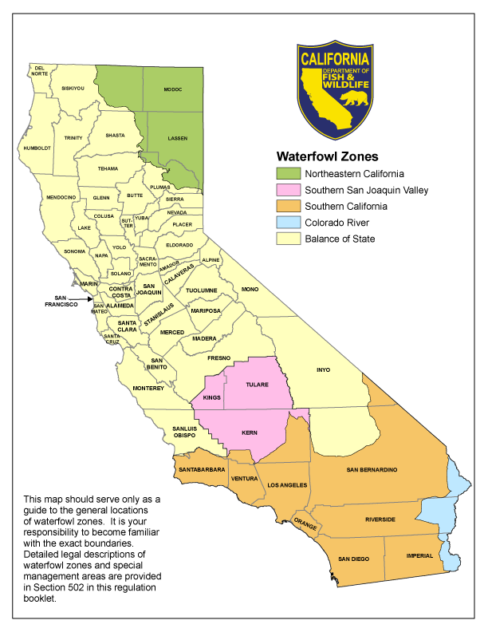
Why Waterfowl?
Available Statewide
Public and Private opportunities almost anywhere there is water; even along the coast.

Slide 16
STATE WILDLIFE AREAS
110 State Wildlife Areas, 710,600 total acres.
32,000 acres of upland habitat.
160,600 acres of wetland habitat.
13,600 acres statewide that are open to the public.
https://www.wildlife.ca.gov/Lands/Places-to-Visit

Slide 17
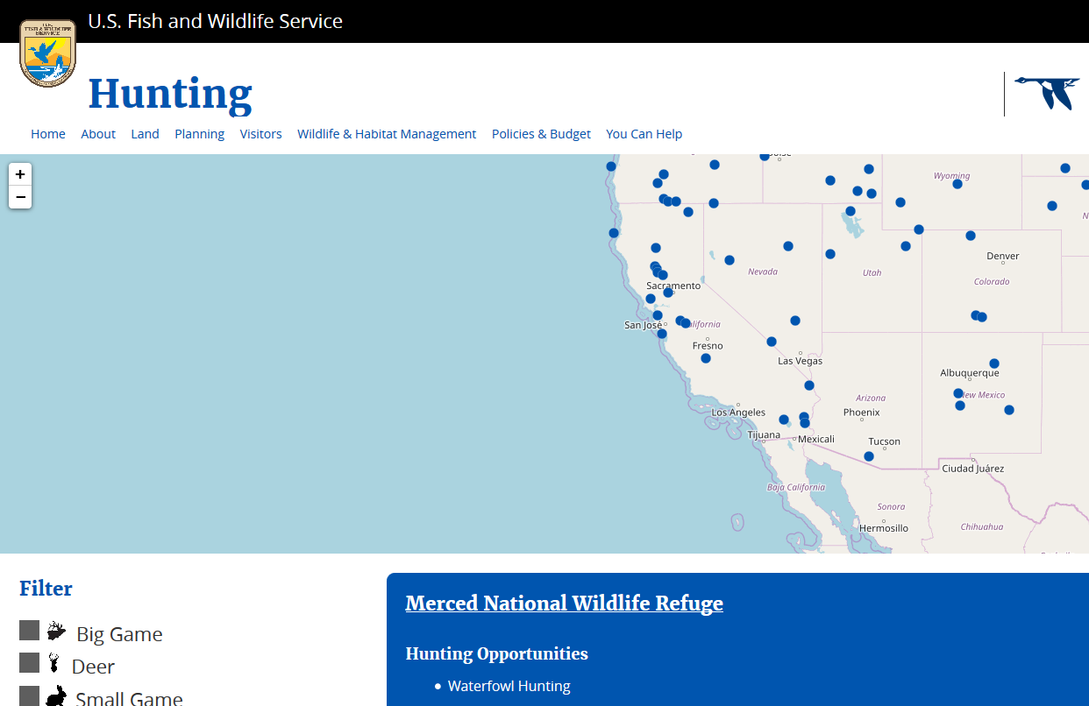
California also has
21 Federal Refuges

Slide 18
Federal Refugee System
Hunt Program managed by DFW.
Sacramento Wildlife Refugee Complex
has over 35,000 acres of wetlands and uplands Habitat.
The San Luis National Wildlife Refuge Complex has over 45,000 acres of wetlands and upland habitat.
https://www.fws.gov/refuges/

Slide 19
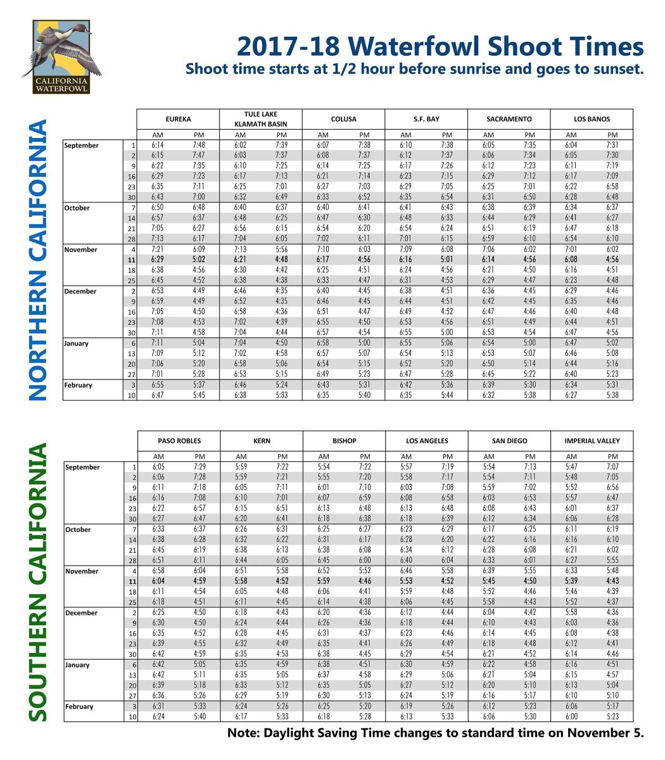
Why Waterfowl?
Long season
100+ days
Approx. 44 traditional shoot days. (S,S,W)

Slide 20
Why Waterfowl?
A shareable sport.
Does not require a ton of equipment, although it can
Many facets to choose from.

Slide 21
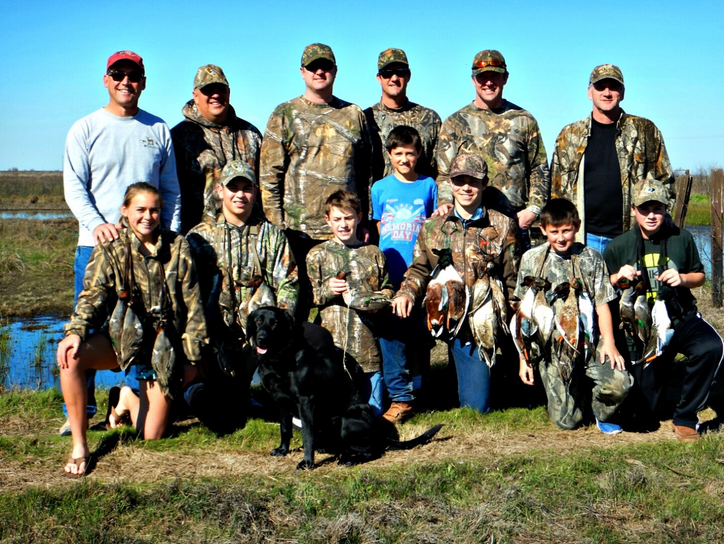
Why Waterfowl?
Special Junior Days
Prior to or after the season

Slide 22
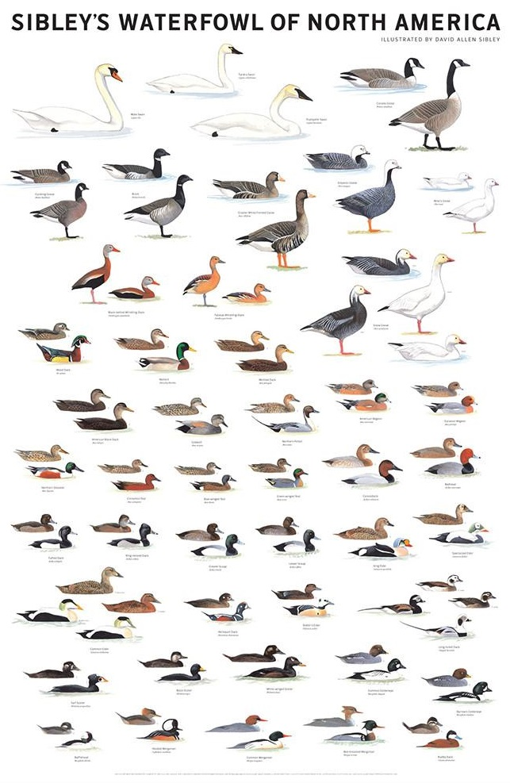
Why Waterfowl?
High encounter rate
California hosts about 39 different species and subspecies of waterfowl and provides vital winter habitat for about 60 percent of the waterfowl population in the Pacific Flyway. (annually estimated to be between 4 - 6 million birds)

Slide 23
Bottomline, We host a lot of ducks!

Slide 24
How are Waterfowl Laws Created
North America and Mexico are divided into 4 administrative flyways. Representatives from each state are on the councils
The Pacific Flyway Council makes season and harvest recommendations to USFWS.
The USFWS develops Recommended regulations framework each state to adopt.
The Ca Fish and Game Commission has public hearings on recommended regulations and votes on final version of regulations. Done in April.

Slide 25
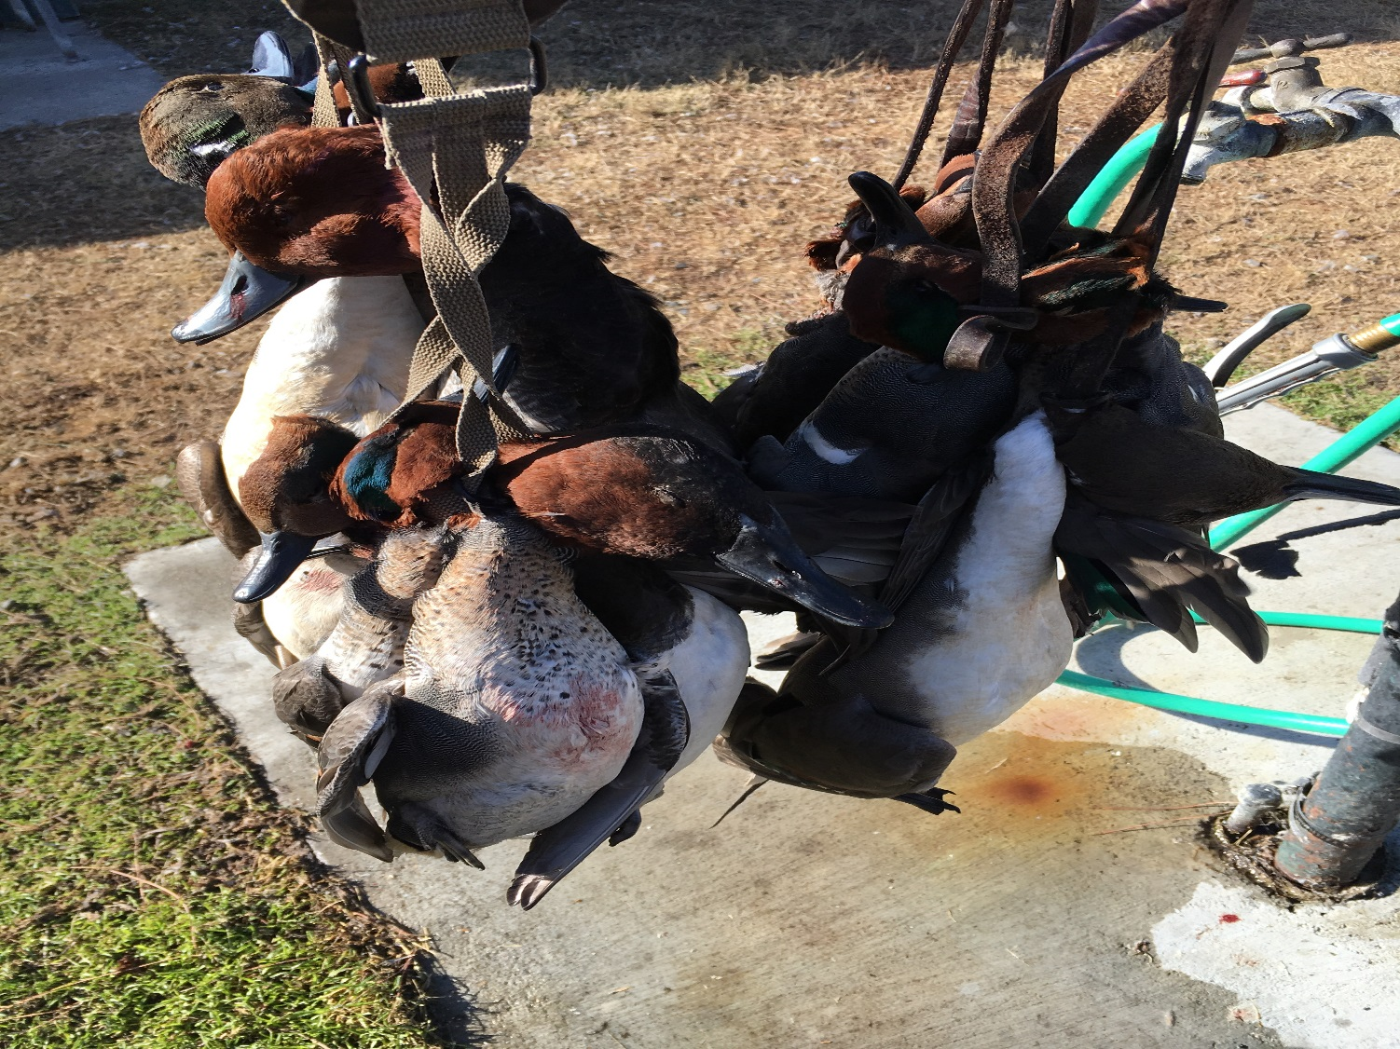
Why Waterfowl?
Liberal limits
Up to seven ducks
Up to 30 geese.

Slide 26
Where do we start?

Slide 27
Where do we start?
Shotguns
Capable of shooting steel or other non-toxic shot
Plugged-no more than 3 shells
Camo/synthetic, pump/semi, your choice really, what do you want?
Reliable and easy to clean.
Multiple choke options
With sling or without

Slide 28
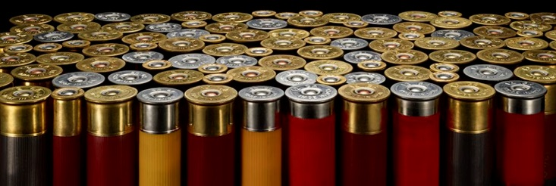
Where do we start?
Shotshells
Do not have to the biggest, fastest and most expensive.
$6 per box at Walmart, 1 oz #6 work fine.

Slide 29
Where do we start?
Waders
Made out of many materials
Rubber
Neoprene
PVC
Breathables
Prices vary as does quality
As cheap as $60
As expensive as $549
Heavy insulation not needed for most CA conditions.

Slide 30
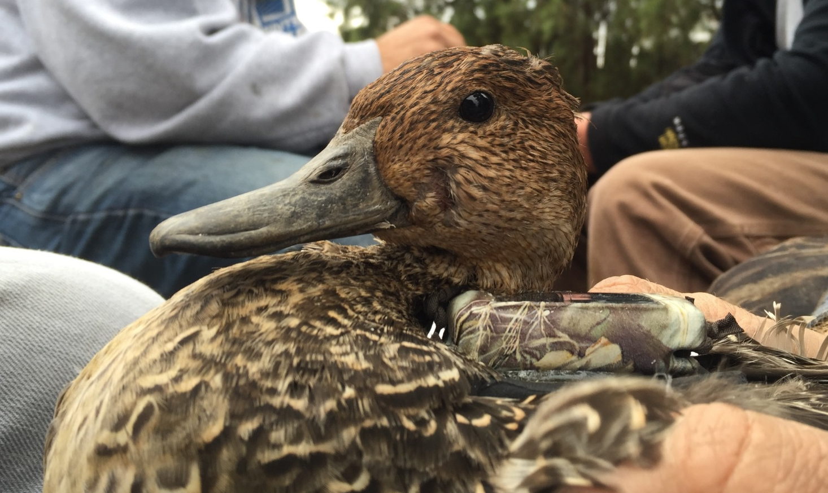
Breeding and Wintering Waterfowl in California

Slide 31
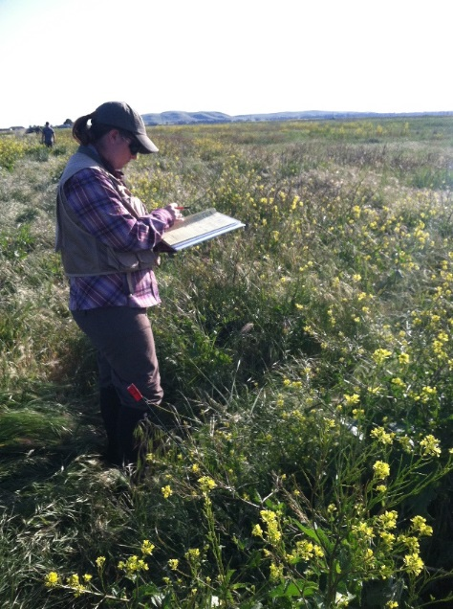
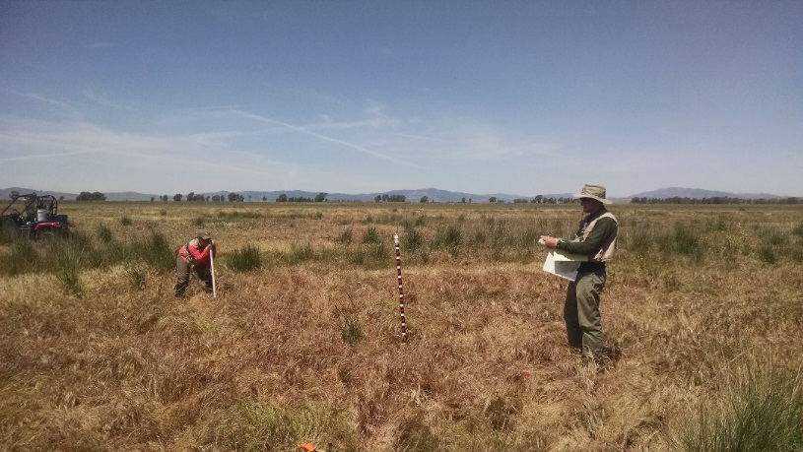
Project Background
USGS partnering with CDFW and DWR to study waterfowl and waterbird populations in Suisun Marsh, California
In 2015 started a 10 year study looking at effects of tidal marsh restoration in Suisun
Component of the research involves the use of GPS telemetry to monitor waterfowl movements
Notes:
There are many components of this study but one aspect of the research is the use of GPS telemetry to monitor waterfowl movements

Slide 32
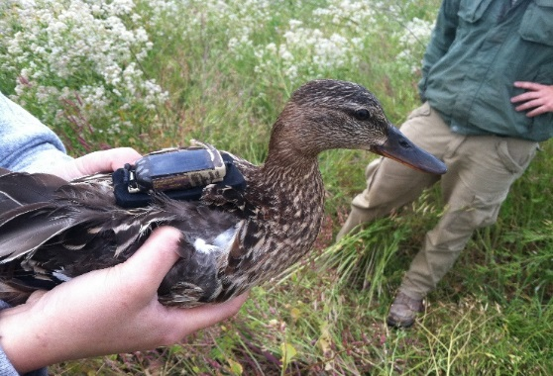
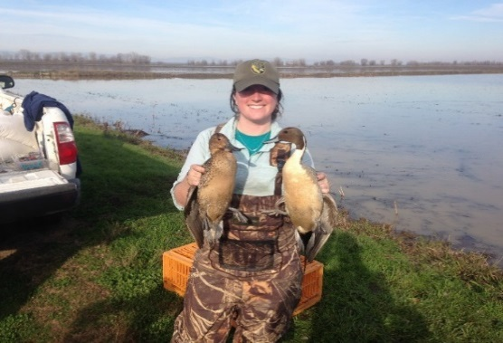
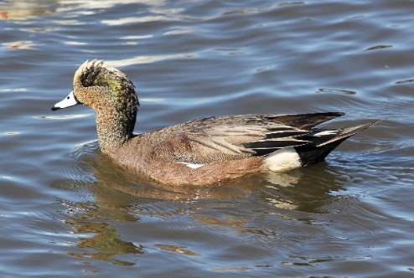
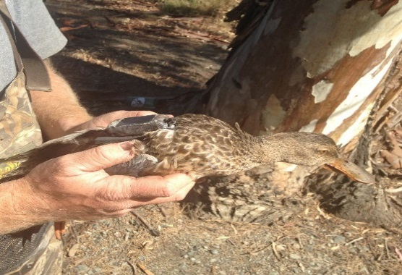
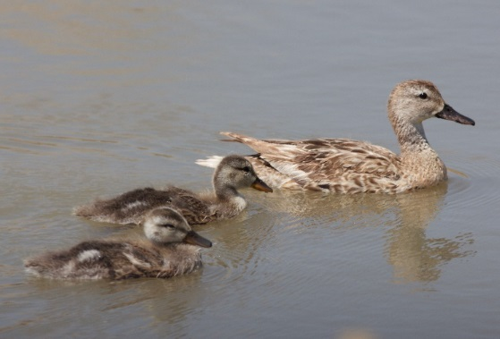
Research objectives
Life cycle of different species
Nesting
Brooding
Molting
Migration
Species differences
Space use and movements
Roosting/Foraging areas (daily and seasonal)
Variables affecting movements (i.e. hunting, weather)
Habitat use regionally
MALLARD
PINTAIL
WIGEON
SHOVELER
GADWALL
Notes:
We want to look at the life cycle of the each individual species
Nesting – nest site locations, nest site fidelity
Brooding – distance from nest site, space-use, brood rearing habitat, “prospecting”
Molting (thesis) – molt sites, molt site habitat
Migration – migration stopovers and corridors, breeding grounds
Species differences – how do species differ with habitat use and movements
Space use – where are birds roosting and foraging, how do they utilize the landscape on an annual basis.
Movements - What variables effect movements? Does hunting limit or increase movement? What about weather such as rain and fog?
Habitat use – what habitats are waterfowl utilizing? Does it change regionally?

Slide 33
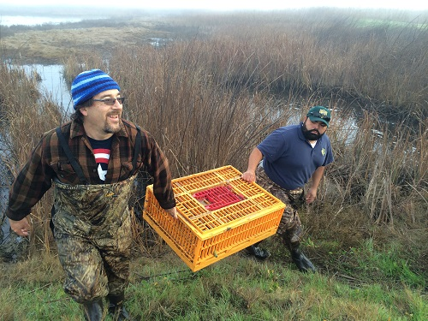
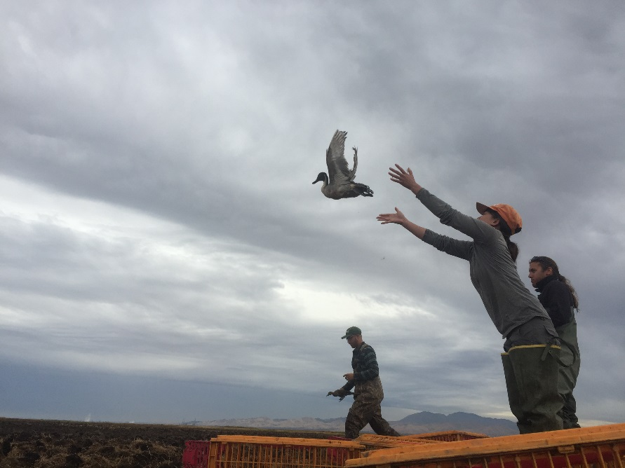
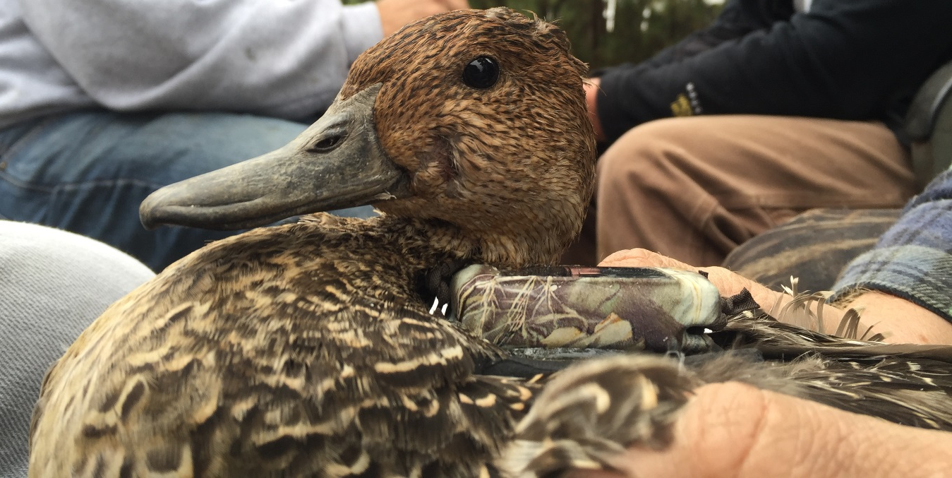
Monitoring Winter Movements:

Slide 34
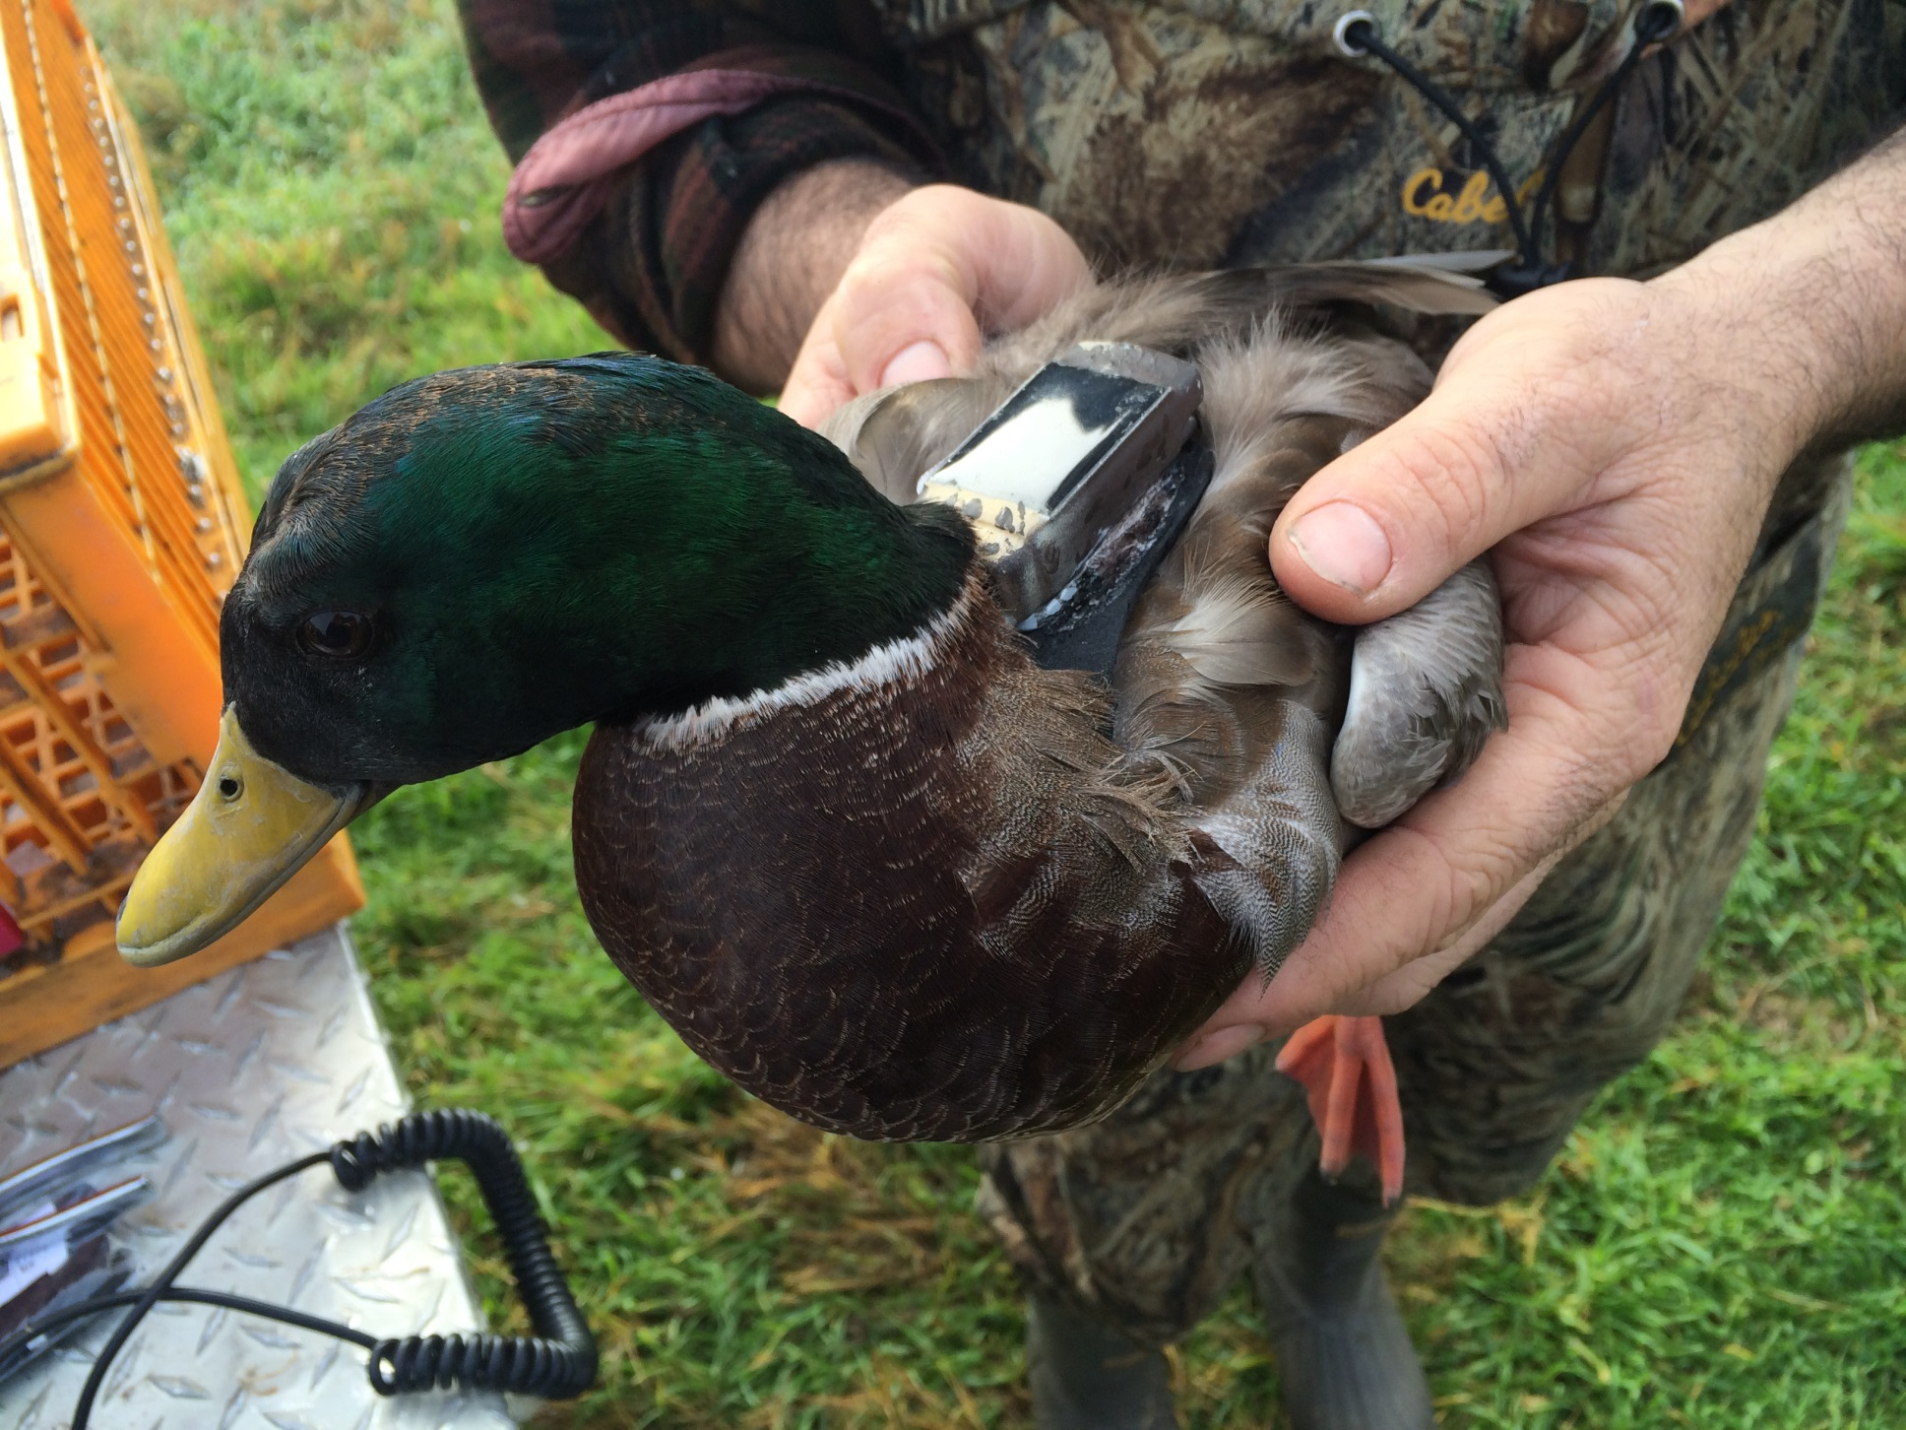
GSM/GPS Transmitter (locations via cell phone network)

Slide 35
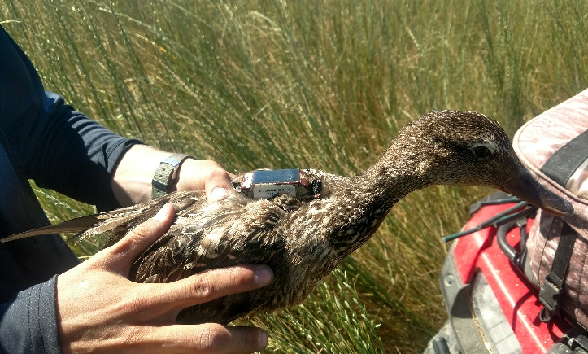
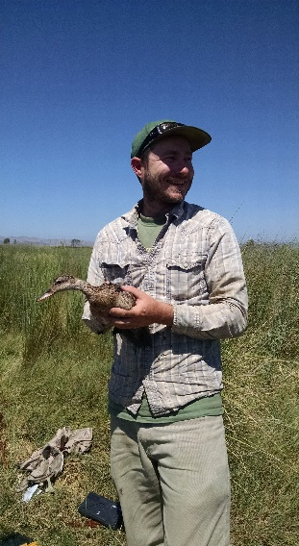
Gadwall Distribution
Important Links:
Sacramento Valley
San Joaquin Valley
Klamath Basin

Slide 36
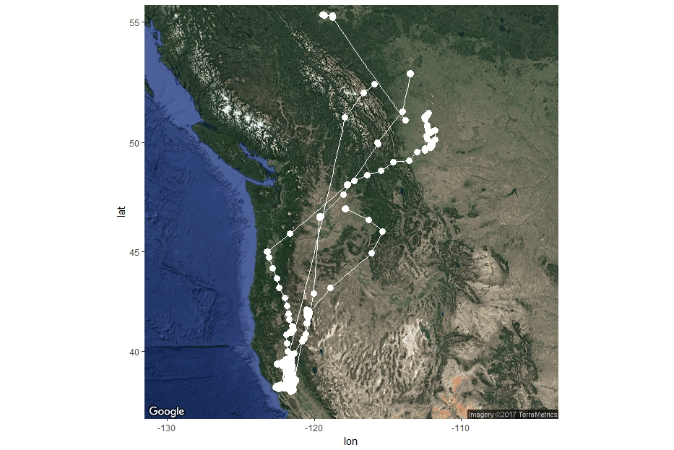
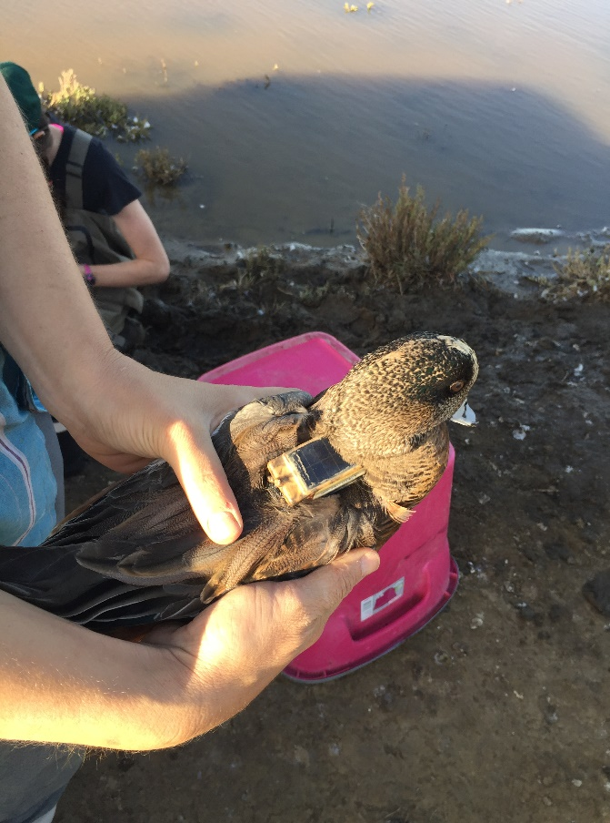
American Wigeon Distribution
Important Links:
Sacramento Valley
San Joaquin Valley
Canadian Prairie Pothole

Slide 37
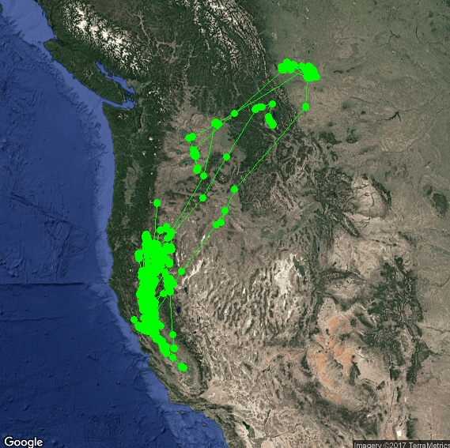
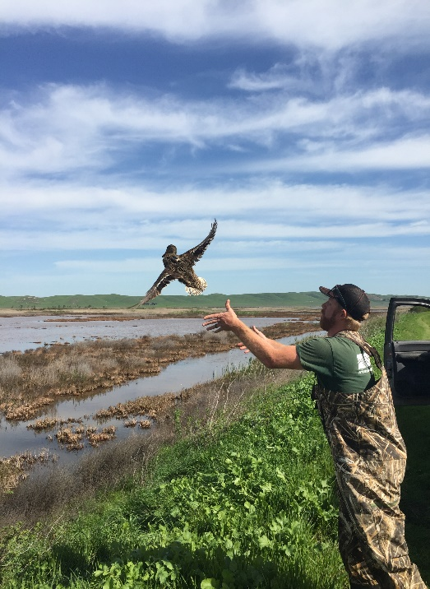
Mallard Distribution
Important Links:
Sacramento Valley
San Joaquin Valley
Canadian Prairie Pothole
Klamath Basin
Eastern Oregon and Washington

Slide 38
Northern Shoveler Distribution
Important Links:
Sacramento Valley
San Joaquin Valley
Canadian Prairie Pothole
Klamath Basin
Pacific Northwest

Slide 39
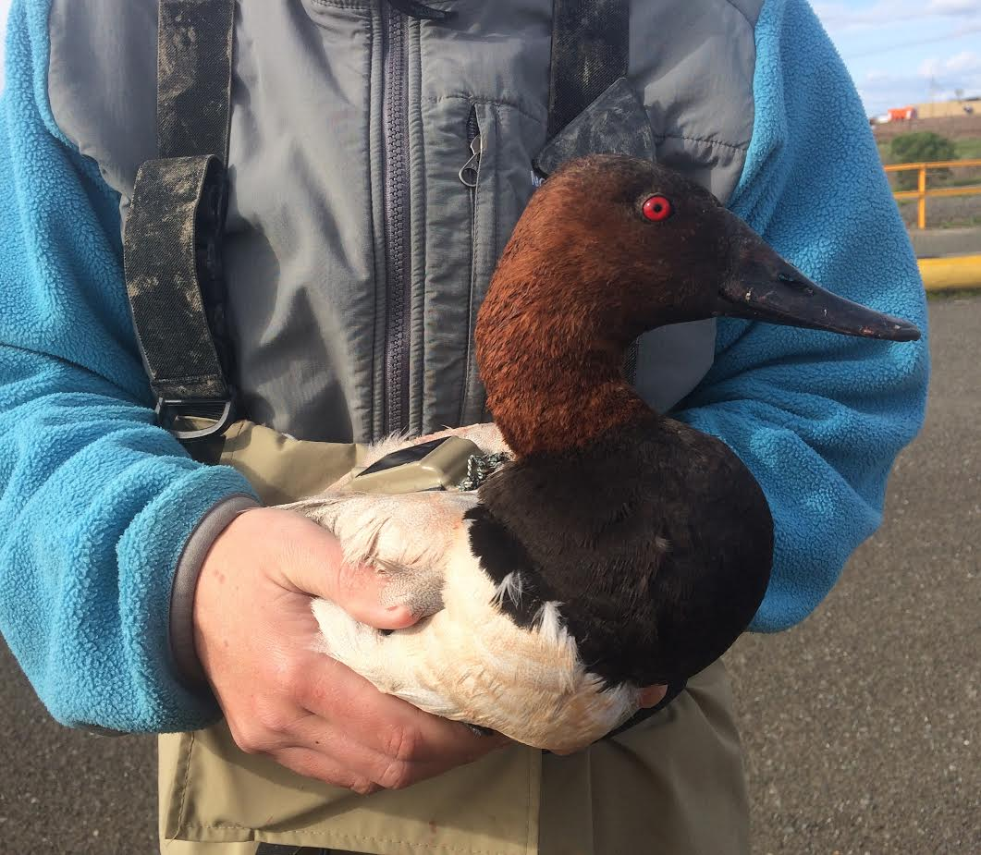
Canvasback Distribution
Important Links:
Sacramento Valley
San Joaquin Valley
Canadian Prairie Pothole
Klamath Basin
Great Basin

Slide 40
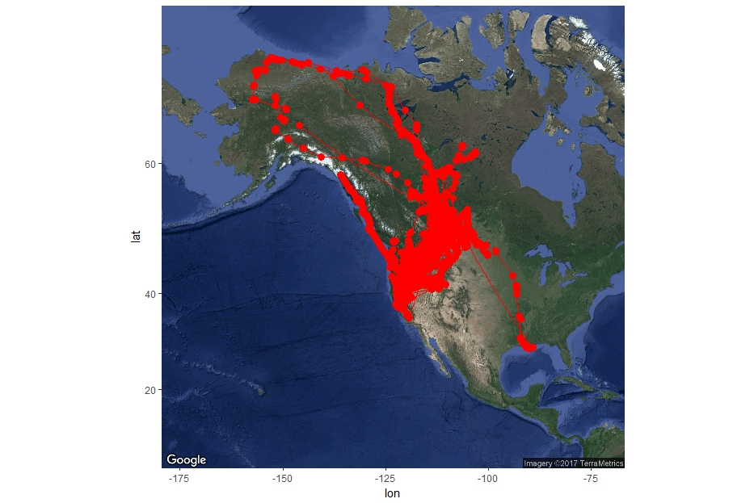
Northern Pintail Distribution
Important Links:
Sacramento Valley
San Joaquin Valley
Canadian Prairie Pothole
Klamath Basin
Eastern Oregon and Washington
Great Basin
Western Boreal Forest
Alaska
Mississippi Alluvial Valley

Slide 41
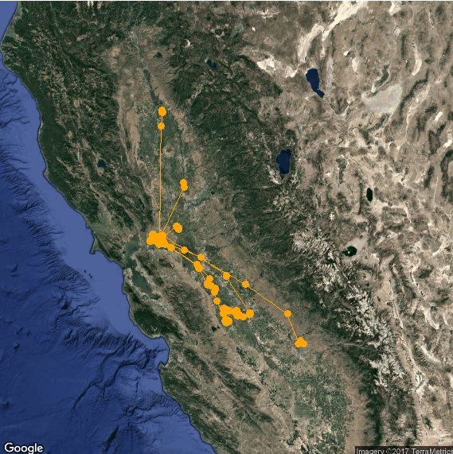
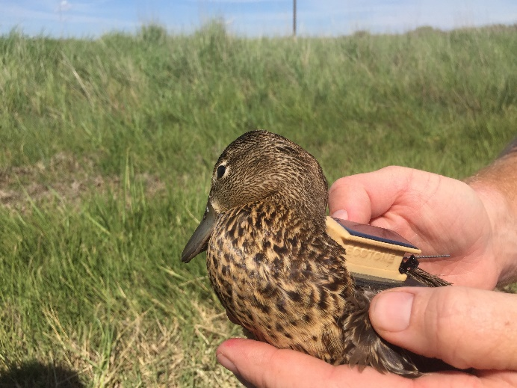
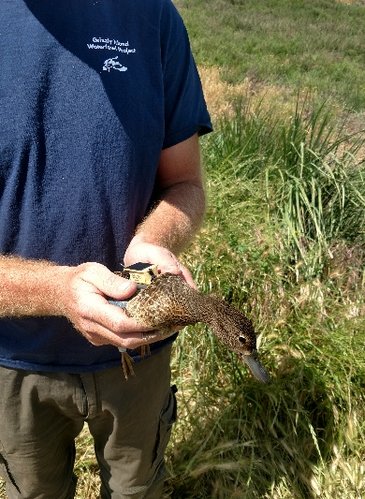
Cinnamon Teal Distribution
Important Links:
Sacramento Valley
San Joaquin Valley

Slide 42
ready, set, go!
With this information, you are now ready to complete your 2018 Correspondence Course.
To-Do List:
☑ Review Correspondence course Powerpoint/PDF study material
□ Register on Kalkomey: https://www.register-ed.com/events/view/125915
Complete the Survey Monkey exam: https://www.surveymonkey.com/r/C3BXLRX
** Note: Failure to complete ALL requirements above will result in an INCOMPLETE.
Finish all the requirements, and you are done! Your hours will be automatically credited from your registration. If there are any issues, YOUR COORDINATOR WILL CONTACT YOU. If you do not hear from a coordinator or hunter education staff member, no further action is required, and you have successfully fulfilled the requirements for the hunter education instructor training in 2018.

Slide 43
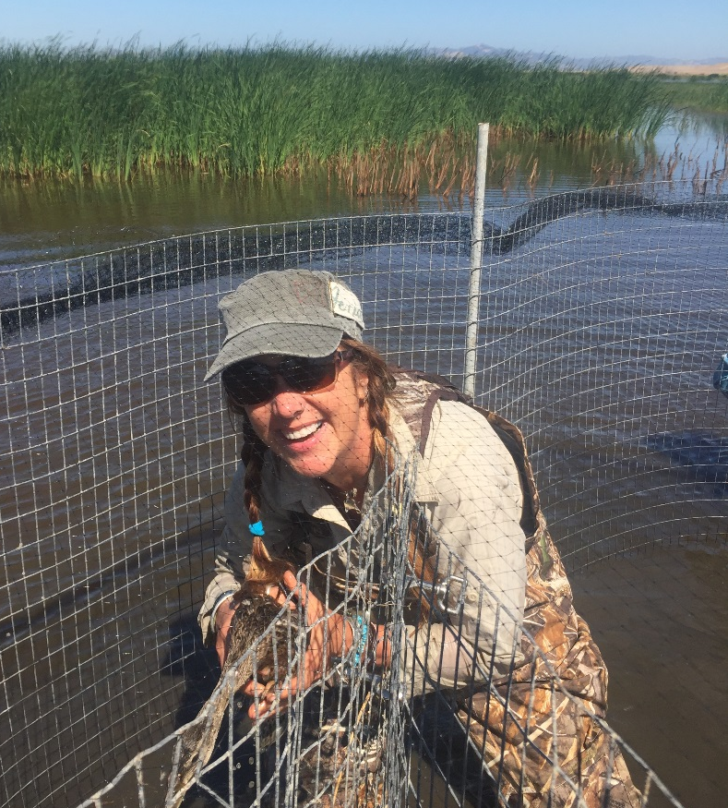
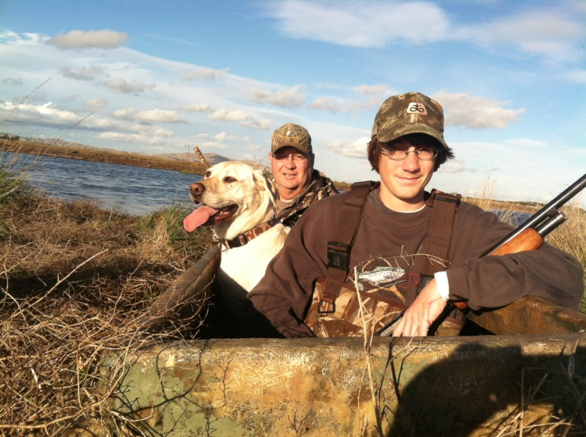
The End--Thank You!!

