Slide 1
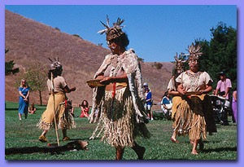
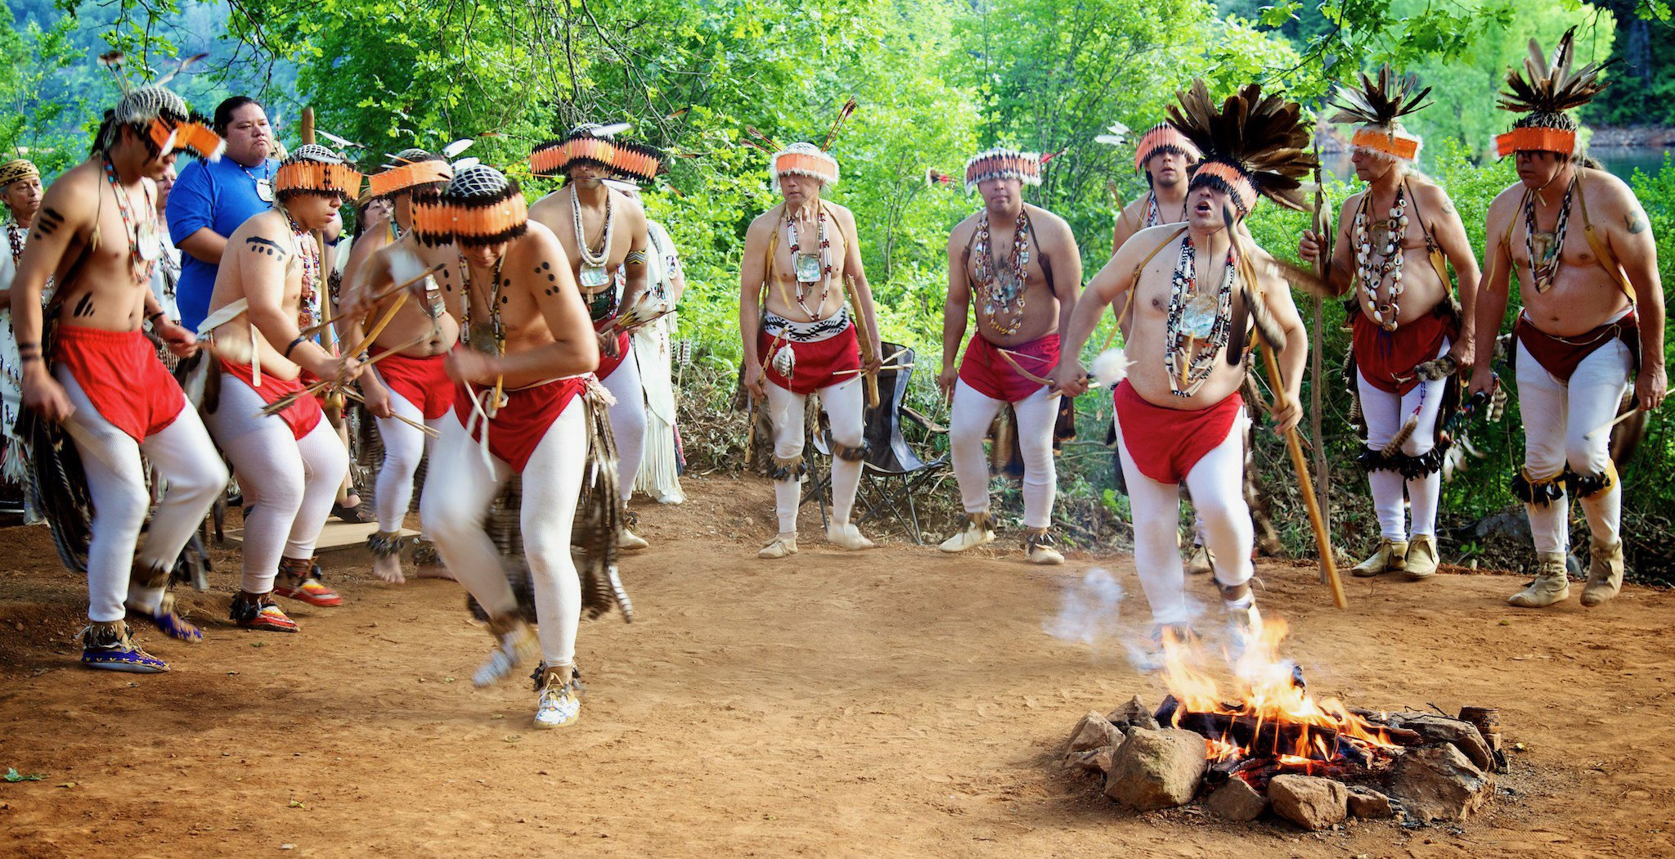
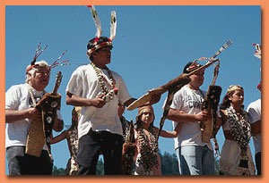
The Diverse California
Native Population

Slide 2
Goals of Presentaiton
The goals of the presentation are as follows:
Share information on the diversity of California Indian tribes;
Share world view and aspects of Traditional Ecological Knowledge;
Recommend strategies for working with California’s tribes.

Slide 3
Land Acknowledgment
I am mindful in acknowledging
That the land I stand on today, was and
Continues to be occupied by the indigenous
People of this area, the Miwok, Maidu, and Nisenan.
Recognizing their culture that is rich with
Spiritual ties to the land and waters that resonate
With their traditions. We are humbled and take
this opportunity to thank and honor them.

Slide 4
Governor’s Reconciliation Policies
“Consistent with the goals of such Executive Orders, and in the spirit of truth and healing in recognition of past harms done to California Native American communities, it is the policy of this administration to encourage every State agency, department, board and commission (collectively, “entities”) subject to my executive control to seek opportunities to support California tribes’ co-management of and access to natural lands1 that are within a California tribe’s ancestral land and under the ownership or control of the State of California, and to work cooperatively with California tribes that are interested in acquiring natural lands in excess of State needs.”

Slide 5
Purpose of this Policy
“The purpose of this Policy is to partner with California tribes to facilitate tribal access, use, and co-management of State-owned or controlled natural lands and to work cooperatively with California tribes that are interested in acquiring natural lands in excess of State needs in order to, among other things: • Support tribal self-determination and self-government; • Facilitate the access of California Native Americans to sacred sites and cultural resources; • Improve the ability of California Native Americans to engage in traditional and sustenance gathering, hunting and fishing; • Partner with California tribes on land management and stewardship utilizing Traditional Ecological Knowledges; • Reduce fractionation of tribal lands; and • Provide opportunities for education, community development, economic diversification, and investment in public health, information technology and infrastructure, renewable energy, water conservation, and cultural preservation or awareness. (September 25, 2020)

Slide 6
California Population Prior to Contact

Slide 7
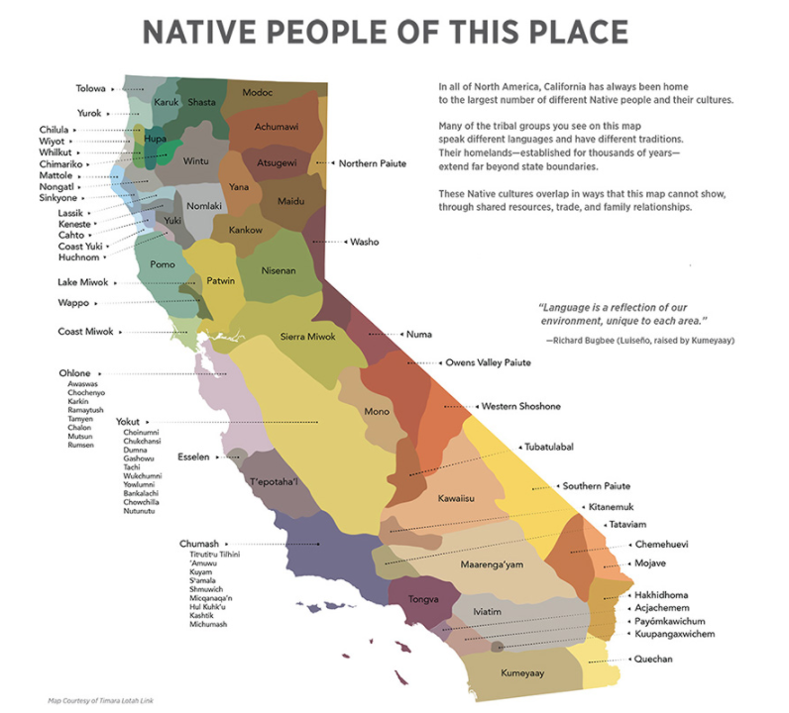
Diverse People

Slide 8
LANGUAGE DIVERSITY
Penutian: Washington, Oregon, Northern/Central California, Zuni, Gulf Coast, Yucatan, Belize.
Hokan: Spoken in Northern California, Arizona, and Baja California.
Uto-Aztecan: Western United States, Mexico, El Salvador
Athabascan: Alaska, Canada, Pacific Coast, Arizona, New Mexico, Northern Mexico
Yukian: Exclusively California language
Algonquian: Northern California, Northeast U.S., Eastern Seaboard, Northern, Central, and Eastern Canada, U.S. Plain States, and Rocky Mountains.

Slide 9
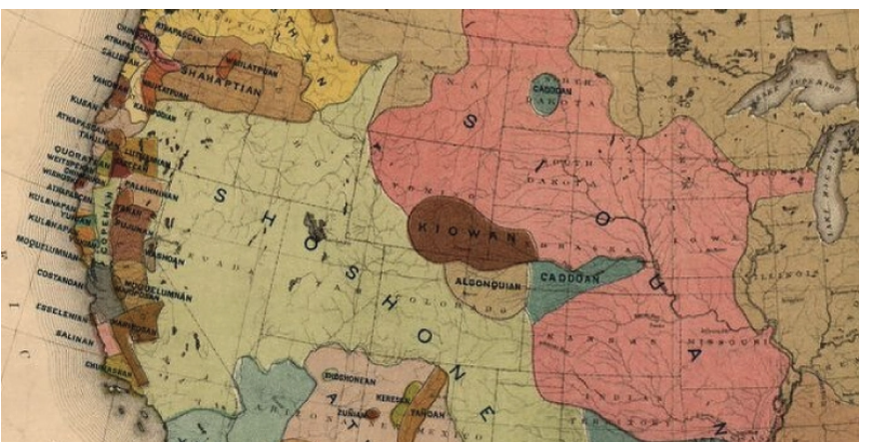
Every language family in U.S., exists in California

Slide 10
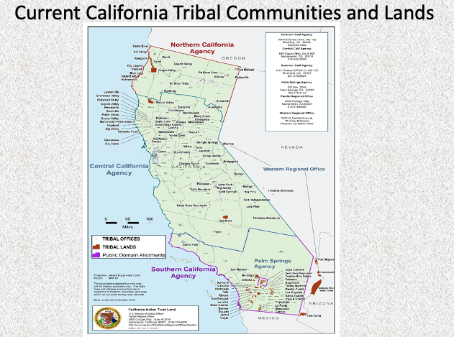
Current California Tribal Communities

Slide 11
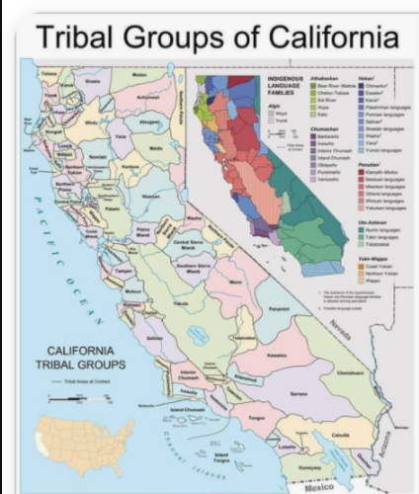

Slide 13
Other factors contributing
To Diversity:
Federally Recognized
Non-Federally Recognized
Reservation vs. Rancheria
Enrollment Categories:
CDIB
Judgement Rolls
Disenrolled
Self Identified

Slide 14
TEK Video
This short 4-minute video highlights the tribal perspective and discusses Traditional Ecological Knowledge.
https://youtu.be/iWc7zwVUSB8
- https://ucdavis.box.com/s/nuhxsnq3086ejc9mbiievyed8axw2cbb

Slide 15
Understanding TEK
Traditional Ecological Knowledge
Refers to evolving knowledge acquired by
Indigenous and local peoples over hundreds or thousands of years through direct contact with the environment.

Slide 16
Understanding TEK
Traditional Ecological Knowledge
TEK is specific to a location
Includes relationships between plants, animals, natural phenomena, landscapes, and timing of events
Encompasses the world view of indigenous people which includes ecology, spirituality, human and animal relationships, and more

Slide 17
Example of TEK
Prior to Contact
Prior to contact, native horticulturalists practiced various forms of forest gardening and fire-stick farming in the forests, grasslands, mixed woodlands, and wetlands, ensuring that desired food and medicine plants continued to be available. The natives controlled fire on a regional scale to create a low-intensity fire ecology which prevented larger, catastrophic fires and sustained a low-density agriculture in loose rotation; a sort of "wild" permaculture.^{[3][4][5][6]}

Slide 18
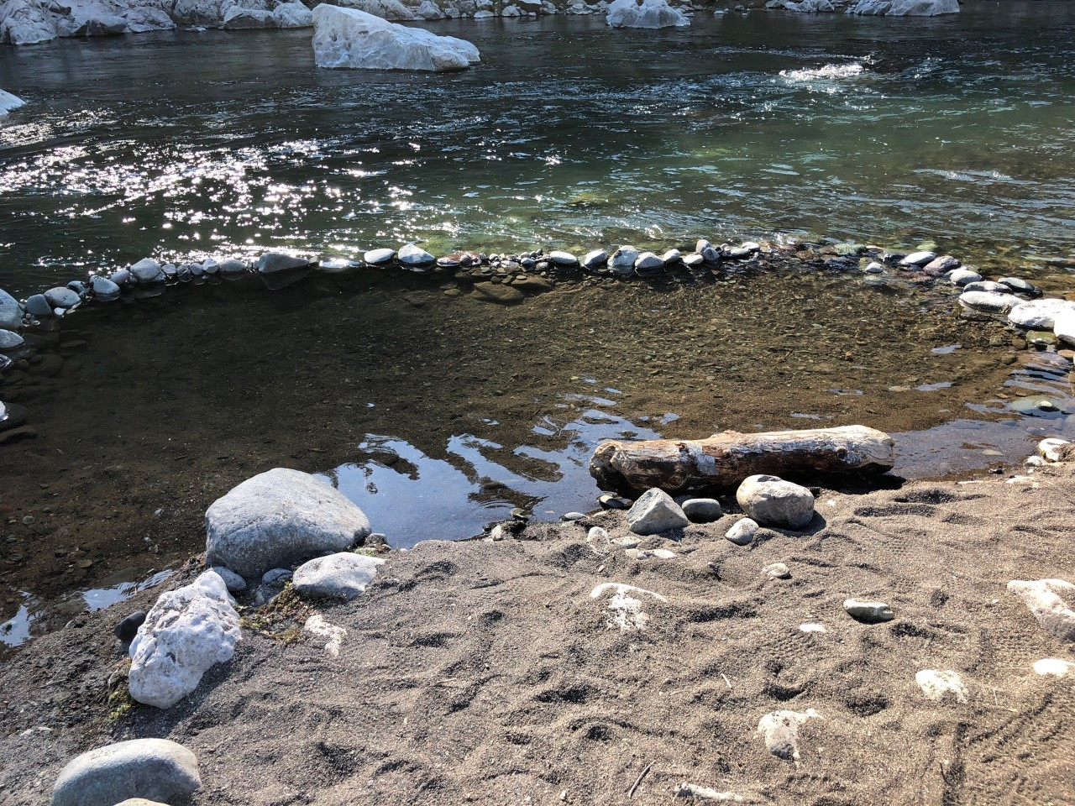
The Winnemem make Baby Salmon Protection Pools, which provide migrating smolts a
place to rest and hide from predators during their journey to the ocean.

Slide 19
Native Traditional Fire Burning

Slide 20
An Example of How Past State Laws
Eliminating a TEK Practice Impacts Us All :
The Act for the Government and Protection of Indians (Chapter 133, Cal. Stats., April 22, 1850) was enacted by the first session of the California State Legislature.^{[1]} The act facilitated removing California Indians from their traditional lands, separating at least a generation of children and adults from their families, languages, and cultures (1850 to 1865). This California law provided for "apprenticing" or indenturing Indian children and adults to Whites, and also punished "vagrant" Indians by "hiring" them out to the highest bidder at a public auction if the Indian could not provide sufficient bond or bail."^{[2]} It was amended in 1860.
This act, however, also cited that Indians could not “set the prairie on fire, or refuse to use proper exertions to extinguish the fire when the prairies are burning." For years, indigenous inhabitants of California had set fire to their grasslands in order to draw game into canyons and other areas where Native American hunters could kill them

Slide 21
American Indian Religiouis
Freedom ACT (AIRFA)
Consult with the tribal representative to identify for land management procedures to conflict with Native Americans’ religious observances and to seek alternarives that would resolve the potential conflicts
Conflicts can also invoke the Religious Freedom Restoration Act (RFRA) which says that the government shall not overly burden religious exercise without compelling jurisdiction.

Slide 22
Tips Working with Tribes
Know the tribes in your region (Federally Recognized and Non-Federally Recognized, Tribal Non-profits) Developing a Land Acknowledgment Statement helps with this task
Read and implement the 10 page CDFW Consultation Policy! (Remember: Consultation is not restricted to a list serve email)
Contact or visit the tribe to determine your contact (Introduce yourself virtually)
Make your visits intentional (Introduce yourself, Establish contact point)
Identify areas they may need assistance with or have questions of
If possible, develop joint ventures within your scope of services
Establish Co-management ventures such as the Conservation of Humbug Valley Project where a collective of nine Maidu organizations and CDFW’s North Central Region filed competing claims to gain ownership of Humbug Valley
Establish regional tribal Liaisons (See CDFW Consultation Policy: Page 4, Section 4, #2)
Support Non-federal recognized tribes via their non-profit organizations
If your agency doesn’t have a consultancy process, develop one
Review CDFW use of Offensive references, i.e., “Squaw”, “Indian Joe”, “Digger”, etc.
Support the renaming of places, rivers, creeks, geographic areas to their Native names

Slide 23
Where we Intersect
The Mission of the Department of Fish and Wildlife is to manage California's diverse fish, wildlife, and plant resources, and the habitats upon which they depend, for their ecological values and for their use and enjoyment by the public.
In the short video, the narrator says, “The whole world view of tribal communities emphasizes the intricate world of people in the eco system. They acknowledge that human well being really depends on maintaining some type of reciprocal relationship with nature. This changes the focus of how do we protect nature from people to how do we conserve nature for people.”

Slide 24
Questions/Comments
California became a state on September 9, 1850. Thereafter, September 9th was celebrated as Admission Day. In 1925, California was commemorating the 75th anniversary (Diamond Jubilee) of it joining the union in San Francisco. Wintu tribal bands attended and danced at the event. (P.S.: We became citizens in 1924)

