Slide 1
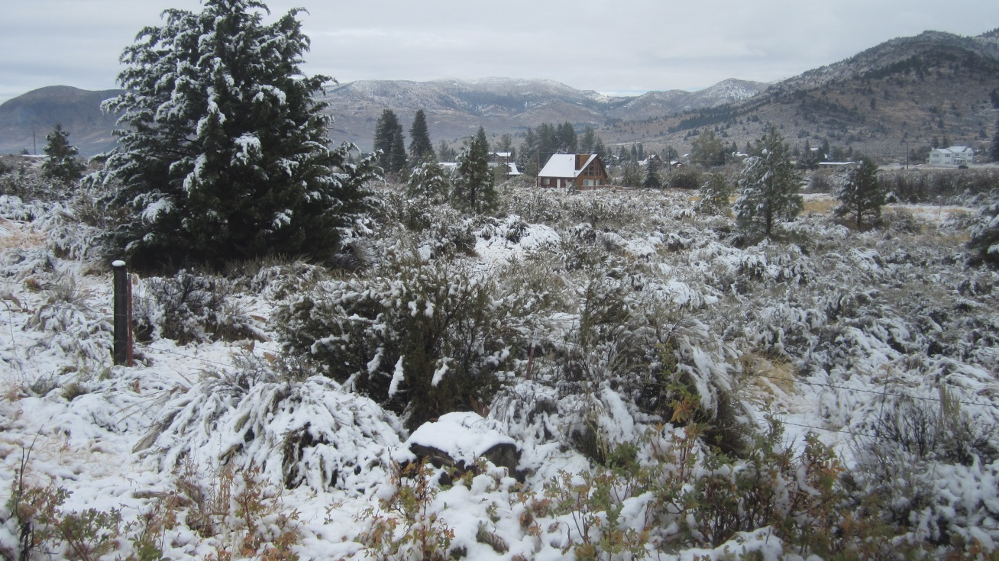
November 16, 2016, 10:00am
Wildlife Conservation Board Meeting
State Capitol, Room 112
Sacramento, California 95814

Slide 2
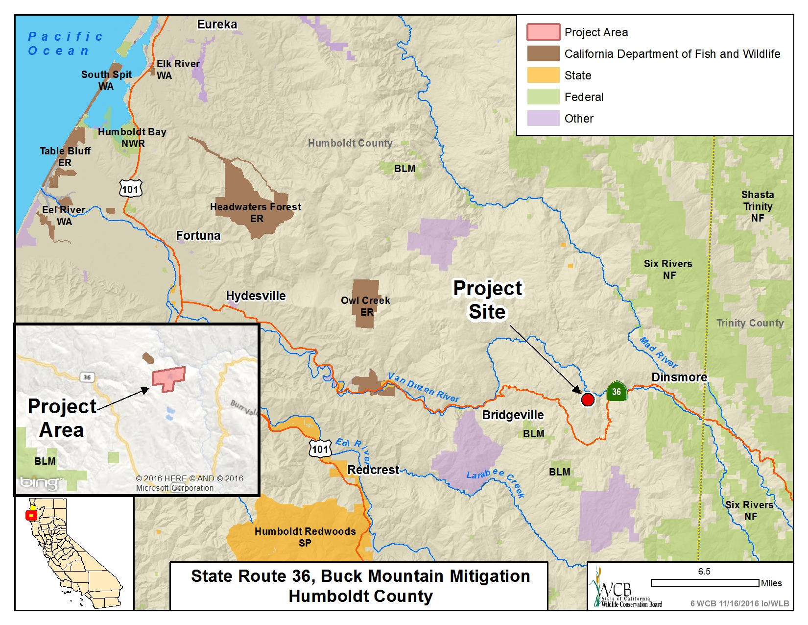

Slide 3
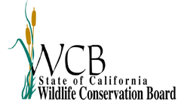
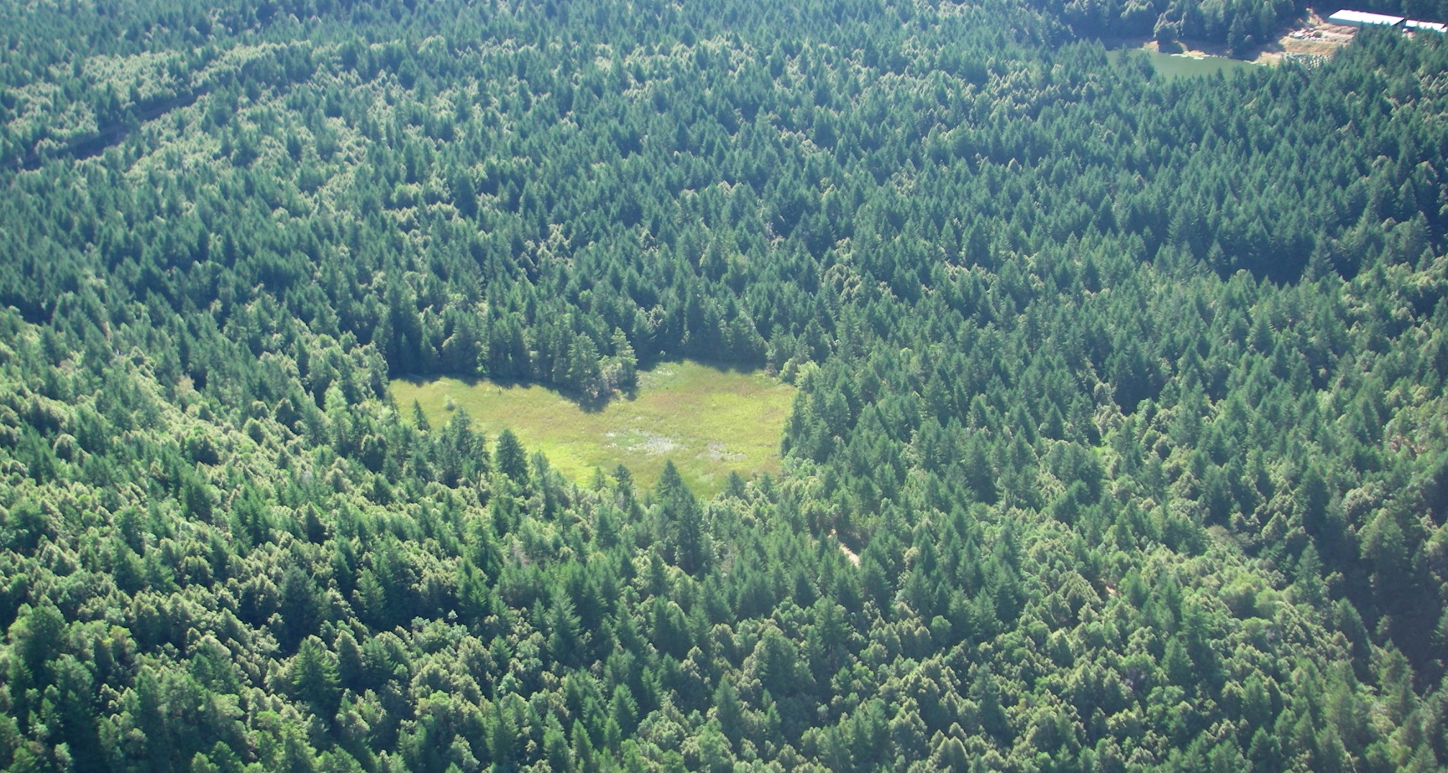
#6. State Route 36. Buck Mountain Mitigation
The peatland acquisition includes a 5.1 heart-shaped fen situated within the 155-acre mixed-hardwood second growth conifer forest. The fen is considered a Sensitive Natural Community and is a very unique wetland type in California and is fed by groundwater and its outfall stream is a tributary to the Van Duzen River.

Slide 4
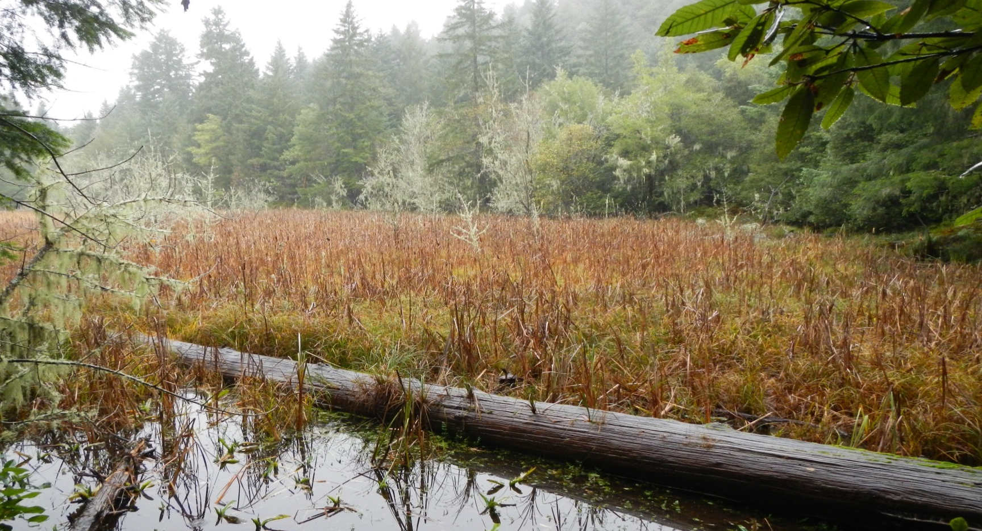
#6. State Route 36. Buck Mountain Mitigation
Unique plants such as bogbean (Menyanthes trifoliate) have been observed in the fen in addition to State Species of Special Concern such as the southern torrent salamander (Rhyacotriton variegatus) and northern red-legged frog (Rana aurora).

Slide 5
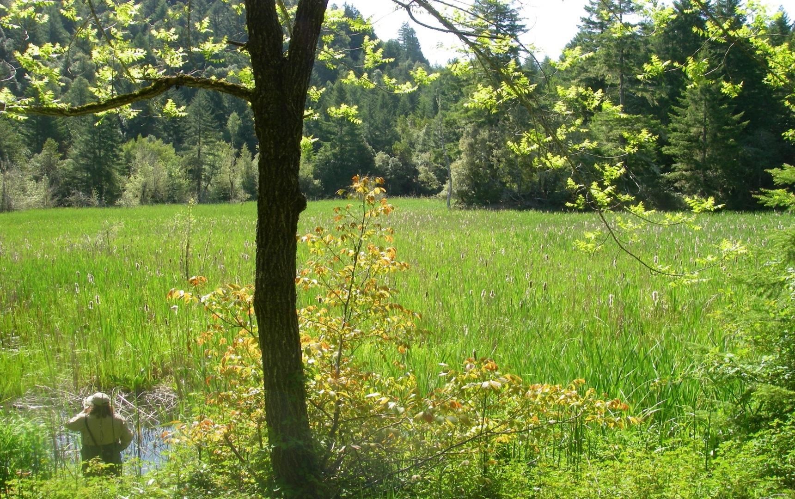
#6. State Route 36, Buck Mountain Mitigation
The mosaic of hydrophytic vegetation in spring, with Oregon Ash (Fraxinus latifolia) leafing out in the fore-ground.

Slide 6
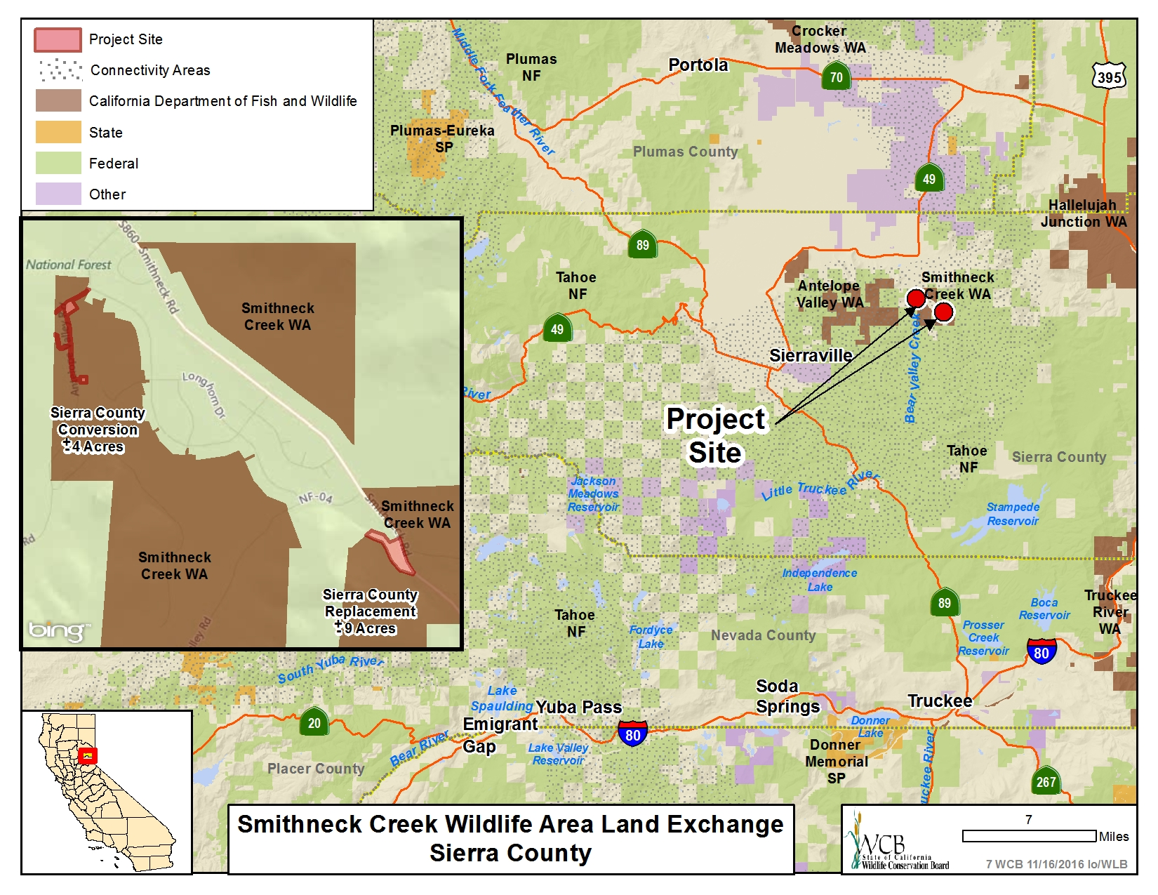

Slide 7
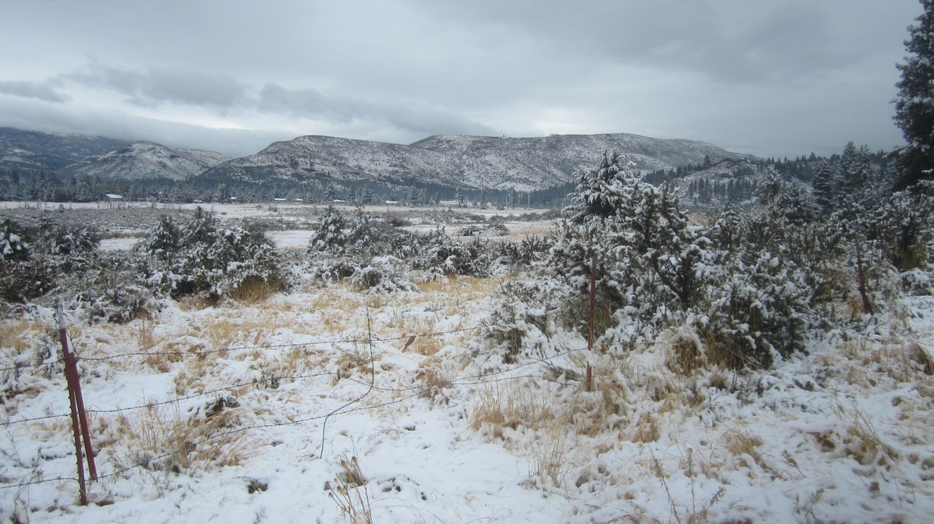
#7. Smithneck Creek Wildlife Area Land Exchange
The State Property being exchanged is for a 1.00 acre parcel, a 0.50 acre parcel and an easement.

Slide 8
#7. Smithneck Creek Wildlife Area Land Exchange
The County of Sierra is exchanging this 8.68 acre parcel located in the southern edge of the Sierra Valley adjacent to the Sierra Brooks Subdivision

Slide 9
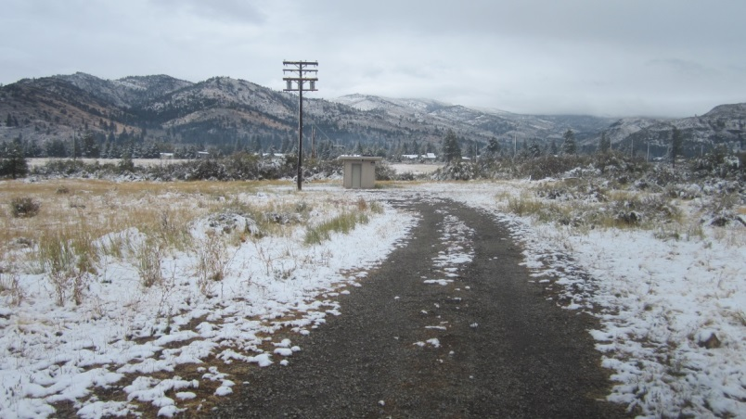
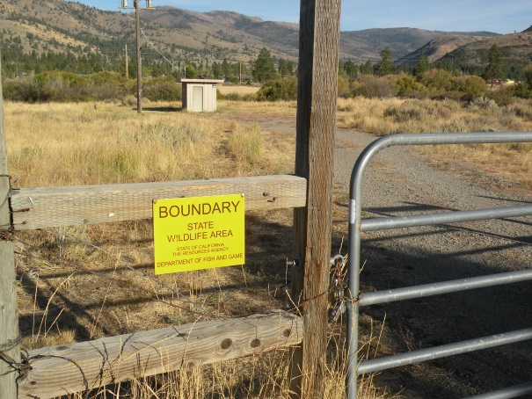
#7. Smithneck Creek Wildlife Area Land Exchange
An Existing pump house operated by the County is used by the Sierra Brooks Subdivision for existing residences

Slide 10
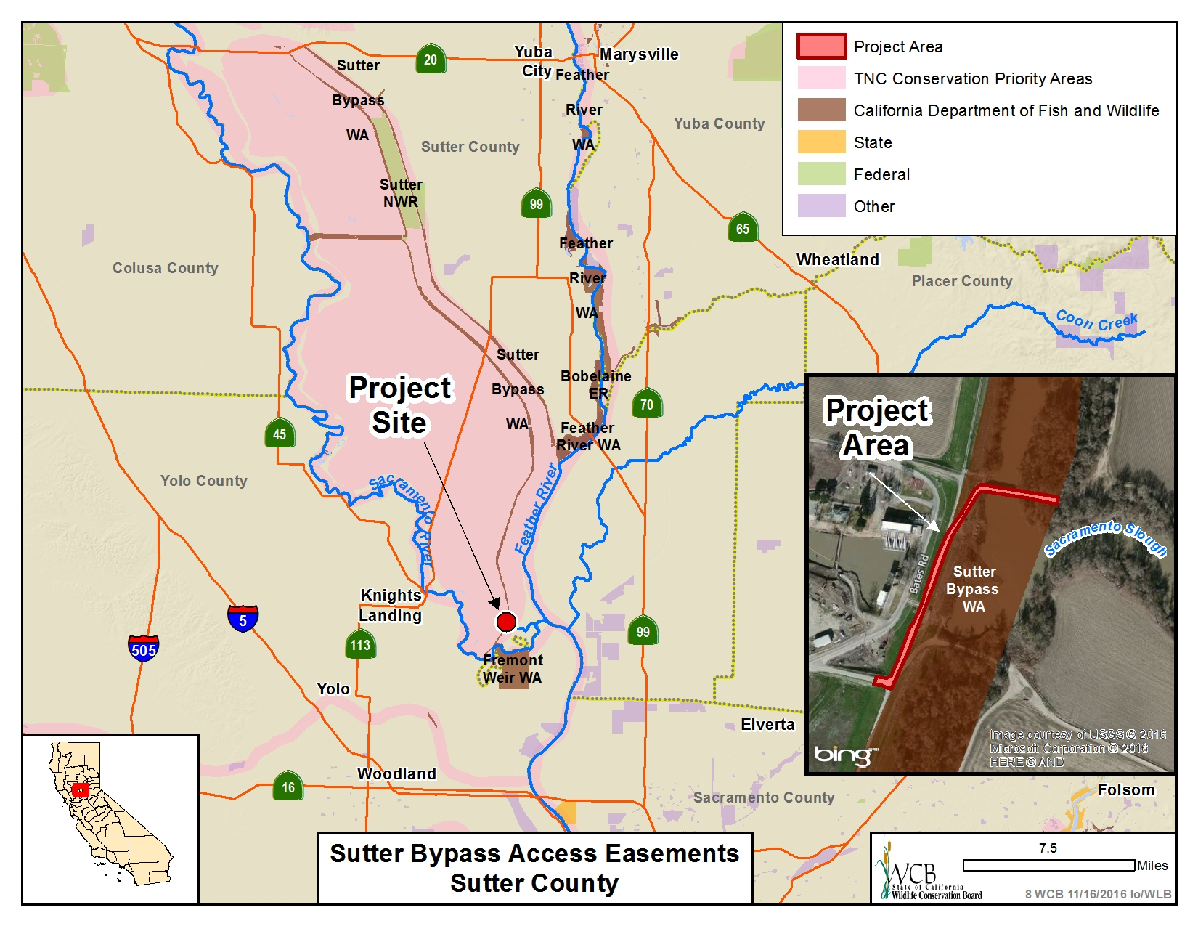

Slide 11
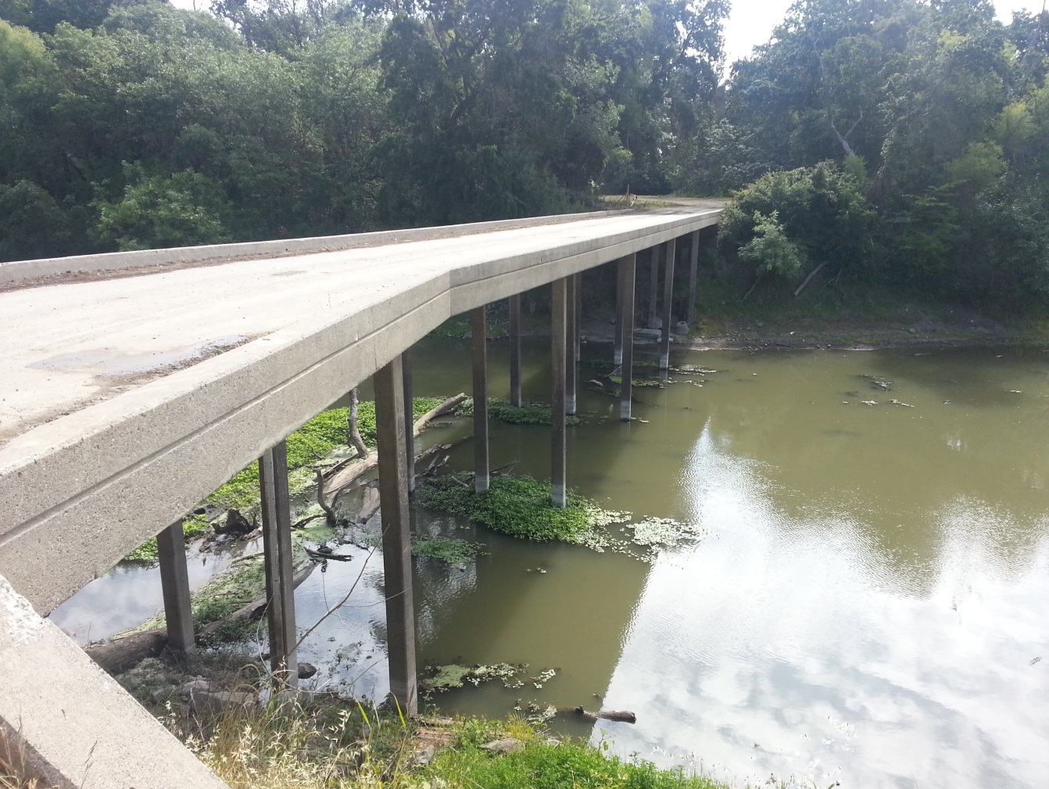
#8. Sutter Bypass Access Easements
Picture of the bridge over the Feather River – looking east

Slide 12
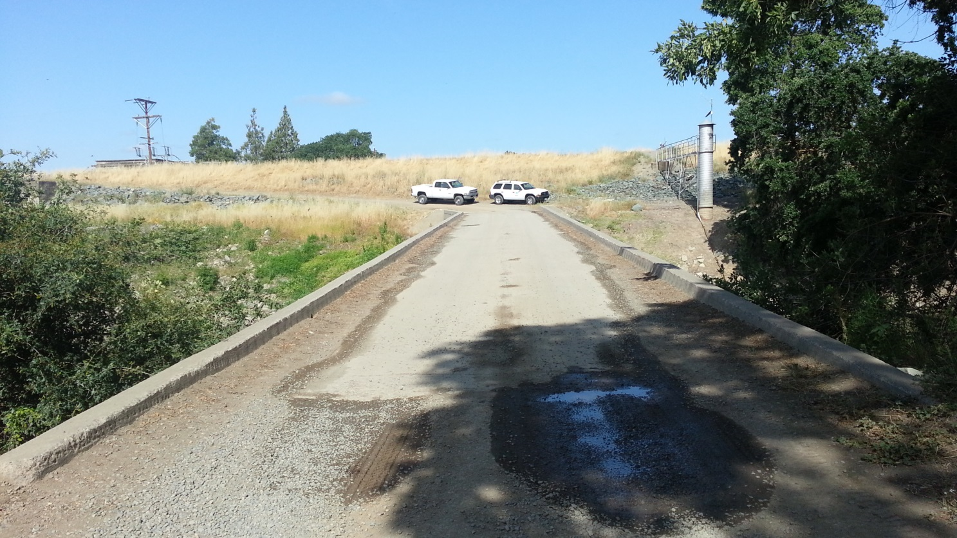
#8. Sutter Bypass Access Easements
Picture of the bridge and access easement – looking west

Slide 13
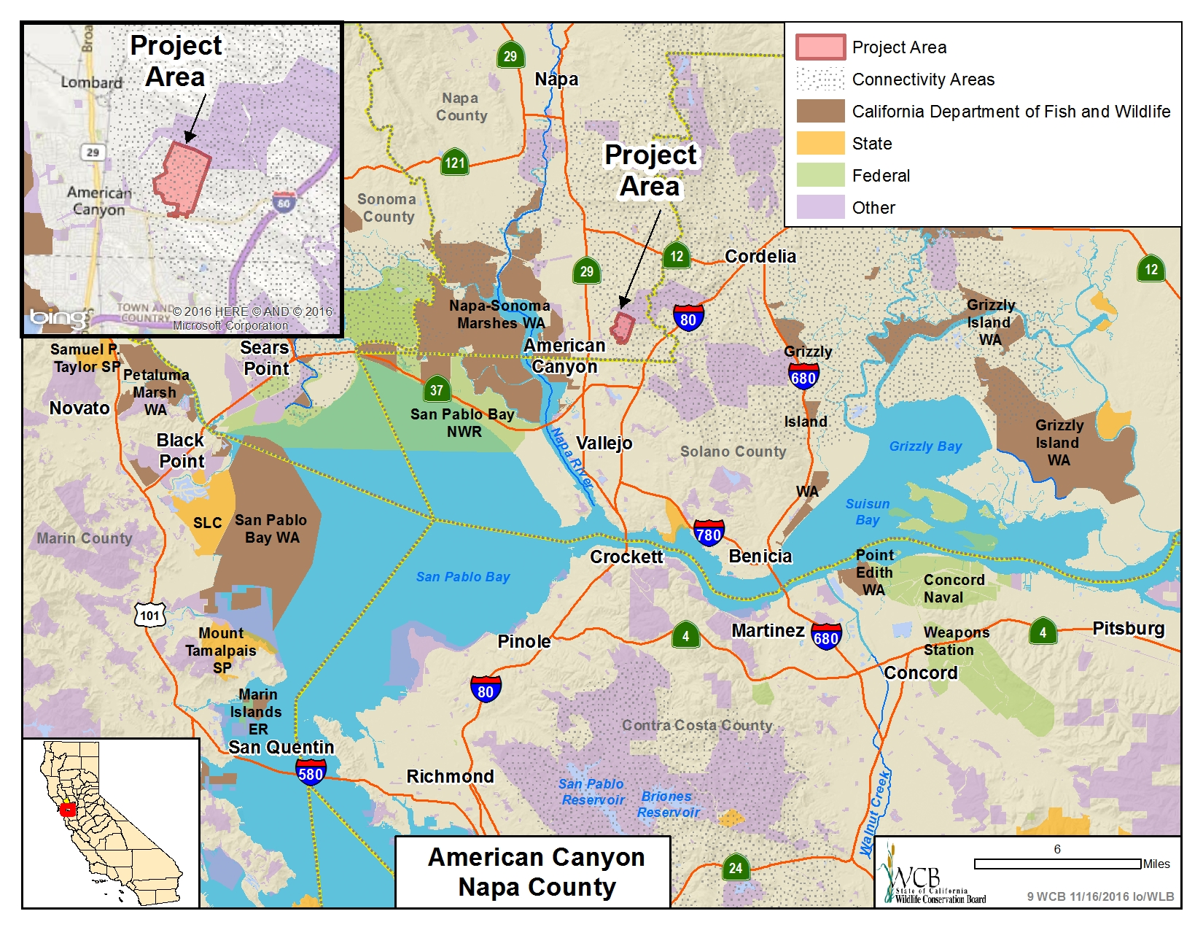

Slide 14
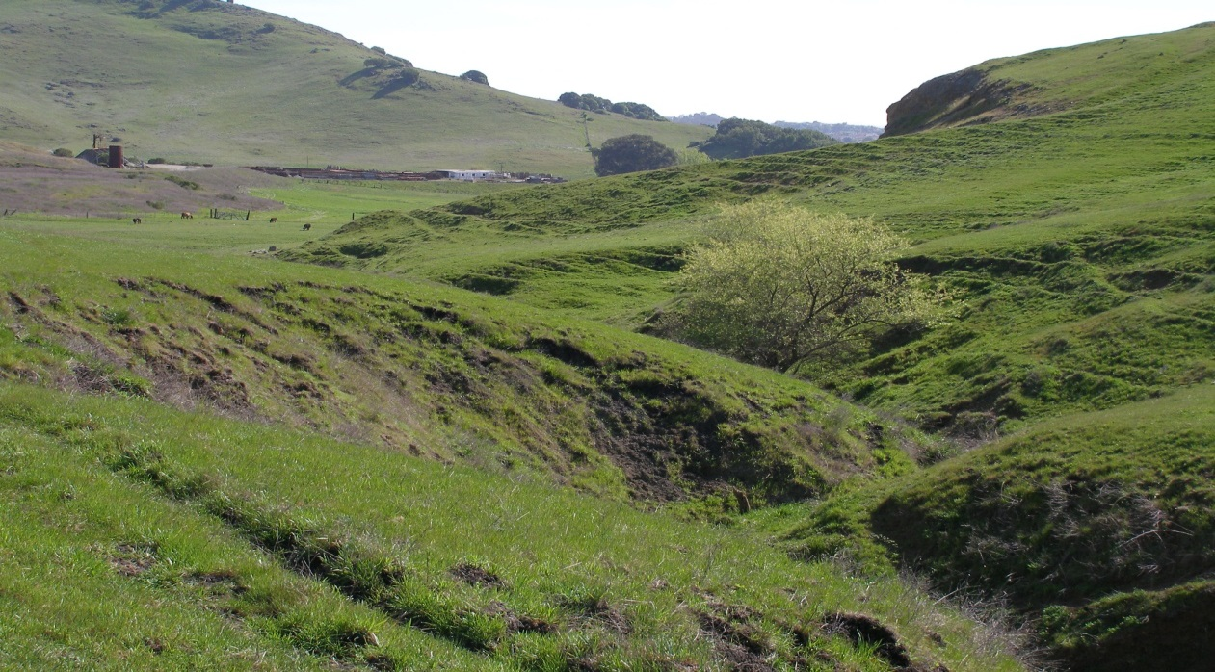
#9. American Canyon
Northerly view of the property

Slide 15
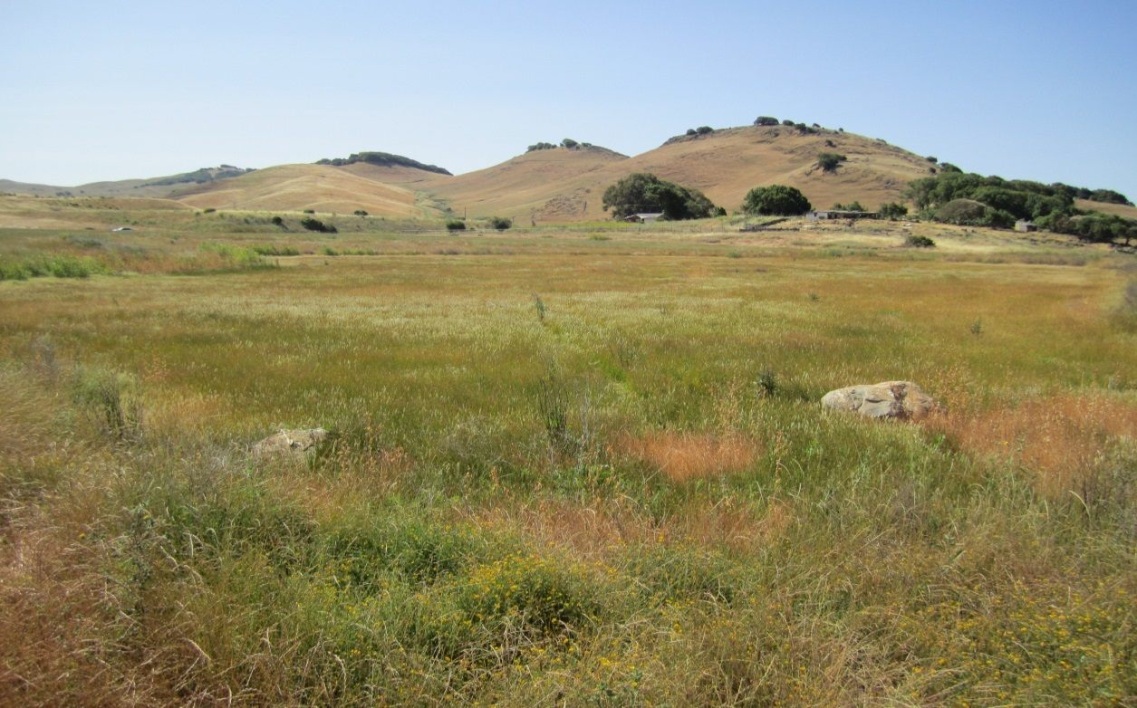
#9. American Canyon
Westerly view of the property

Slide 16
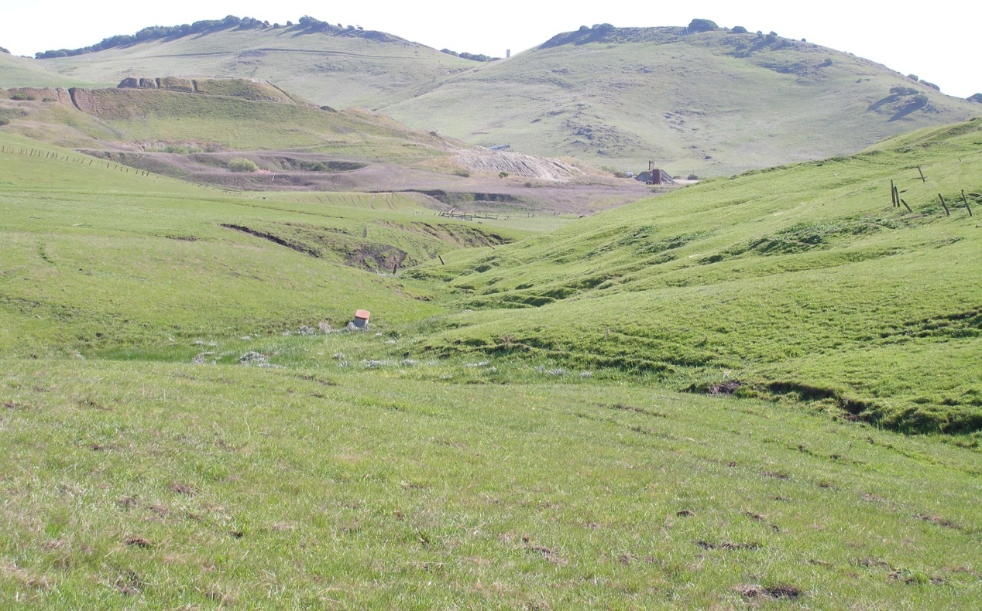
#9. American Canyon
Northwesterly view of the property

Slide 17
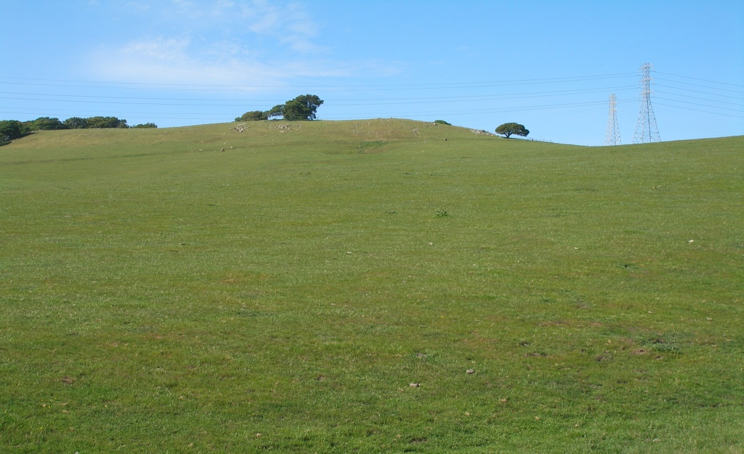
#9. American Canyon
Westerly view of the property

Slide 18
#10. Corte Madera Tidal Marsh Restoration
This item has been withdrawn from consideration at this time

Slide 19
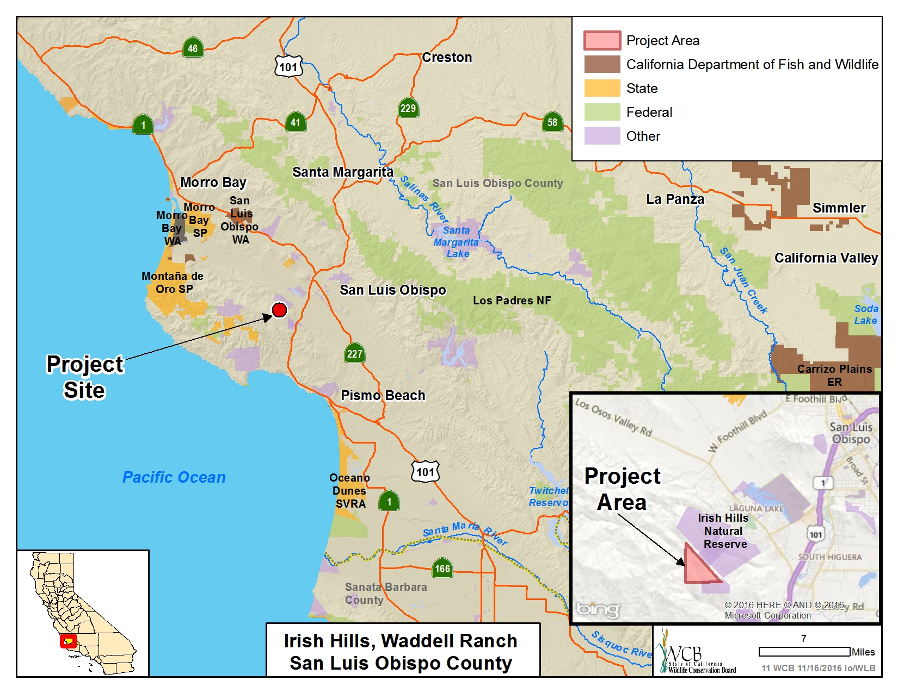

Slide 20
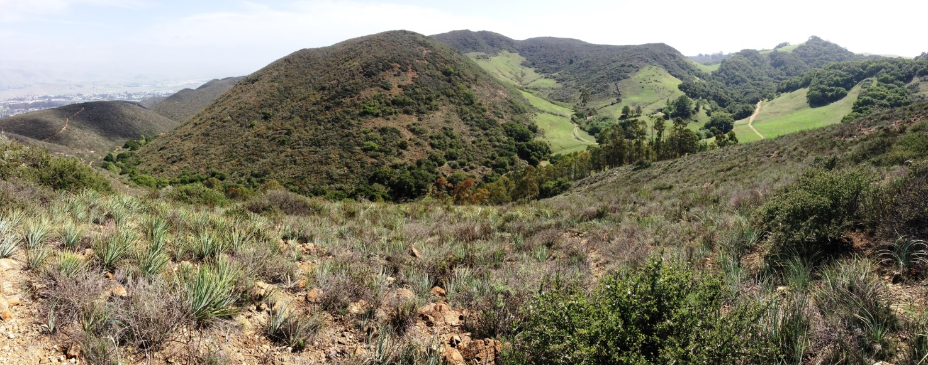
#11. Irish Hills, Waddell Ranch
Panoramic view of Waddell Ranch property, looking southwest from the City’s Irish Hills Natural Reserve

Slide 21
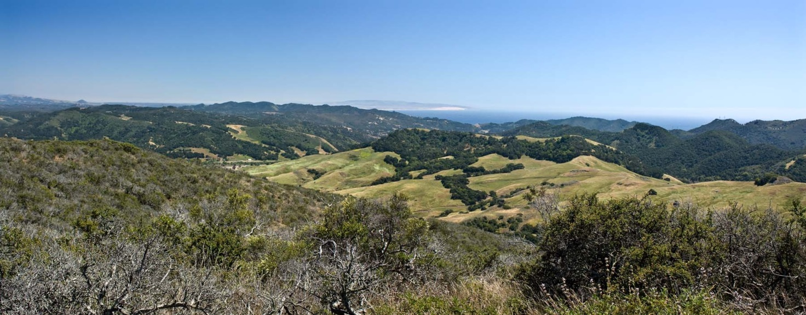
#11. Irish Hills, Waddell Ranch
Panoramic view of Waddell Ranch from the top of Froom trail looking west toward the Pacific Ocean
Photo courtesy of Rob DeGraff

Slide 22
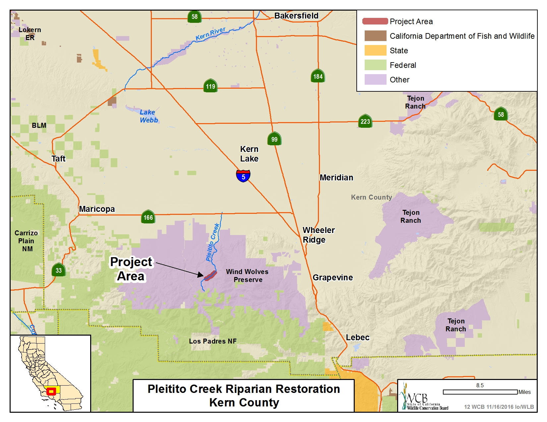

Slide 23
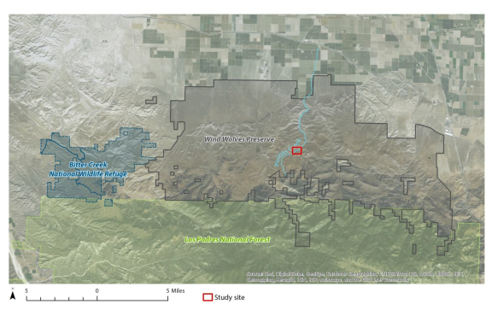
#12. Pleitito Creek Riparian Restoration
Properties bordering Wind Wolves include Bitter Creek National Wildlife Refuge to the west and Los Padres National Forest to the south

Slide 24
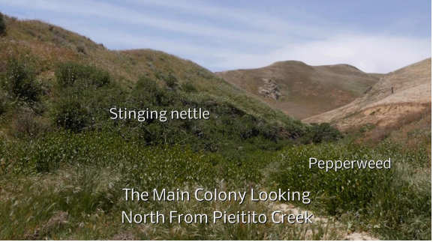
#12. Pleitito Creek Riparian Restoration
Tricolored black birds nested in native nettle in 2016. None were observed in adjacent non-native invasive perennial pepperweed.

Slide 25
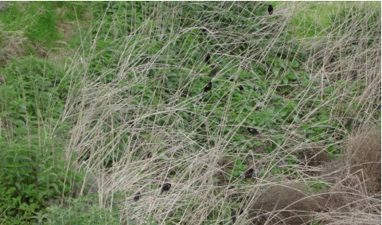
#12. Pleitito Creek Riparian Restoration
Tricolored blackbirds nesting in the native nettle along Pleitito Creek

Slide 26
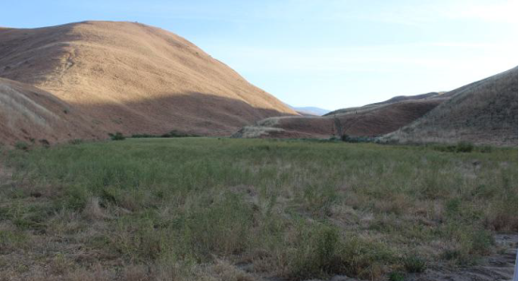
#12. Pleitito Creek Riparian Restoration
High density infestation along Pleitito Creek, where perennial pepperweed has formed a monoculture. Native nettle nesting substrate will be planted here in the re-vegetation phase.

Slide 27
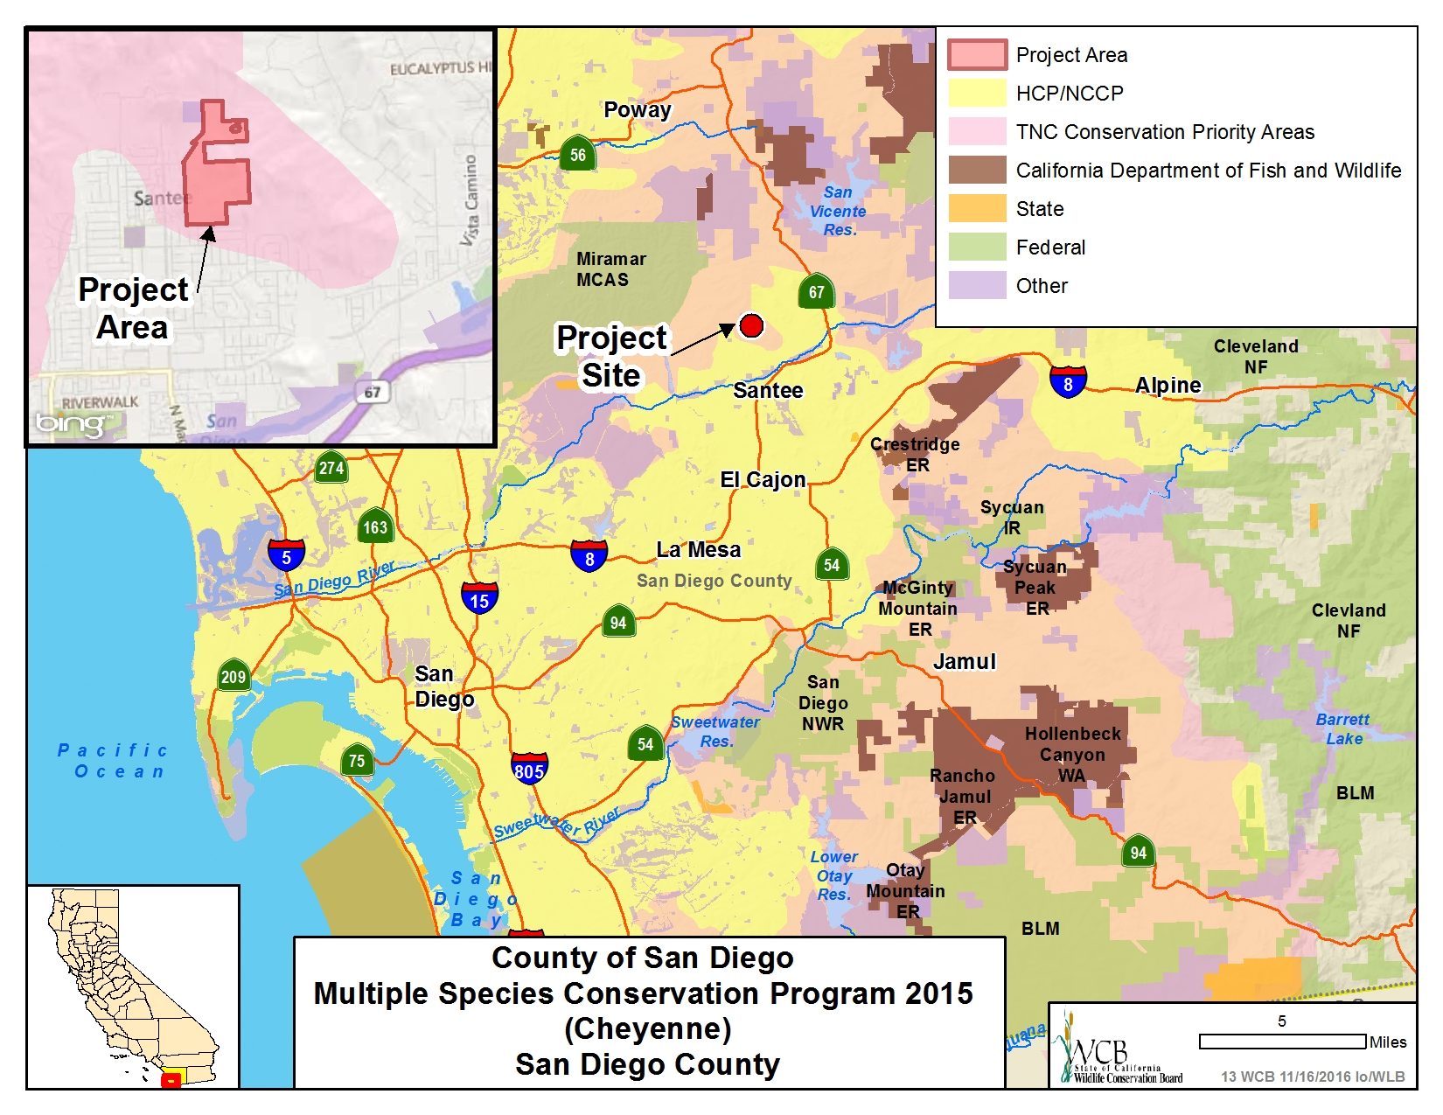

Slide 28
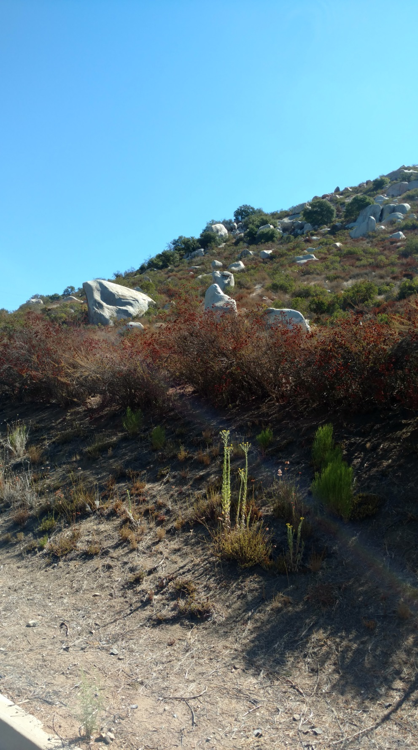
#13. County of San Diego Multiple Species Conservation Plan 2015 (Cheyenne)
Looking north at vegetation found on property

Slide 29
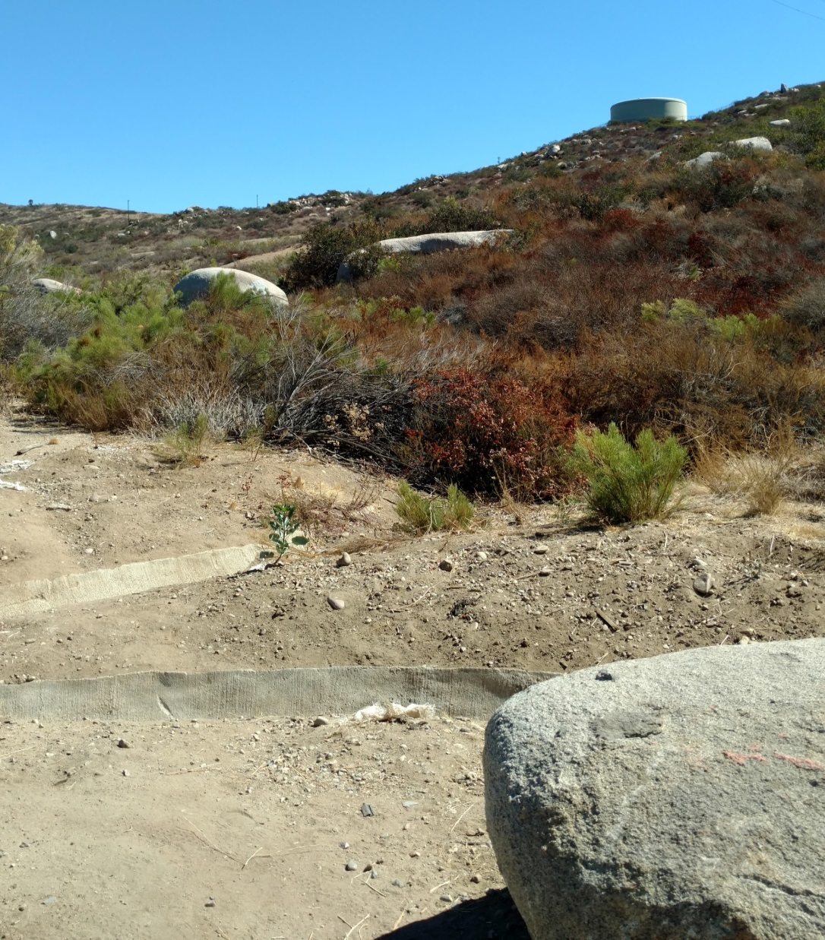
#13. County of San Diego Multiple Species Conservation Plan 2015 (Cheyenne)
Northwestern view of property boundary

Slide 30
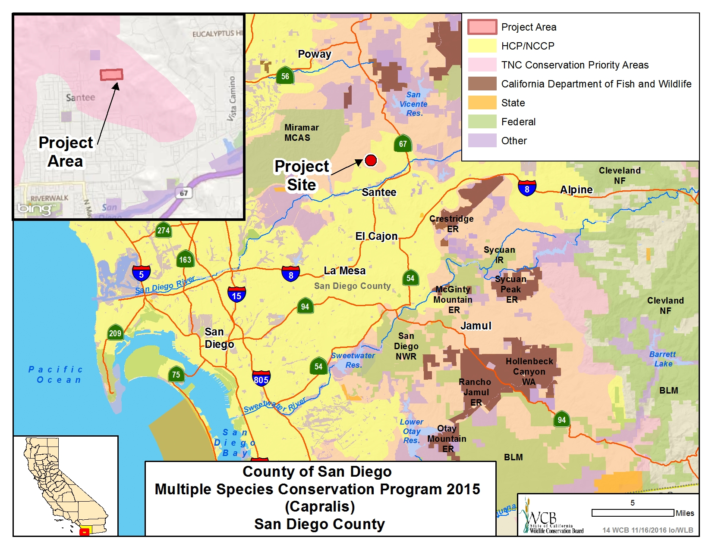

Slide 31
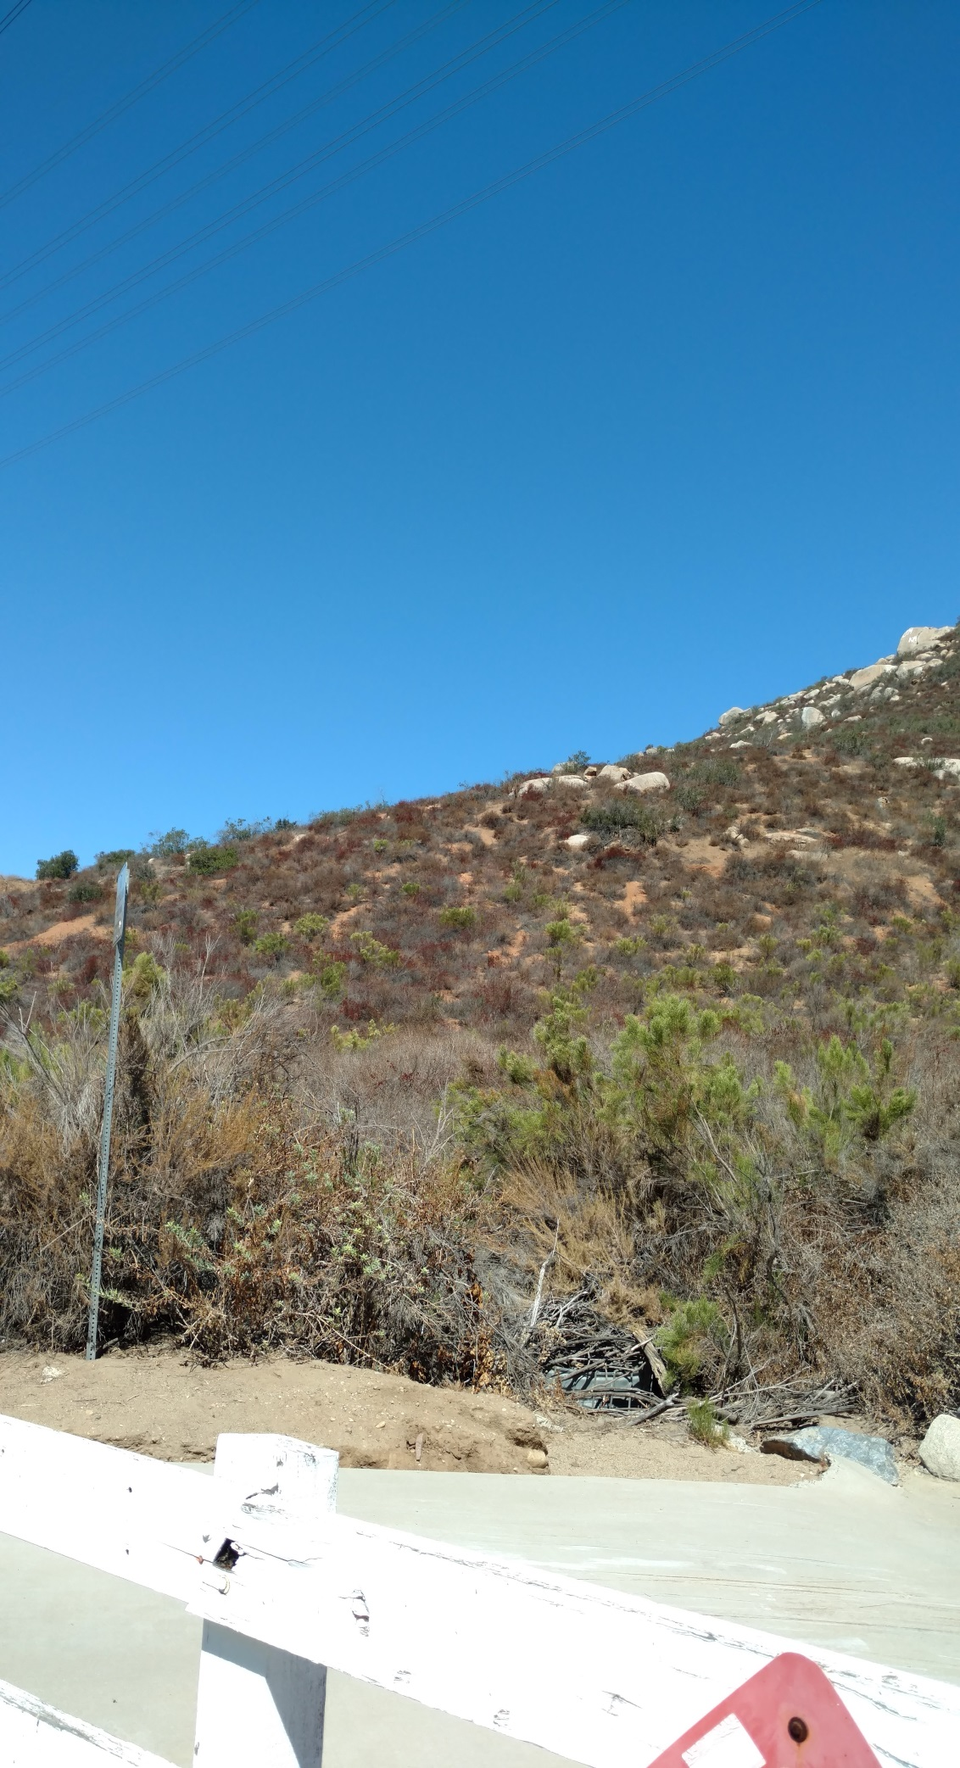
#14. County Of San Diego Multiple Species Conservation Plan 2015 (Capralis)
View of property and vegetation from access road

Slide 32
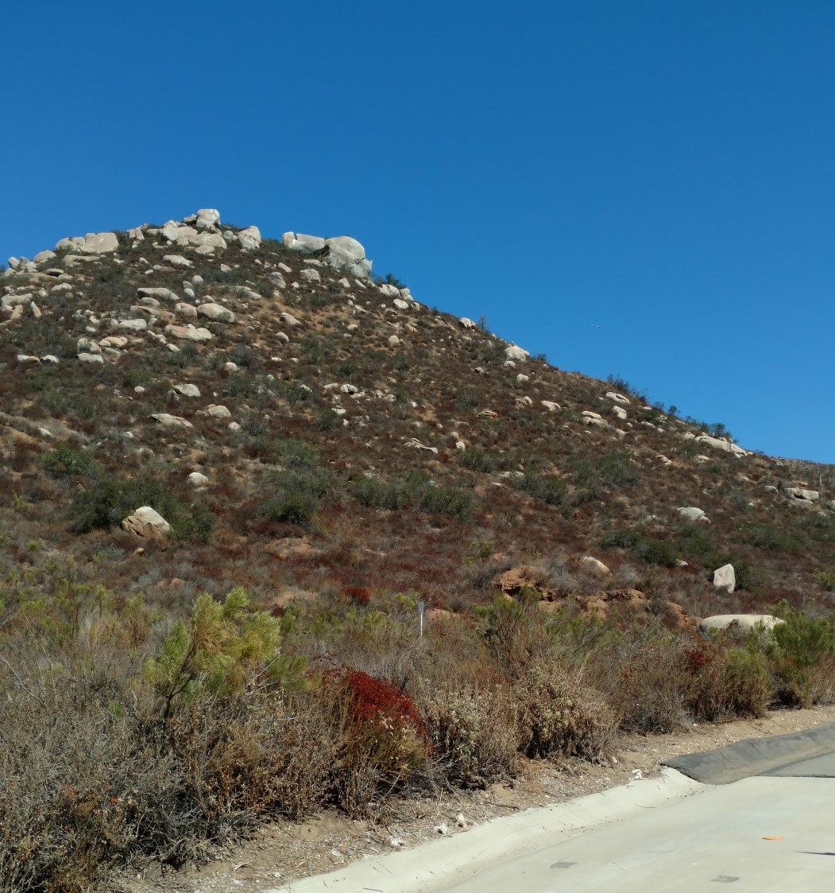
#14. County Of San Diego Multiple Species Conservation Plan 2015 (Capralis)
Rocky out cropping found on property

Slide 33
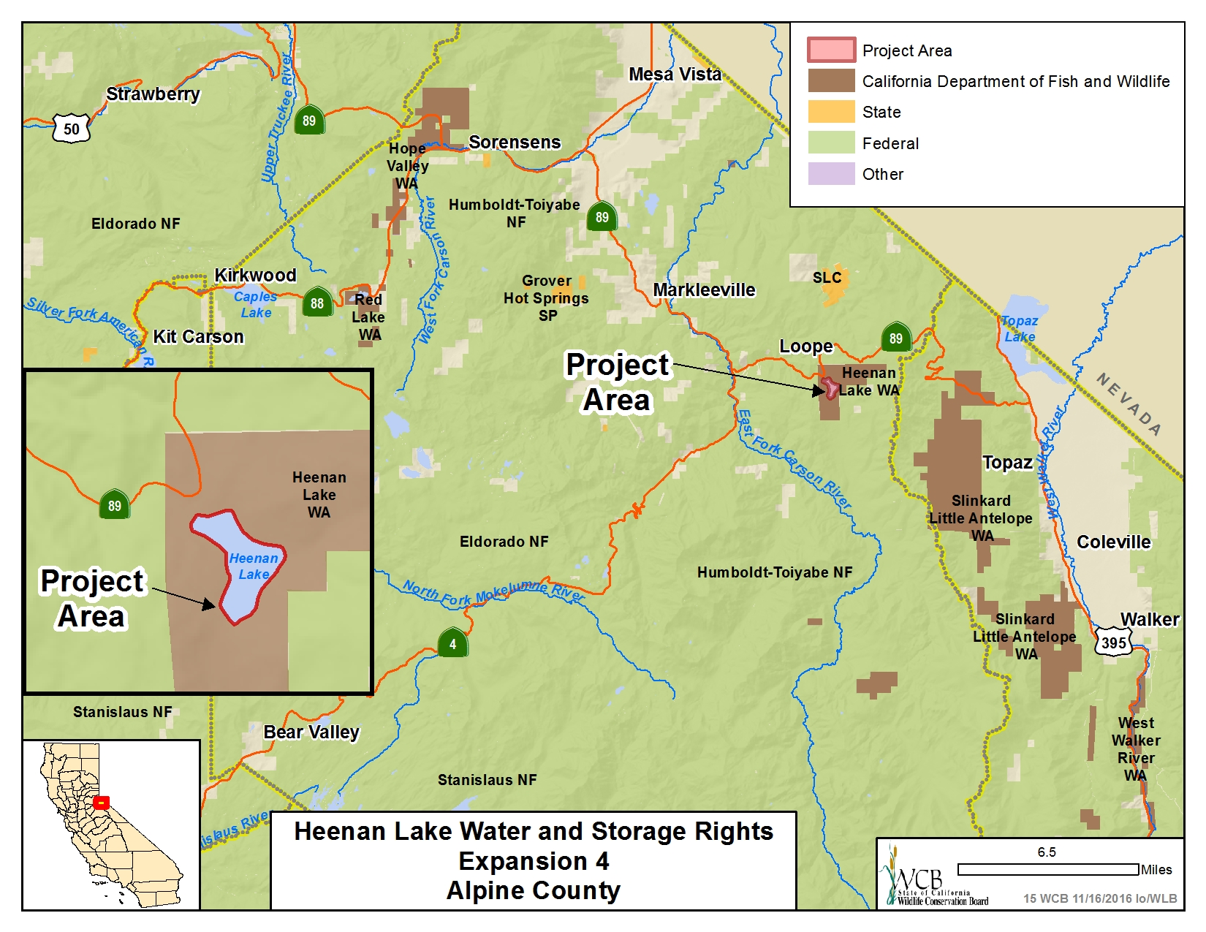

Slide 34
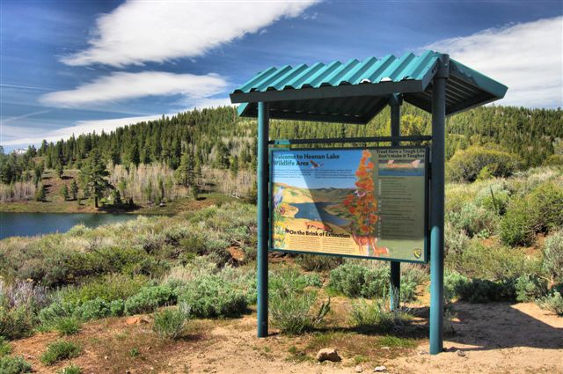
#15. Heenan Lake Water and Storage Rights, Expansion 4
Heenan Lake Wildlife Area information station

Slide 35
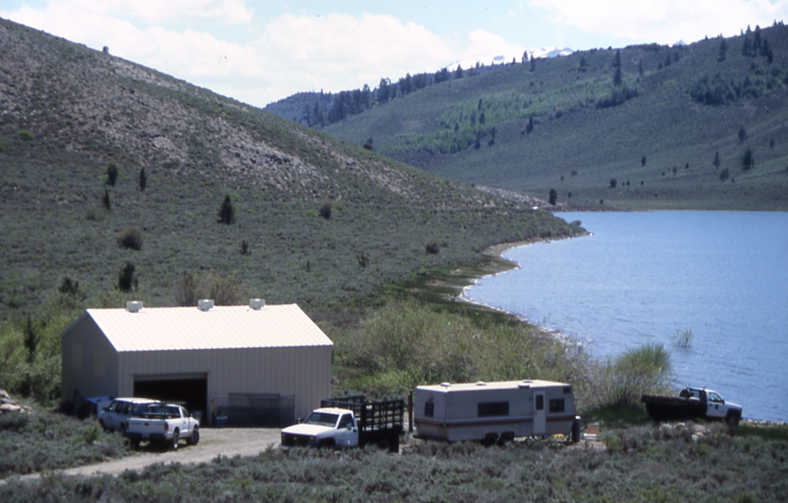
#15. Heenan Lake Water and Storage Rights, Expansion 4
Heenan Lake fish spawning station

Slide 36
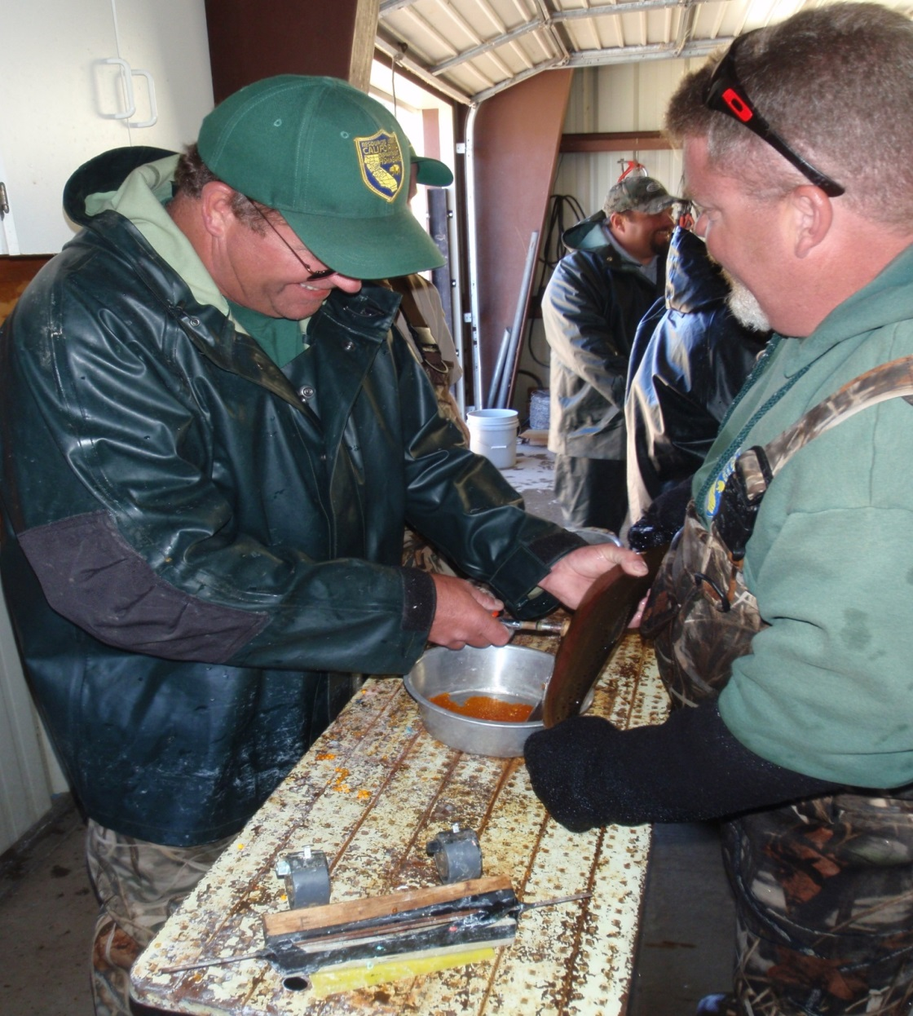
#15. Heenan Lake Water and Storage Rights, Expansion 4
Spawning adult Lahontan cutthroat trout broodstock for CDFW egg take

Slide 37
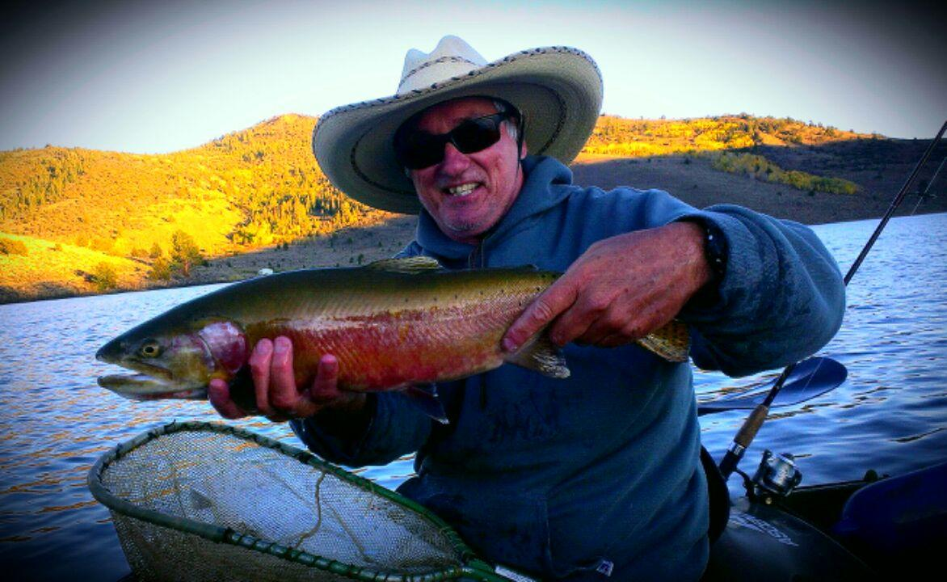
#15. Heenan Lake Water and Storage Rights, Expansion 4
CDFW Environmental Scientist John Hanson with a Lahontan cutthroat trout

Slide 38
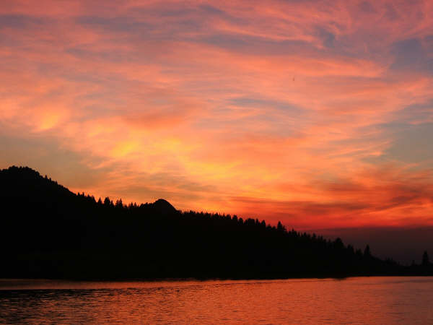
#15. Heenan Lake Water and Storage Rights, Expansion 4
Sunset at Heenan Lake

Slide 39
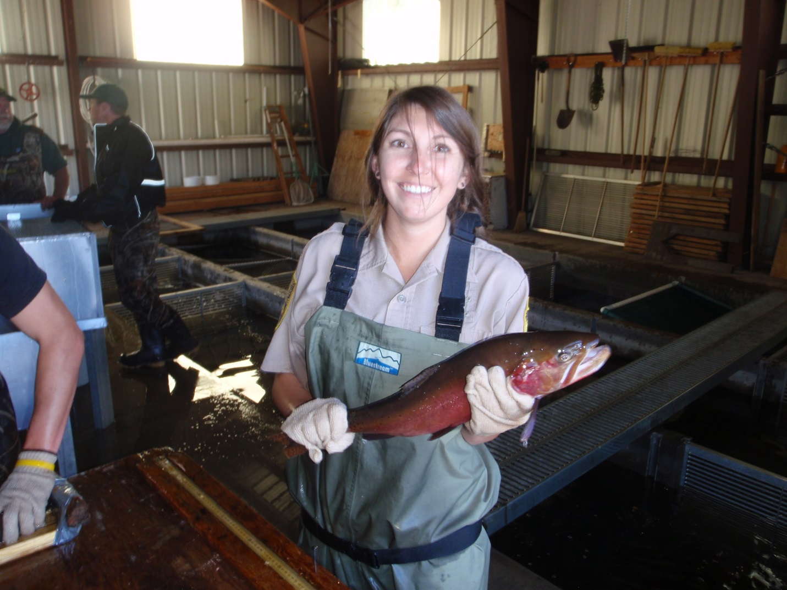
#15. Heenan Lake Water and Storage Rights, Expansion 4
CDFW scientific aid with a Lahontan cutthroat trout in the fish spawning facility

Slide 40
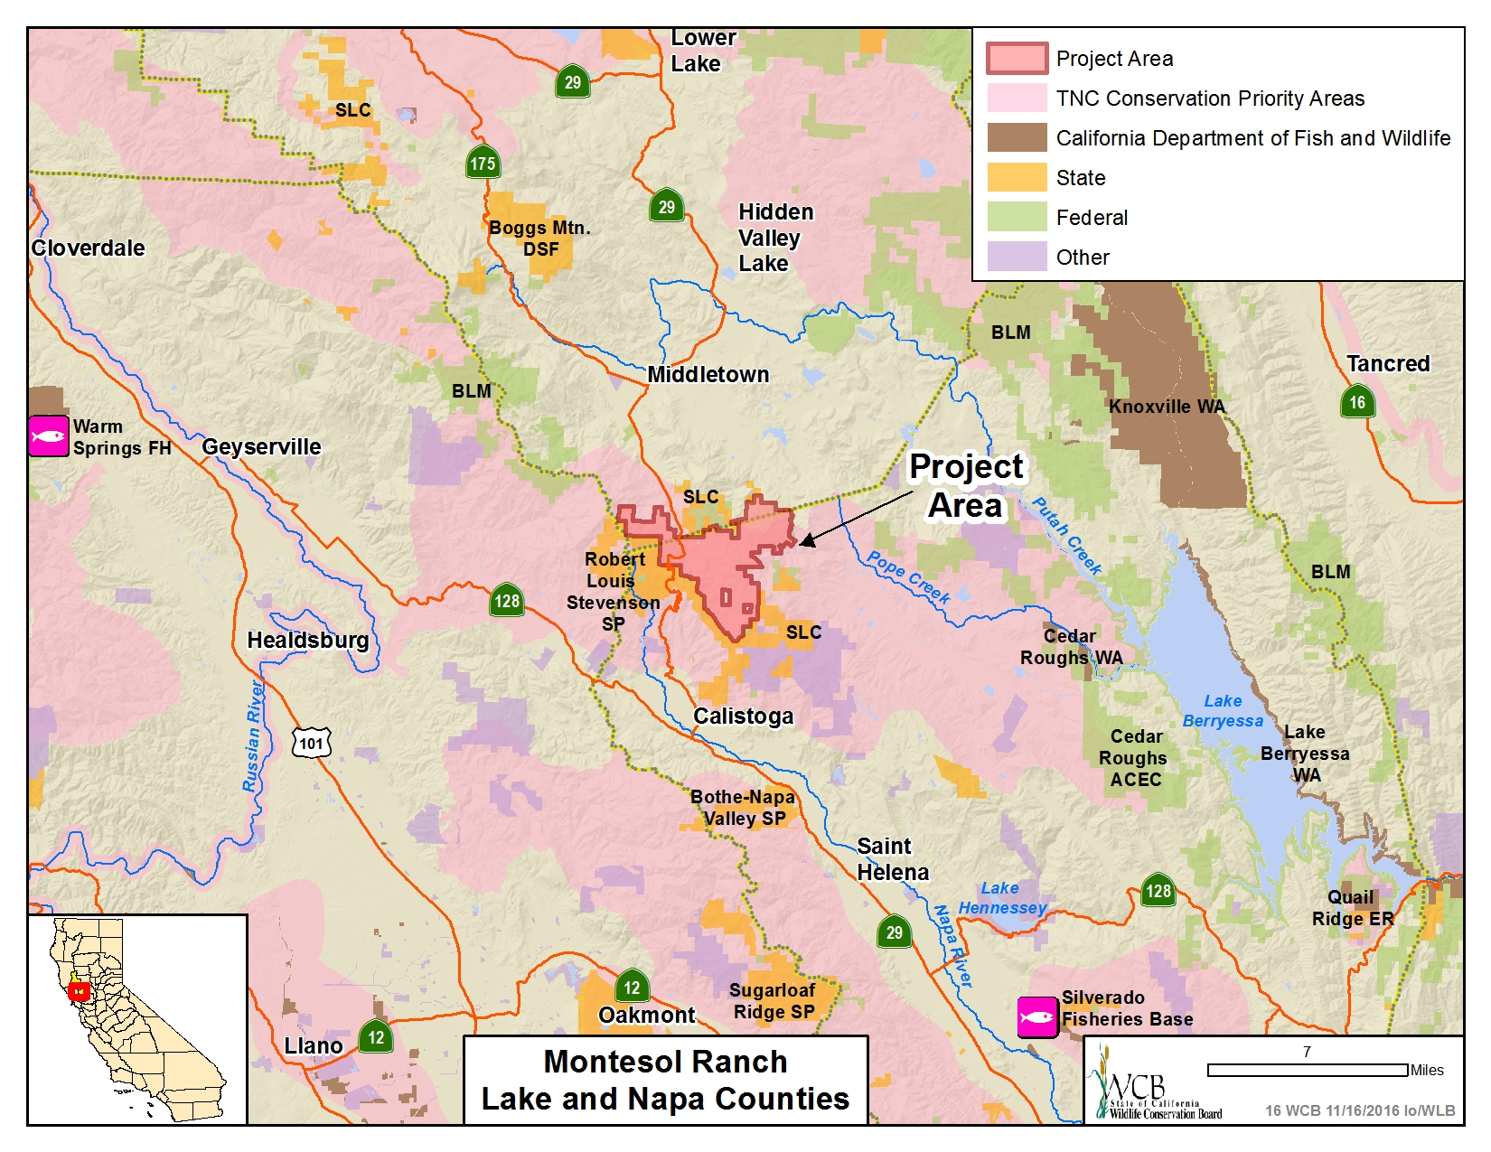

Slide 41
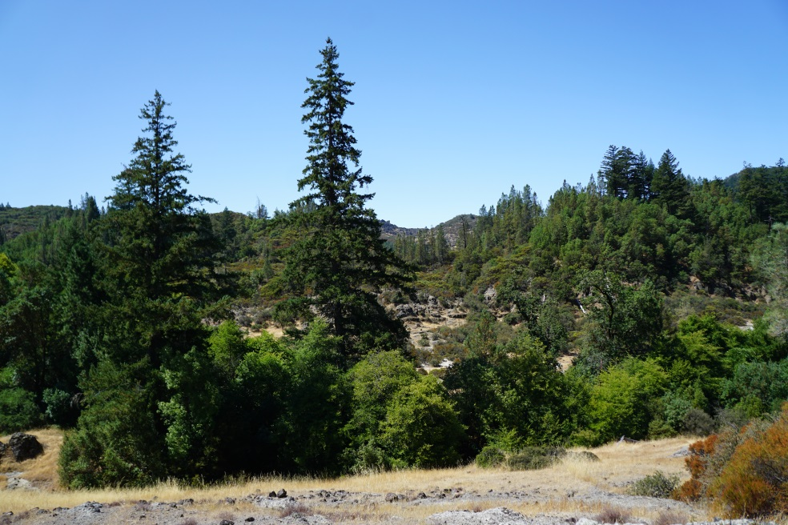
#16. Montesol Ranch
The Property is within the Napa Valley American Viticultural Area (AVA), which extends along most of Napa County, from its northern border with Lake County to the city limits of American Canyon, and from its western border with Sonoma County to Lake Berryessa.

Slide 42
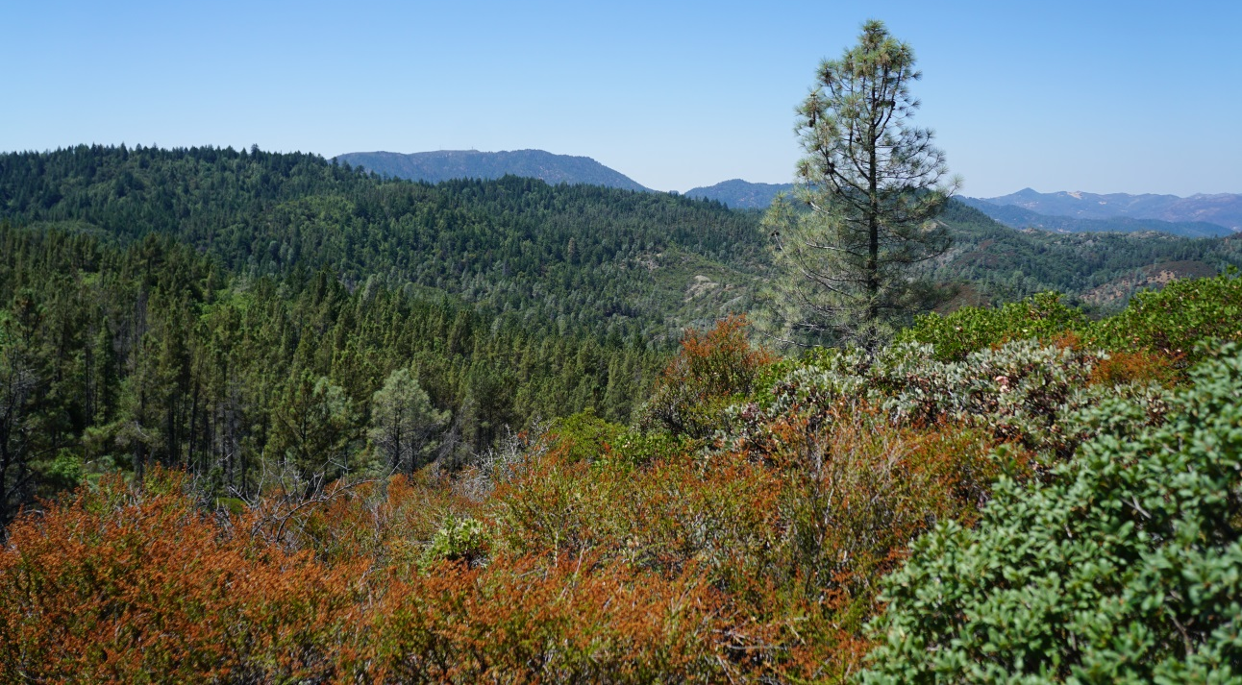
#16. Montesol Ranch
The Forest Zone includes stands of Douglas Fir, ponderosa pine, montane hardwood, blue oak-gray pine, both black and live oaks, valley foothill riparian vegetation, and annual/perennial grasslands.

Slide 43
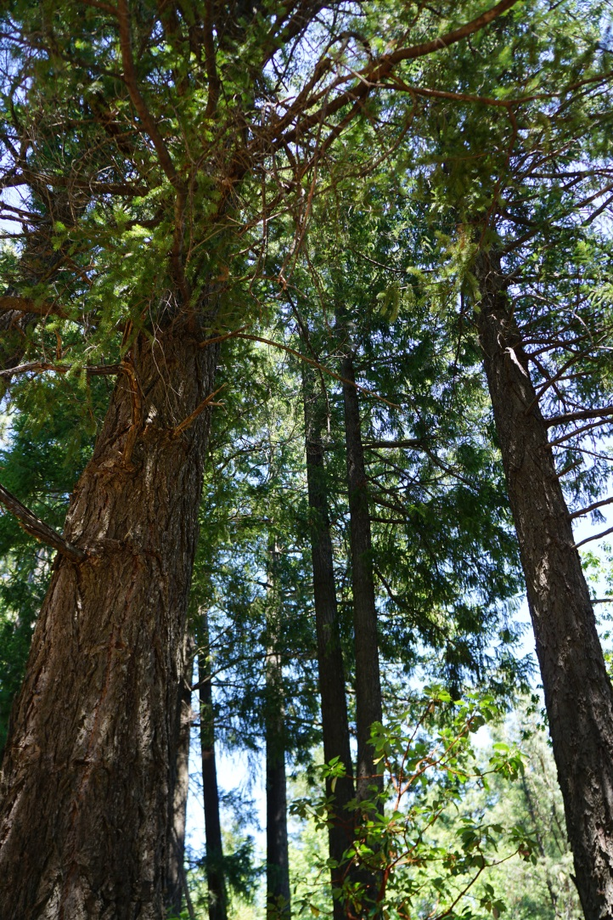
#16. Montesol Ranch
The Easement area will be dedicated to the conservation and preservation of its natural resources. The Easement includes a “Forest Zone”, which will be used primarily as a sustainable working forest.

Slide 44
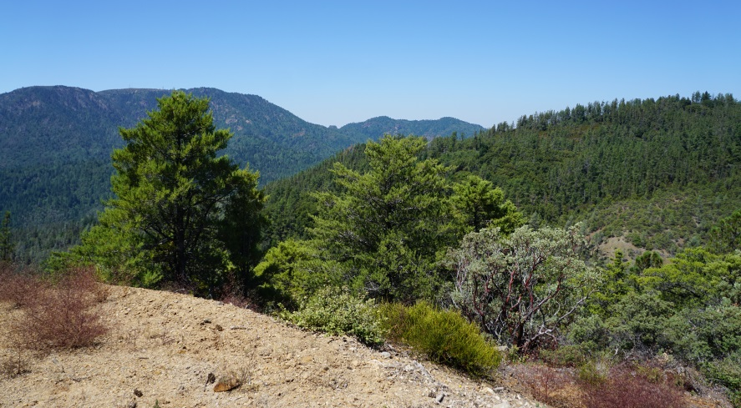
#16. Montesol Ranch
The Property’s scenic and open space qualities will protect existing wildlife corridors and habitat for threatened and sensitive wildlife species.

Slide 45
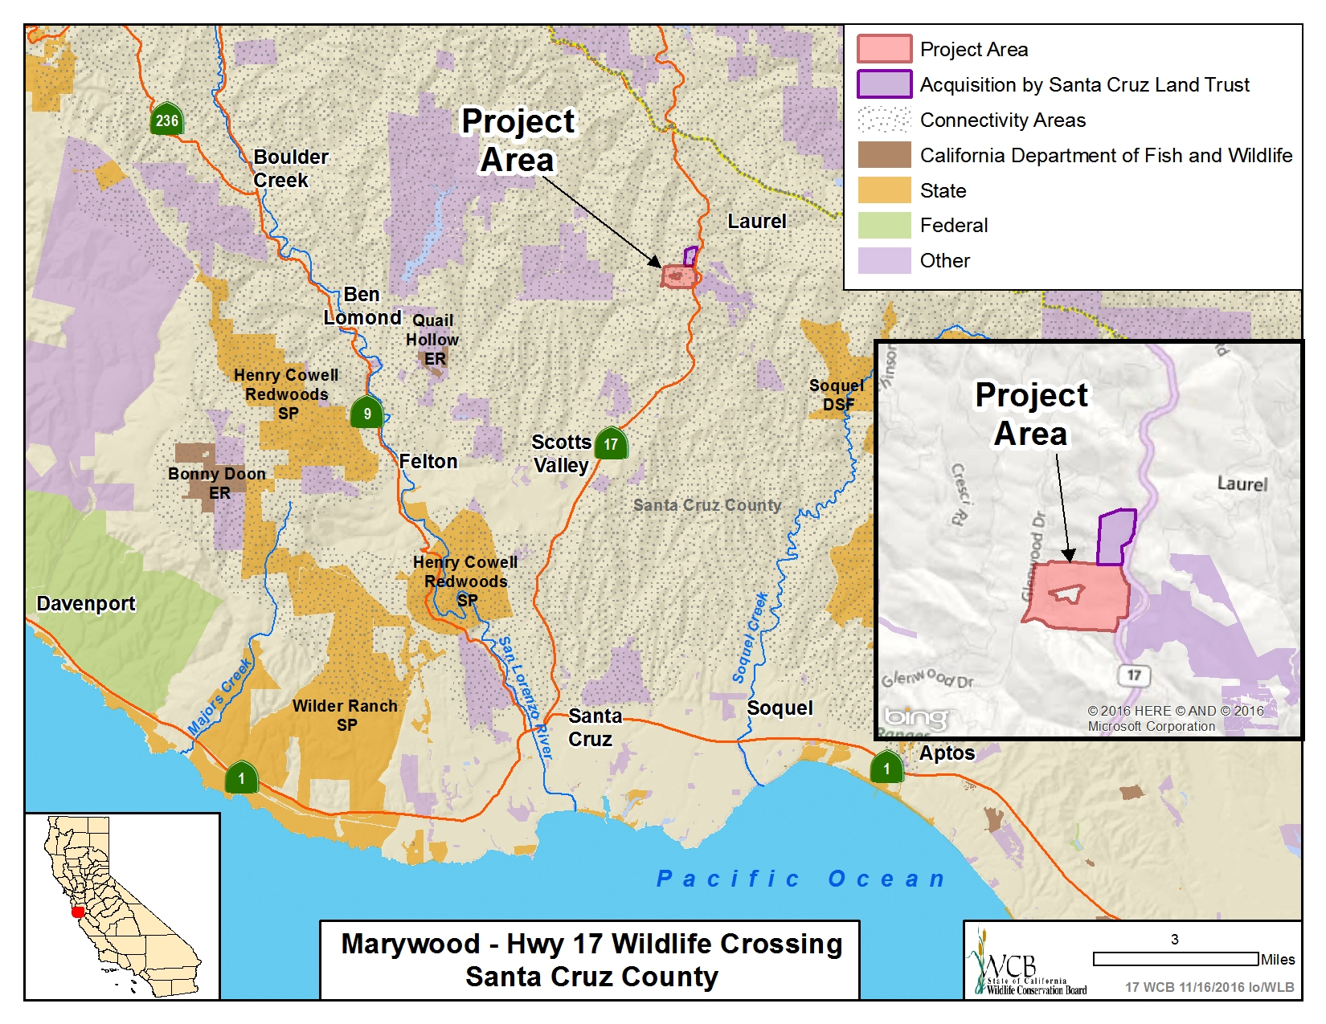

Slide 46
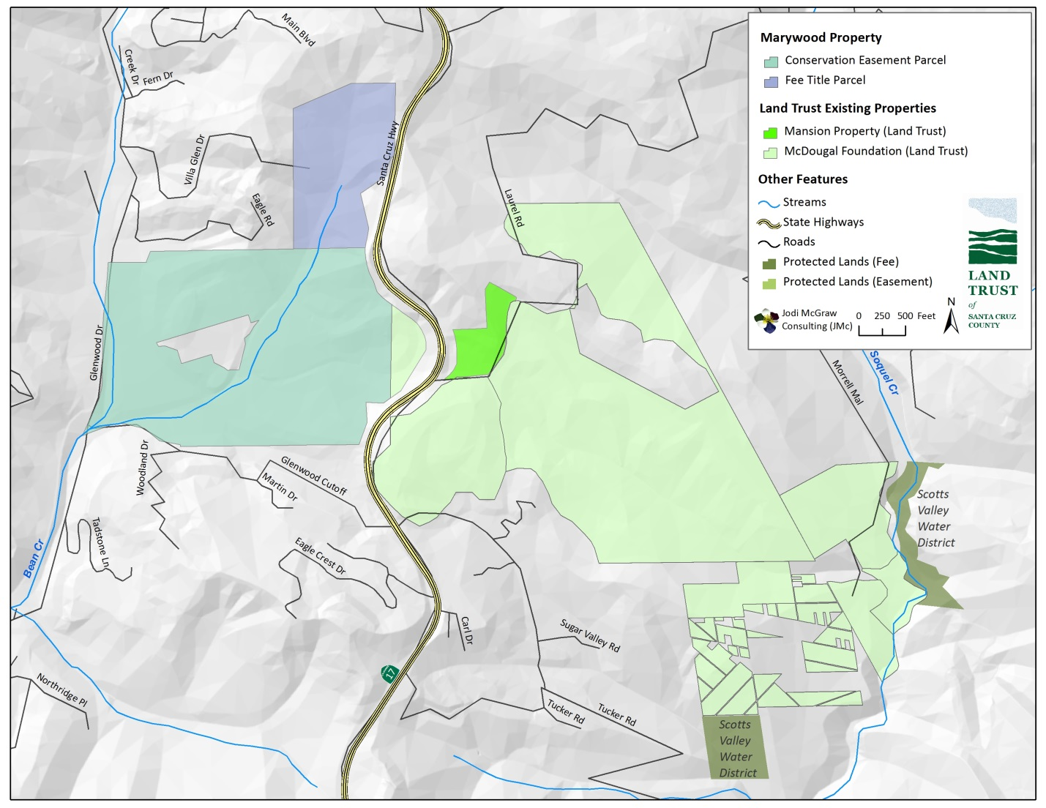
#17. Marywood – Hwy 17 Wildlife Crossing

Slide 47
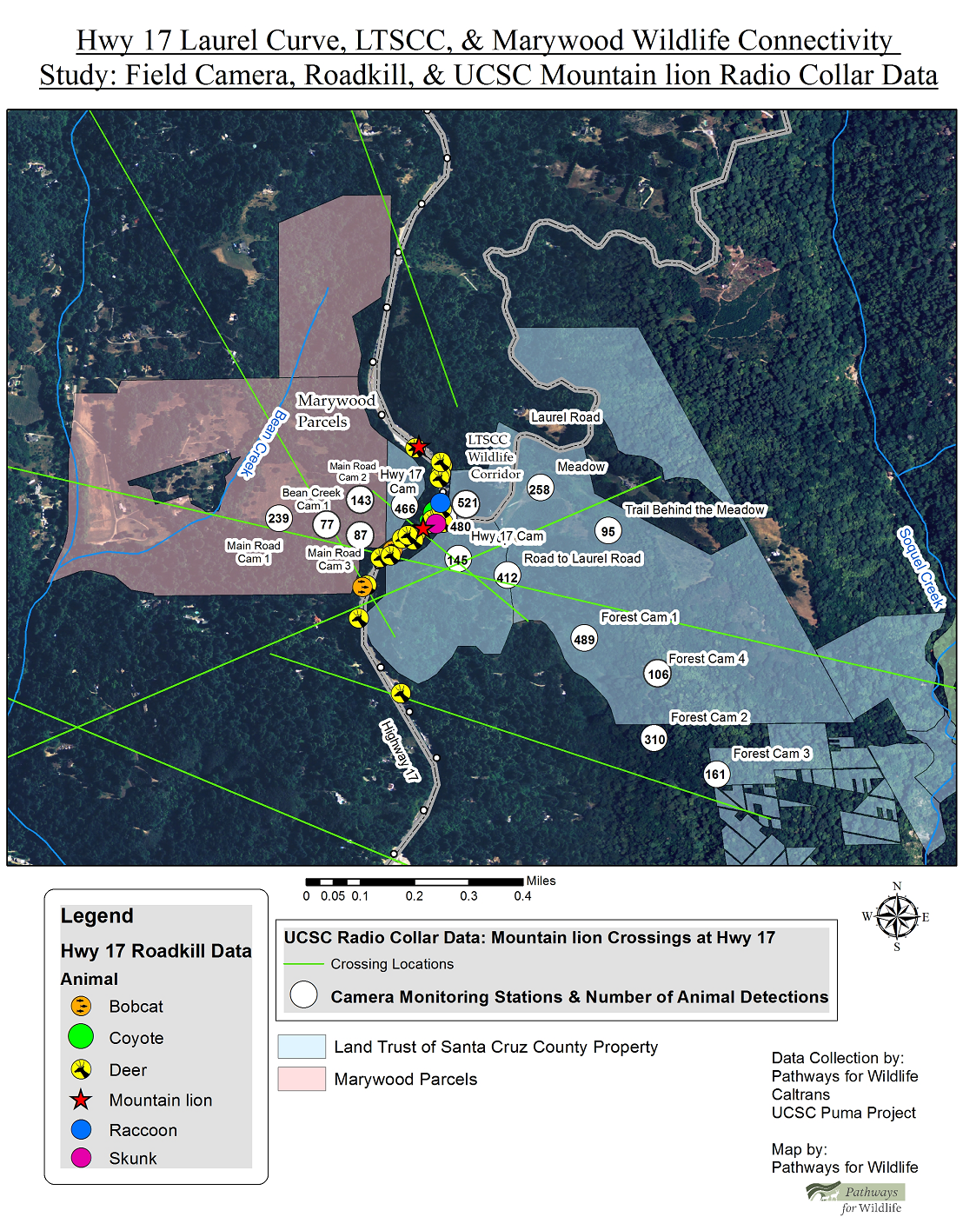
#17. Marywood – Hwy 17 Wildlife Crossing
Hwy 17 Laurel Curve, LTSCC, & Marywood Wildlife Connectivity Study: Field Camera, Roadkill, & UCSC Mountain Lion Radio Collar Data

Slide 48
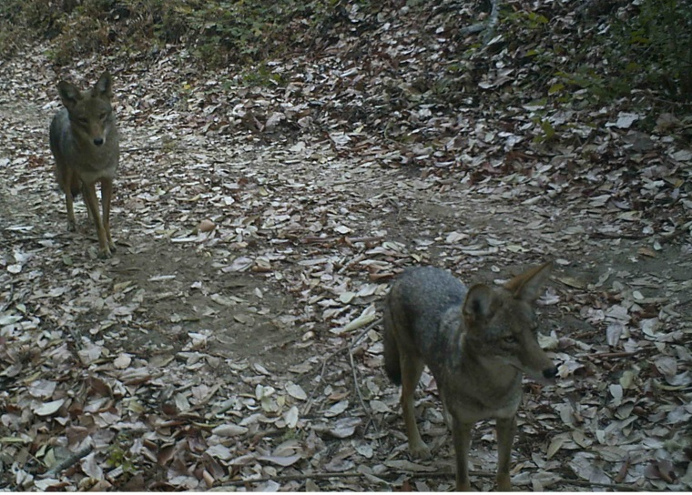
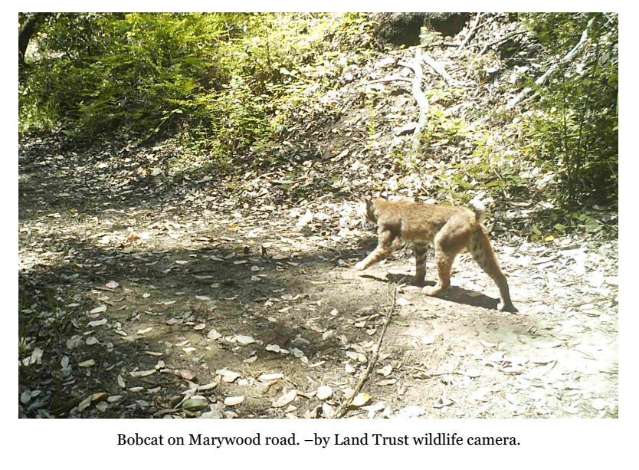
#17. Marywood – Hwy 17 Wildlife Crossing
Wildlife found on property: coyotes, mountain lion, bobcat and fawn nursing on Marywood – taken by Land Trust wildlife camera

Slide 49
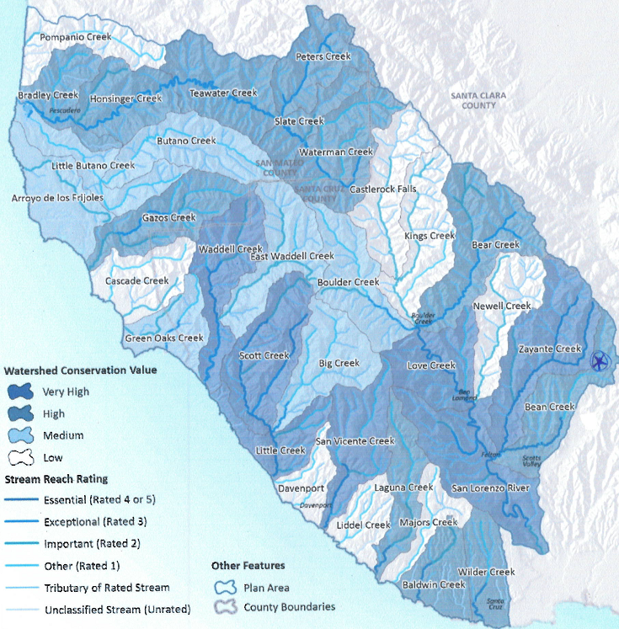
#17. Marywood – Hwy 17 Wildlife Crossing
Conservation value of watersheds and streams within the Plan Area
Property

Slide 50
#17. Marywood – Hwy 17 Wildlife Crossing
Bean Creek-western portion of the property

Slide 51
#17. Marywood – Hwy 17 Wildlife Crossing
Coastal Redwoods located on the property

Slide 52
#17. Marywood – Hwy 17 Wildlife Crossing
Aerial photo of Laurel Curve by drone, looking east towards Marywood Parcel
Photo courtesy of Land Trust of Santa Cruz County

Slide 54
#18. Central Region State Wildlife Area Habitat Enhancement Project
Los Banos WA – Boundary Drain Water Conveyance Enhancement

Slide 55
#18. Central Region State Wildlife Area Habitat Enhancement Project
Gadwall Unit – Ramacciotti Habitat Rejuvenation and Water Conveyance Project

Slide 56
#18. Central Region State Wildlife Area Habitat Enhancement Project
Salt Slough Water Conveyance and Management Uplands Enhancement

Slide 57
#18. Central Region State Wildlife Area Habitat Enhancement Project
North Grasslands WA, Salt Slough Unit – one of the wetlands benefitted by the Wolfsen Road repair

Slide 58
#18. Central Region State Wildlife Area Habitat Enhancement Project
Los Banos Wildlife Area. Wetlands will be restored and enhanced. Water control infrastructure updates will allow optimal moist soil management.

Slide 59
#18. Central Region State Wildlife Area Habitat Enhancement Project
Los Banos WA – boundary drain and road crossing repairs

Slide 60
#18. Central Region State Wildlife Area Habitat Enhancement Project
Boundary drain will be replaced to allow access and enhanced management and road will be widened for public safety and to allow large equipment access.

Slide 62
Chesebro Meadows Acquisition
Sierra Madre – Santa Monica Mountains Linkage

Slide 63
Chesebro

Slide 64
#19. Chesebro Meadow
Chesebro Meadows Acquisition Sierra Madre – Santa Monica Mountains Linkage Regional Trail Network

Slide 65
#19. Chesebro Meadow
Wildlife pictured on meadow

Slide 66
#19. Chesebro Meadow
View of annual grassland interspersed with oak savannah.

Slide 67
#19. Chesebro Meadow
Aerial view of Chesebro Meadows and surrounding area

Slide 69
#20. DFG Land Management Plans, Inland Deserts Region, Phase II, Augmentation II
White-Faced ibis over seasonal wetlands

Slide 70
#20. DFG Land Management Plans, Inland Deserts Region, Phase II, Augmentation II
Permanent wetlands riparian habitat

Slide 71
#20. DFG Land Management Plans, Inland Deserts Region, Phase II, Augmentation II
Riparian restoration project

Slide 72
#20. DFG Land Management Plans, Inland Deserts Region, Phase II, Augmentation II
Spring bloom at San Jacinto Wildlife Area

Slide 73
#20. DFG Land Management Plans, Inland Deserts Region, Phase II, Augmentation II
Potrero Unit uplands

Slide 75
#21. Southern California Coastal Wetland and Riparian Restoration, Phase II
Southern California Wetland Recovery Project (WRP)
Community Wetland Restoration Grant Program (CWRGP)
Created in 2001
Further the wetland recovery goals of the WRP’s Regional Strategy
Build local capacity to plan and implement wetland restoration projects
Promote community involvement in wetland restoration activities
Foster education about wetland ecosystems
Typically funds 10 to 12 projects per year with an annual project budget of approximately $300,000
Proposals come from nonprofit organizations, university departments, and local agencies
Southern California Coastal Wetland and Riparian Restoration, Phase I
$400,000 was approved by the WCB in May 2012
15 projects from 2012 to 2014

Slide 76
#21. Southern California Coastal Wetland and Riparian Restoration, Phase II
HABITAT RESTORATION IN PHASE 1 PROJECTS | ACRES | NATIVE PLANTS PLANTED | NATIVE TREES PLANTED | INVASIVE PLANTS REMOVED | INVASIVE TREES REMOVED
Santa Barbara County
Devereux Slough Margin Enhancement | 8 | 671 | 6 | n/a | 4
Refugio Creek Mouth Restoration Project | 0.7 | 185 | 2,074 |  | 52
Mission Canyon Cape Ivy Eradication Project | 0.5 |  |  | 20,000 sq. ft.
Andree Clark Bird Refuge Wetland Margin Enhancement Project | 1.5 | 861 | 600 | 9,640 cu. yd. | 220
Ventura County
Ventura River Upper Estuary Volunteer Restoration and Wetland Education Program | 8 |  |  | 400 cu. yd. | 12
Santa Clara River Student Restoration Project | 13 | 1307 | 121 | 3.8 tons | 117
Los Angeles County
Lower Topanga Creek Restoration Project | 1.5 | 410 | 78 | 100 cu. yd.
Topanga Lagoon Filter Strip Restoration Project | 1 | 32 | 382 | 170 cu. yd.
Orange County
Invasive Removal in Bell Creek at Audubon Starr Ranch | 1.6 | 200 | 200 | 47 cu. yd. | 12
Santiago Park Nature Reserve Restoration | 5 | 1220 | 30 | 60 cu. yd.
Big Oak Canyon Habitat Restoration | 1.2 |  | 14 | 81.25 cu. yd. | 7
Upper Newport Bay Eelgrass Restoration Project | 0.25 | 32,870
San Diego County
Citizens Restoring Coastal Habitat | 169 | 3,336 | 307 | 223 cu. yd. | 73
Early Detection Rapid Eradication of Specific Invasive Non-Native Plants in Wetlands of San Diego County | 4.6 |  |  | 4.6 acres
Earth Discovery Institute Explorers: A Force for Blue | 3 | 442 |  | 14 cu. yd.

Slide 77
#21. Southern California Coastal Wetland and Riparian Restoration, Phase II
Salt Marsh Restoration project that replaced invasive iceplant with native species

Slide 78
#21. Southern California Coastal Wetland and Riparian Restoration, Phase II
Wetland margin enhancement project

Slide 79
#21. Southern California Coastal Wetland and Riparian Restoration, Phase II
Watershed restoration project

Slide 80
#21. Southern California Coastal Wetland and Riparian Restoration, Phase II
COMMUNITY PARTICIPATION IN PHASE 1 PROJECTS | VOLUNTEERS | EVENTS
Santa Barbara County
Devereux Slough Margin Enhancement | 202 | 10
Refugio Creek Mouth Restoration Project | 308 | 13
Mission Canyon Cape Ivy Eradication Project | 19 | 10
Andree Clark Bird Refuge Wetland Margin Enhancement Project | 145 | 8
Ventura County
Ventura River Upper Estuary Volunteer Restoration and Wetland Education Program | 309 | 31
Santa Clara River Student Restoration Project | 320 | 18
Los Angeles County
Lower Topanga Creek Restoration Project | 1,029 | 26
Topanga Lagoon Filter Strip Restoration Project | 445 | 11
Orange County
Invasive Removal in Bell Creek at Audubon Starr Ranch | 388 | 15
Santiago Park Nature Reserve Restoration | 432 | 12
Big Oak Canyon Habitat Restoration | 450 | 15
Upper Newport Bay Eelgrass Restoration Project | 125 | 10
San Diego County
Citizens Restoring Coastal Habitat | 1,752 | 116
Early Detection Rapid Eradication of Specific Invasive Non-Native Plants in Wetlands of San Diego County | 400 | 7
Earth Discovery Institute Explorers: A Force for Blue | 482 | 43

Slide 81
#21. Southern California Coastal Wetland and Riparian Restoration, Phase II
Volunteers at CWRGP events

Slide 83
#22. Salton Sea Species Conservation Habitat Project, Phase II
Project site location within the Imperial Valley

Slide 84
#22. Salton Sea Species Conservation Habitat Project, Phase II
The Salton Sea receding from its historical shoreline

Slide 85
#22. Salton Sea Species Conservation Habitat Project, Phase II
Project site

Slide 86
#22. Salton Sea Species Conservation Habitat Project, Phase II
Birds at the Salton Sea
Photo courtesy of The Desert Review

Slide 87
#22. Salton Sea Species Conservation Habitat Project, Phase II
Aerial view of the project site

Slide 88
#22. Salton Sea Species Conservation Habitat Project, Phase II
Endangered desert pupfish
Roosting and nesting trees

Slide 89
#22. Salton Sea Species Conservation Habitat Project, Phase II
The Salton Sea

Slide 91
#23. University Heights
View from property looking through San Elijo Hills toward San Marcos

Slide 92
#23. University Heights
County Core/Escondido Creek CAPP

Slide 93
#23. University Heights
View across protected property to subject property in background

Slide 94
#23. University Heights
Full rainbow over protected property skyline, subject property is in the left of the picture

Slide 95
November 16, 2016, 10:00am
Wildlife Conservation Board Meeting
State Capitol, Room 112
Sacramento, California 95814
Photo courtesy of

