Slide 1
Kalkomey Event Manager Walkthrough
By: Matthew Lazzaretto

Slide 2
BENEFITS OF THE NEW SYSTEM
LESS PAPERWORK
NO LONGER HAVE TO FILL OUT SCANTRONS AT THE START OF EACH CLASS
NO LONGER HAVE TO HANDWRITE CLASS ROSTERS
NO LONGER NEED TO KEEP RECORDS FOR CLASSES AFTER JAN 1, 2016
NO LONGER HAVE LOST OR MISSPELLED STUDENT RECORDS
NO LONGER HAVE TO MAIL IN ANY FORMS TO 9TH STREET

Slide 3
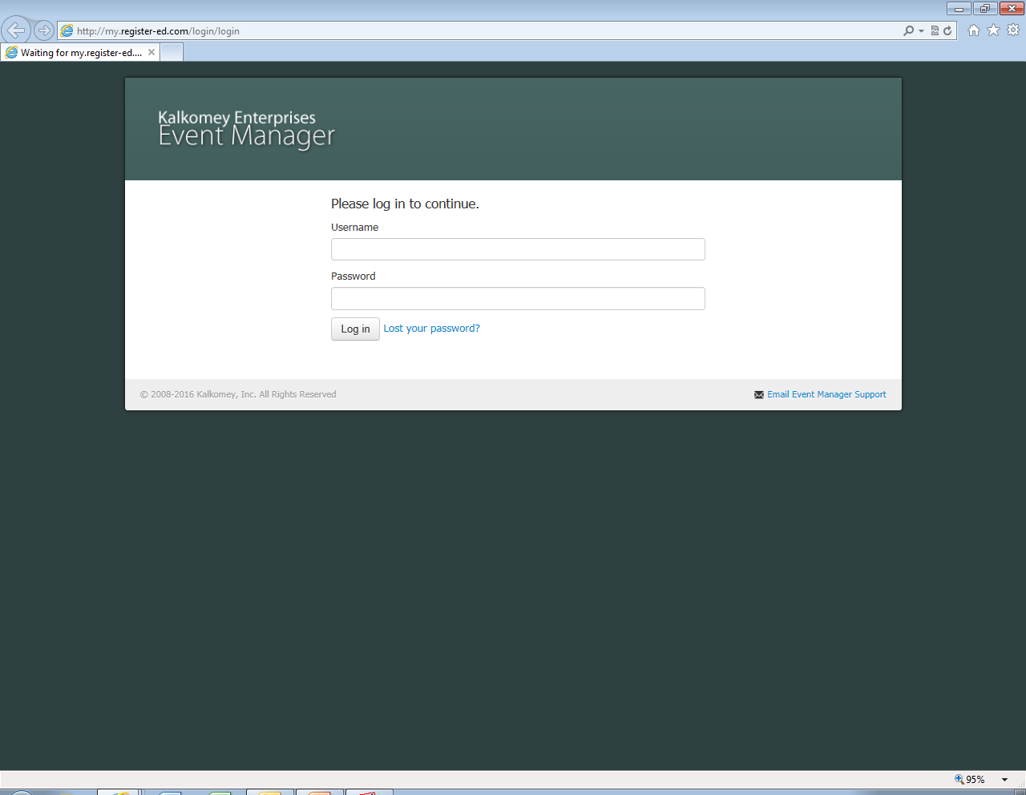
Step 1
WEB ADDRESS
http://my.register-ed.com/login/login

Slide 5
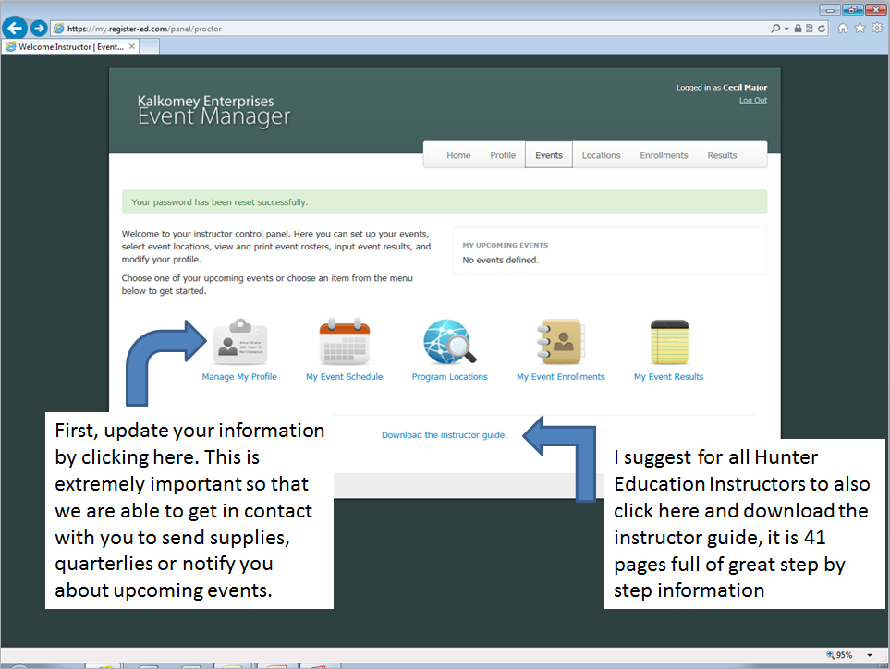

Slide 6
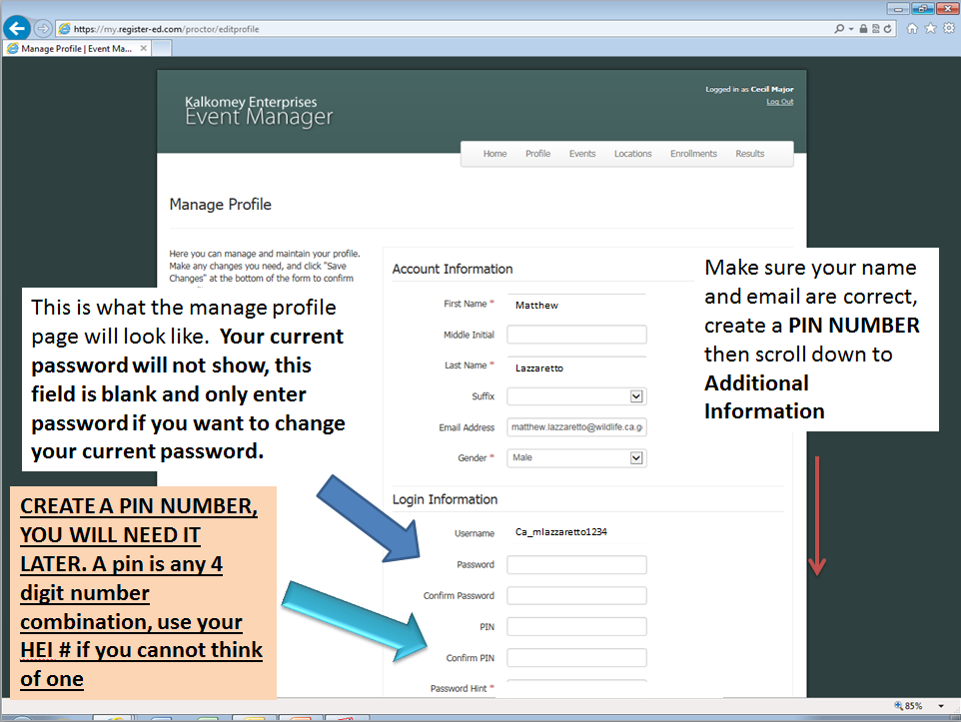

Slide 7
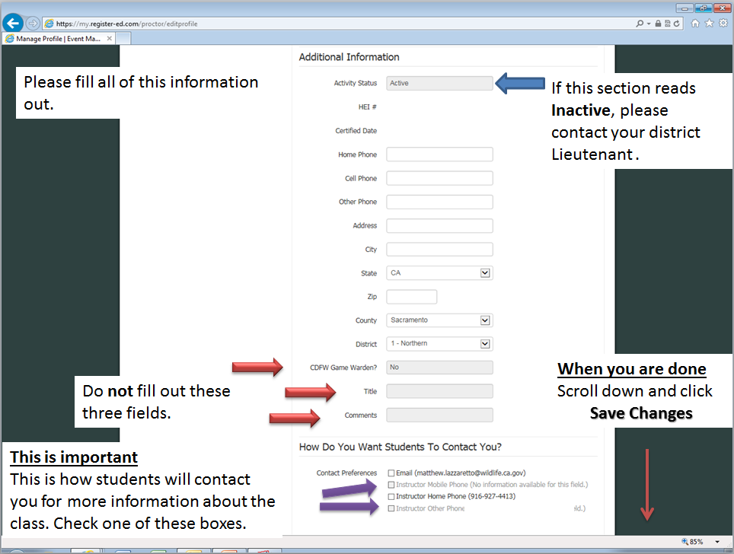

Slide 8
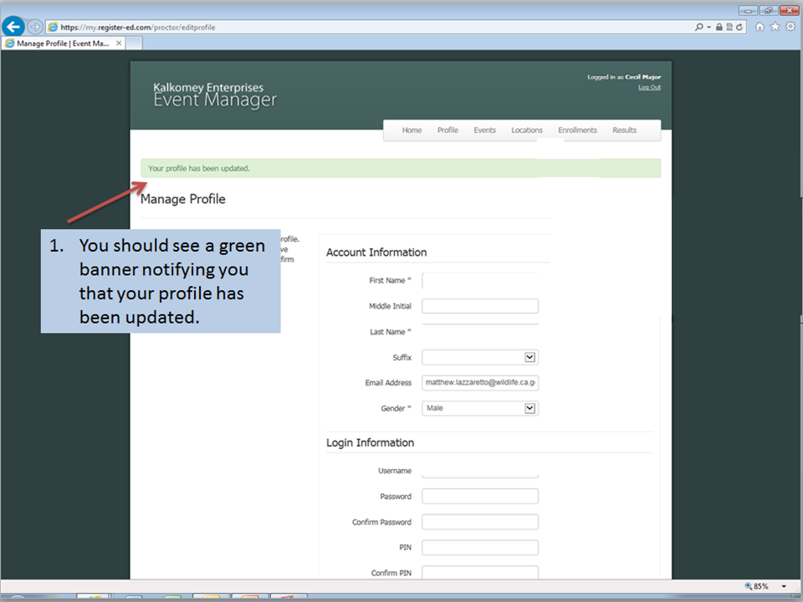

Slide 9
Next Up: Using Event Manager Learn to manage and create classes & events
You are encouraged to work with an experienced instructor before hosting your own event. Please consult with your Lt. Coordinator for referrals to any team members in your area.
Continue to the next slide when you are ready to begin.

Slide 10
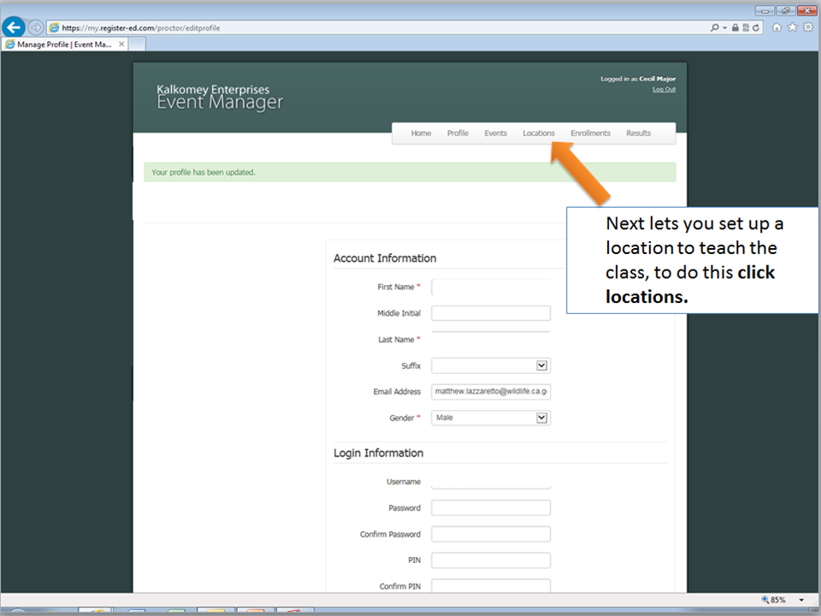

Slide 11
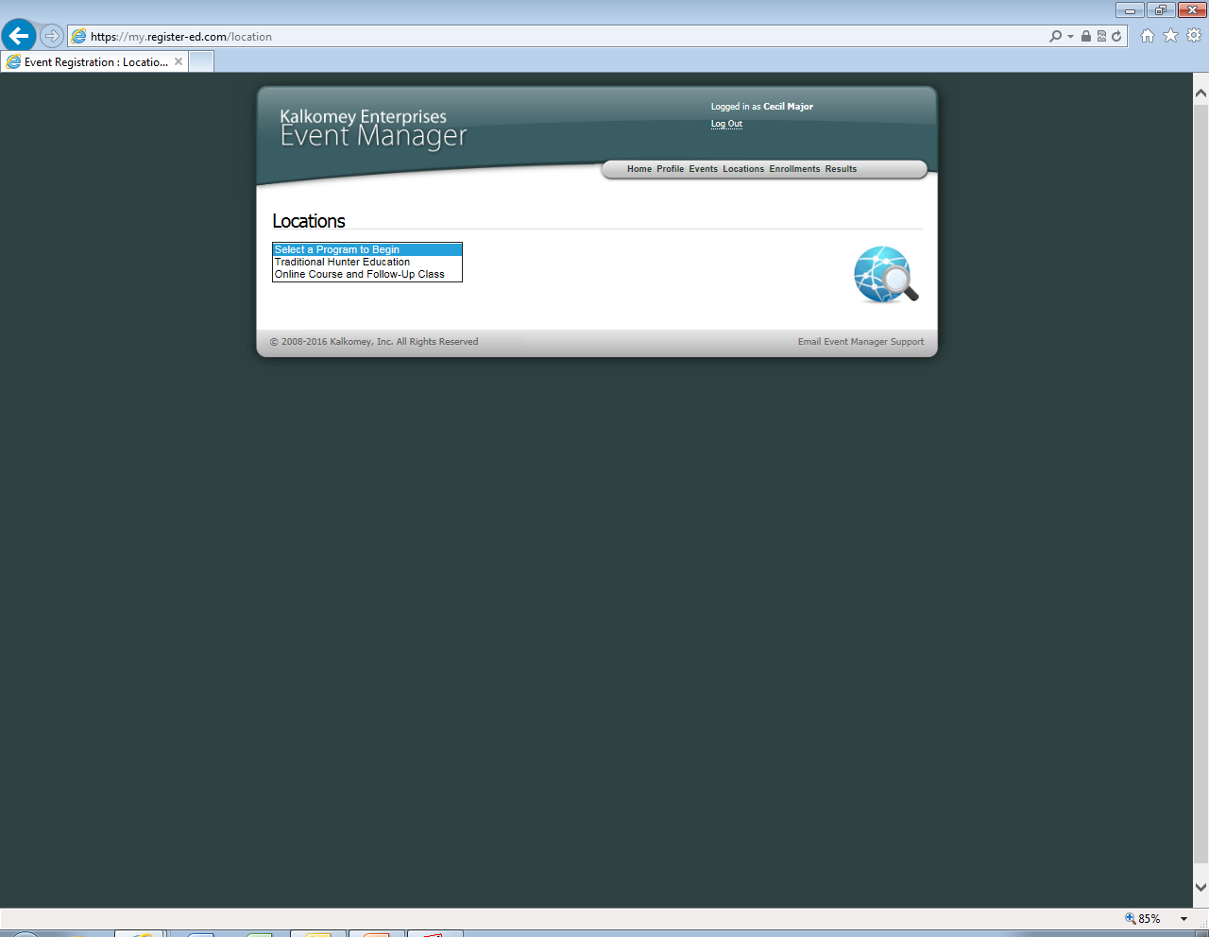
Begin by registering the location.
On the locations page you should see a drop down menu with the following:
Traditional Hunter Education
Online Courses and Follow-up Class
Bow Hunter Education (if you are a certified bow hunter ed instructor)
Unfortunately, if you teach traditional as well as online classes you have to set up a location for each.
I want to create a traditional so I will click Traditional.

Slide 12
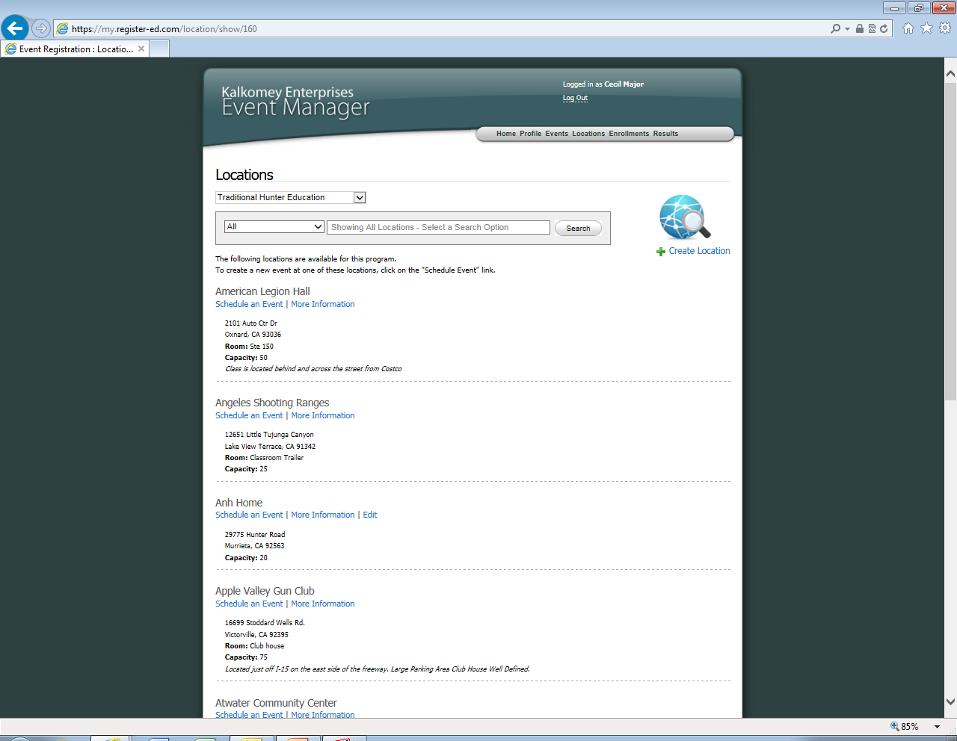
To search for locations
Change the box that says All to Name
Then type in a key word in the box below such as “knights”
Here is a listing of all current traditional course locations that instructors have inputted into the system. These are in alphabetical order, check to make sure your location is not here by using the search system at the top. Many common places such as Yolo Sportsman’s association and Knights Landing Sportsman's club have already been added in the system.

Slide 13
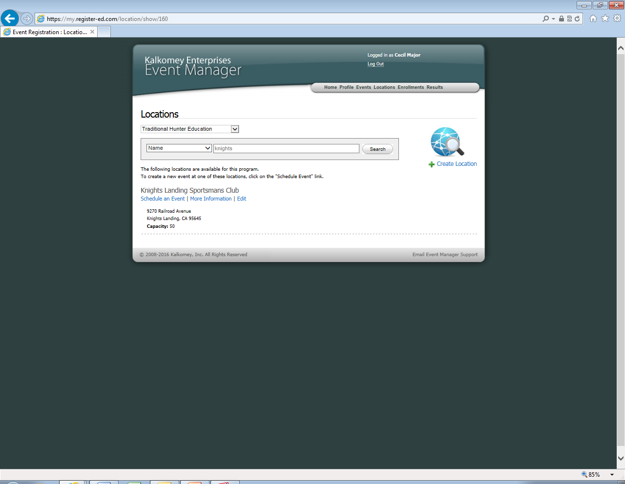
If you are able to find your location, click Schedule an Event.
Skip to slide 17 to learn more about this process.
If you are unable to find your teaching location click here to create a new location.

Slide 14
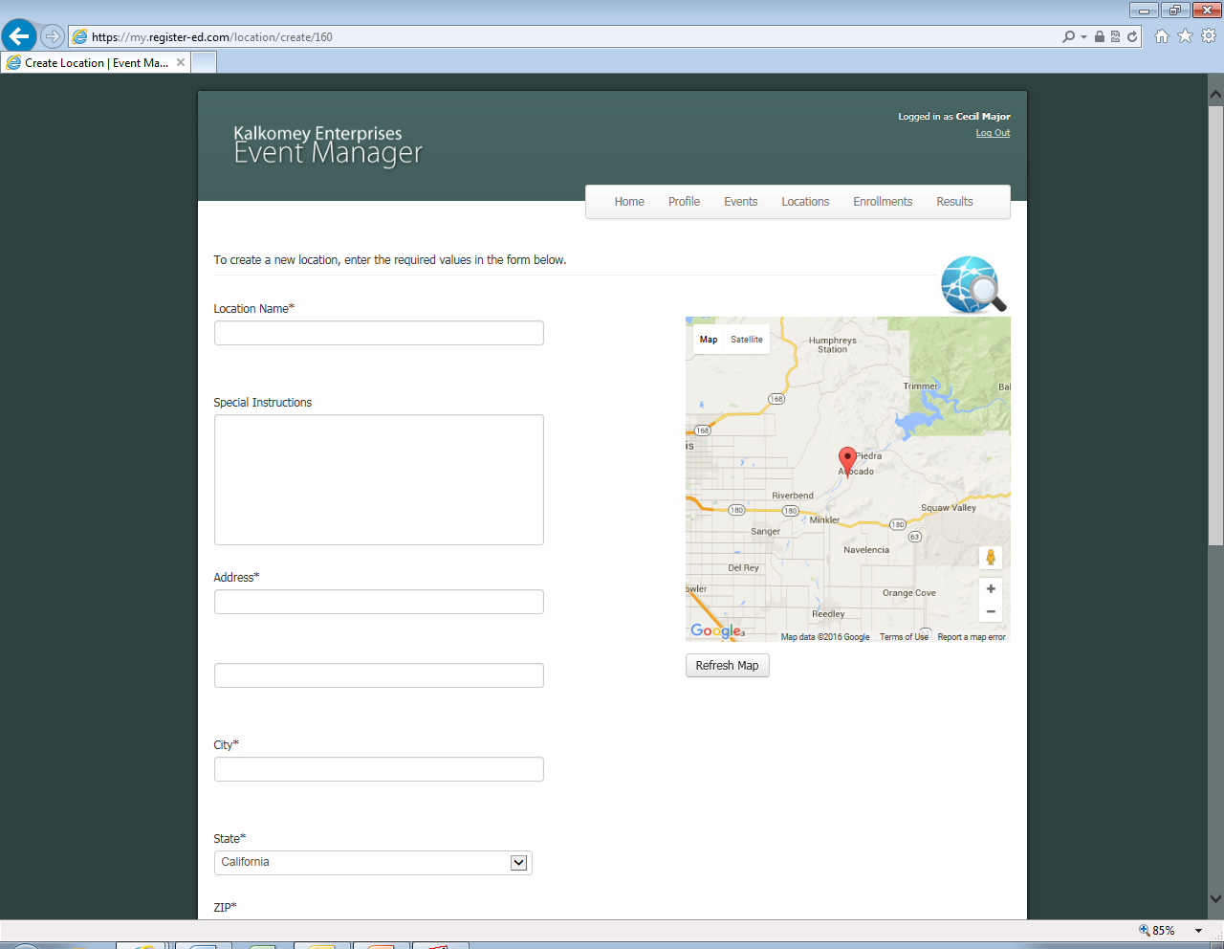
Location Name
Can be name of business such as Yolo Sportsman’s or a name you call the location such as
Bob’s Hunter Ed class.
Special Instructions
Things students will have to know about the location such as park near rifle range or meet near the green LED sign
Address and Map
First type in the address, city, state and zip code (left)
Then click “Refresh Map” above and it should show the location of class, if not you can manually move the location icon.

Slide 15
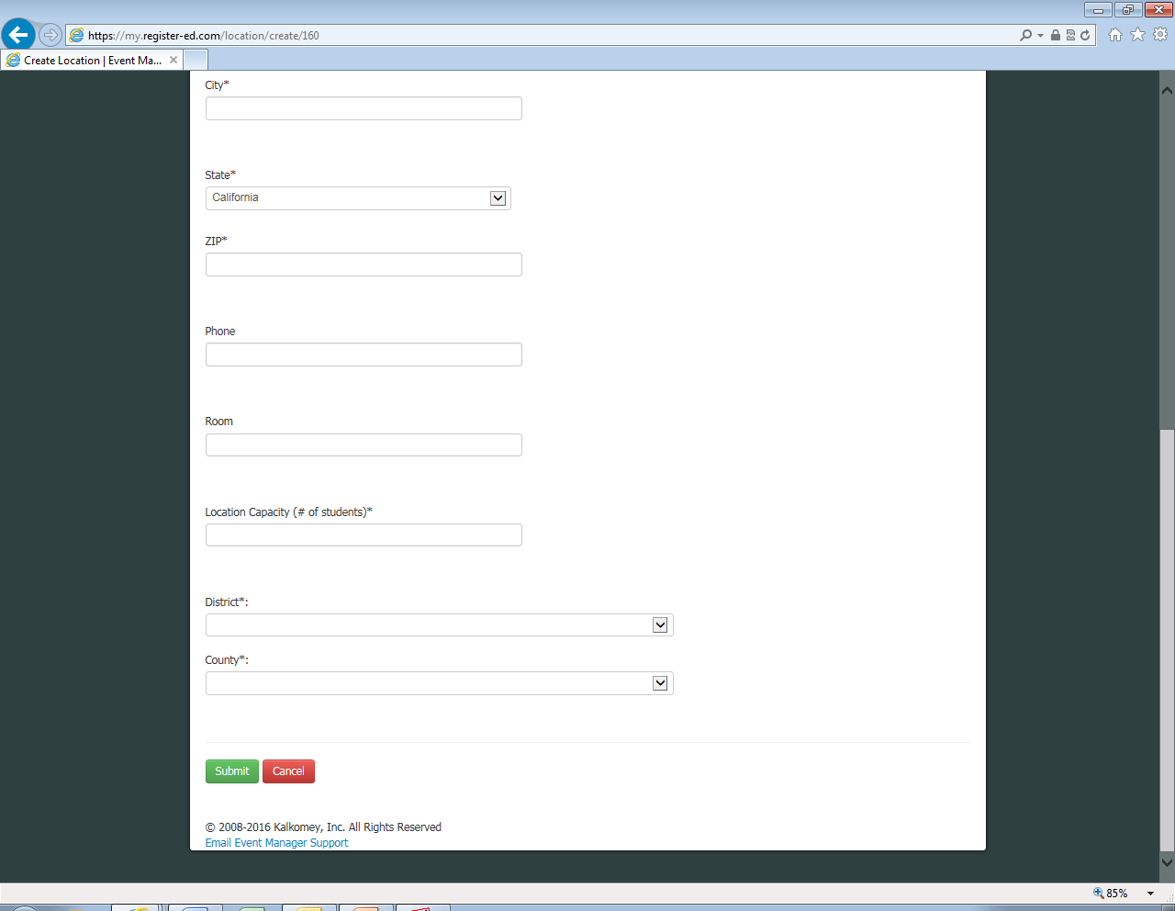
Phone
Example: The phone number to the gun club you are teaching at to help students with driving directions. NOT your personal phone.
Room number-leave blank if there is not one.
How many students can the facility hold? 18? 100?
District (if need help determining)
Northern- Lt. Blake
North Coast- Lt Bundesen
Central- Lt. Olague
Southern- Lt. Norris
When you are done hit submit.

Slide 16
Now lets create a class, to do
this Click “Events”

Slide 17
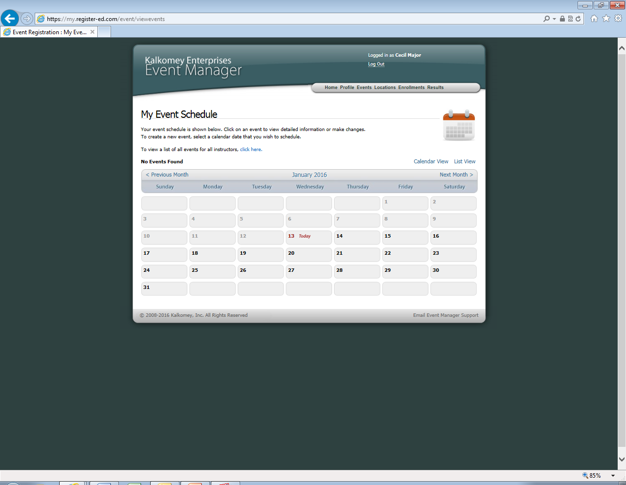
The calendar always goes to todays date, to set up a class click the next month feature until you find the month you are teaching a class.
Once you find your desired class date and month, click on the date, for example I will click on January 30th because I want to teach a class then.

Slide 18
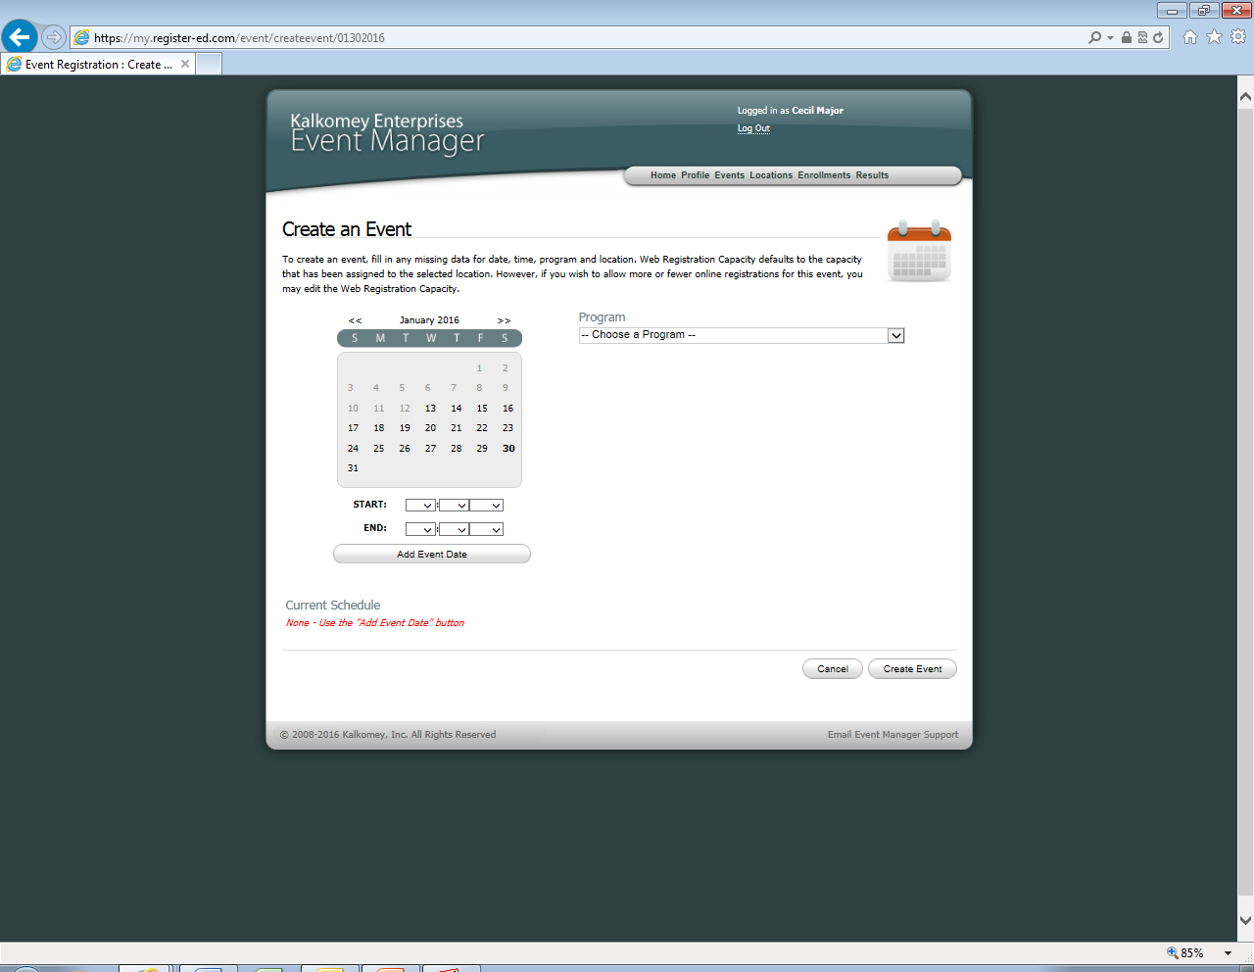
First add the hours of the class you are planning on teaching.
A start time might be 8:30 am
And the End might be 1:00 pm.
Then click add event date. If there is a second date such as January 31st
I would still click add event date first, then after click the 31st on the calendar and select the start and end times.
Once you add the date and times for the class, click on Choose Program. This will ask what type of class you are teaching; Traditional? Online follow-up?

Slide 19
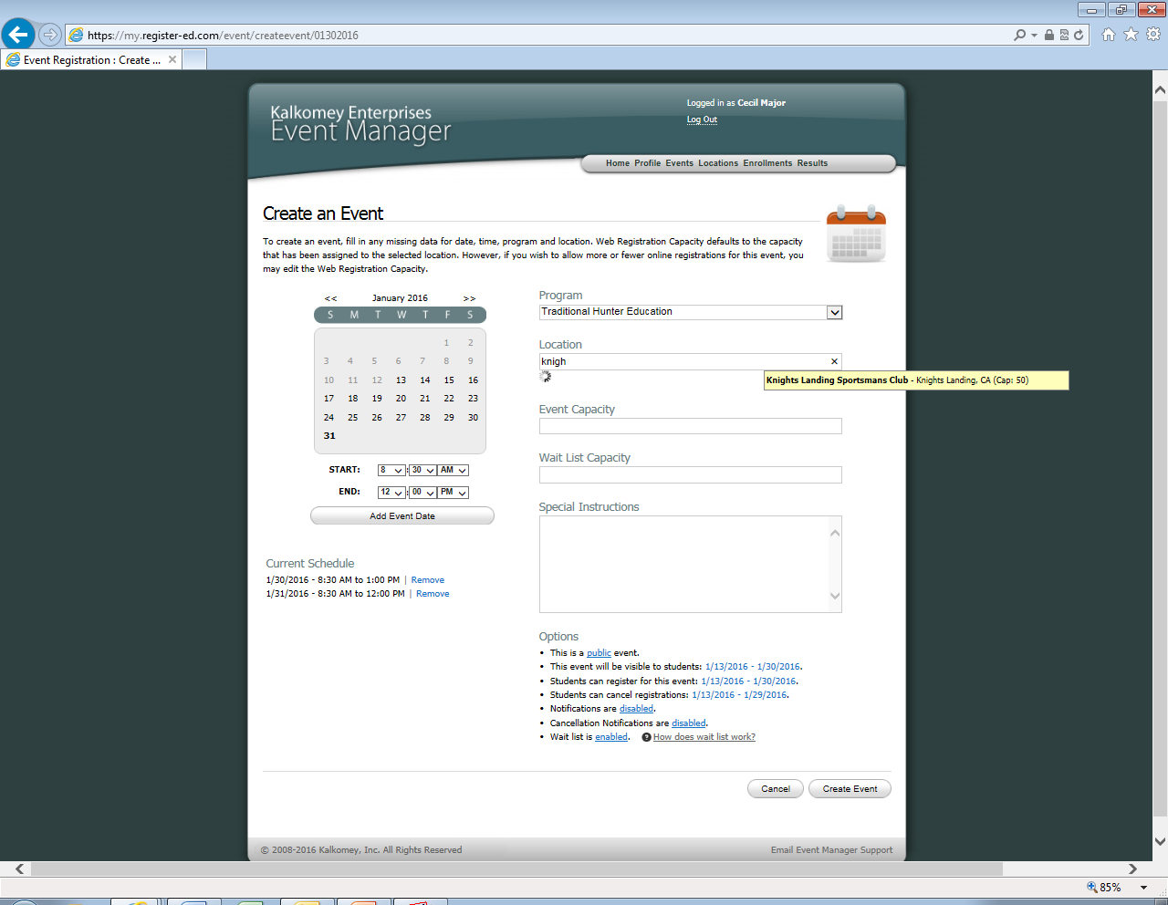
Once the program is selected more items below will appear on the screen such as location, event capacity and waitlist.
Location
Begin to type the name of the location you just created such as the start of the word “knights” and a yellow box will appear showing locations with that phrase in it
Event Capacity
Event capacity automatically fills in to the max capacity of the location of the class. This may have to be changed manually, the location might hold 50 such as knights landing but if you teach alone you must set the event capacity to a maximum of 25 students.

Slide 20
Wait List Capacity
Once the class is full students who still wish to sign up can do so on a wait list. If one student who is registered for the class decides he cannot go and cancels his registration, the next person on the wait list is notified.
The capacity refers to how many students you will allow on this list.
Special Instructions Box
This box lets instructors relay any important information pertaining to their class to the future students. For example: Class fee is $10 dollars and will be collected at the door. Please pack a lunch or bring money for hotdog stand. Anything instructor feels is important for students to know should be written here.

Slide 21
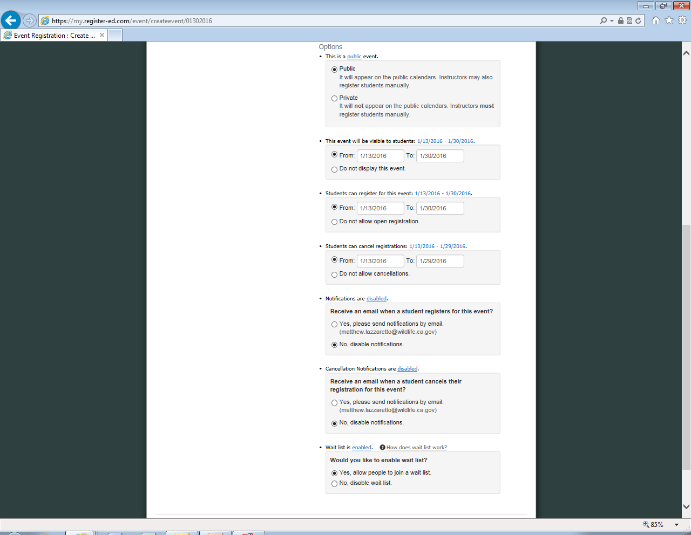
Public vs Private Events
Private events are not posted for the public to see, instructors must email students a link to register or manually add them. This is good for someone teaching a boy scout troop or a middle school class.
This event will be visible to students: When do you want your class to be visible on the website. You may not want questions about a class in December right now so you might select the class to start being visible in mid September.
Students can register for this event: You may want a class to be viewable that is in December, but it is so far away people might forget they registered for the class and not show up, so you could start the registration period in October.
Students can cancel registrations: Do you let students cancel their registration, if so during what time period?
Receive an email when a student registers for this event?: Do you like getting updates on how full your class is? Or do you teach over 100 students a month and don’t want over 100 emails.
After you fill out this information click create event below.
Receive an email when a student cancels their registration for this event?: Is knowing that a student is no longer coming to your class important to you?
Would you like to enable wait list? Do you want people waiting on spots to open in your class?

Slide 22
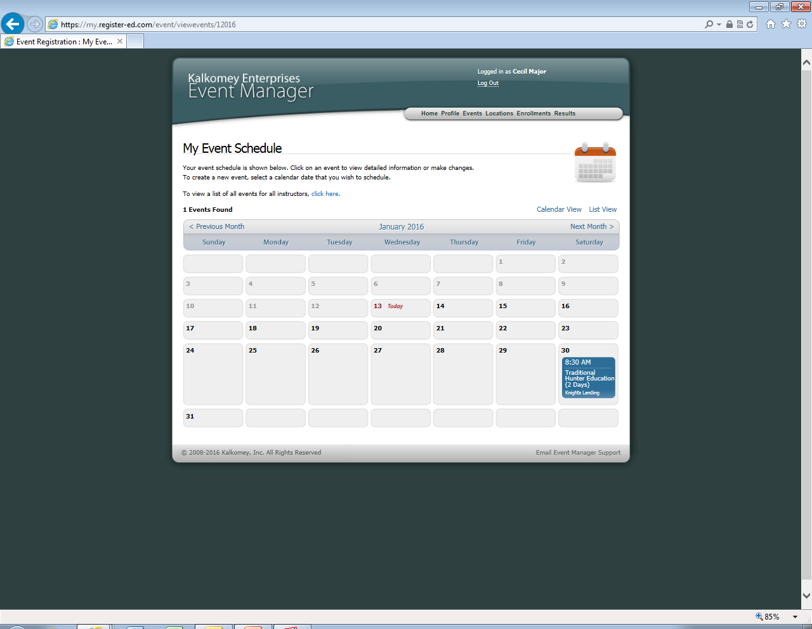
After creating the event it will bring you back to the calendar view. If you are team teaching a class click back on the event to add further information. If you are teaching alone, the event has been created and you do not need to submit any further information.

Slide 23
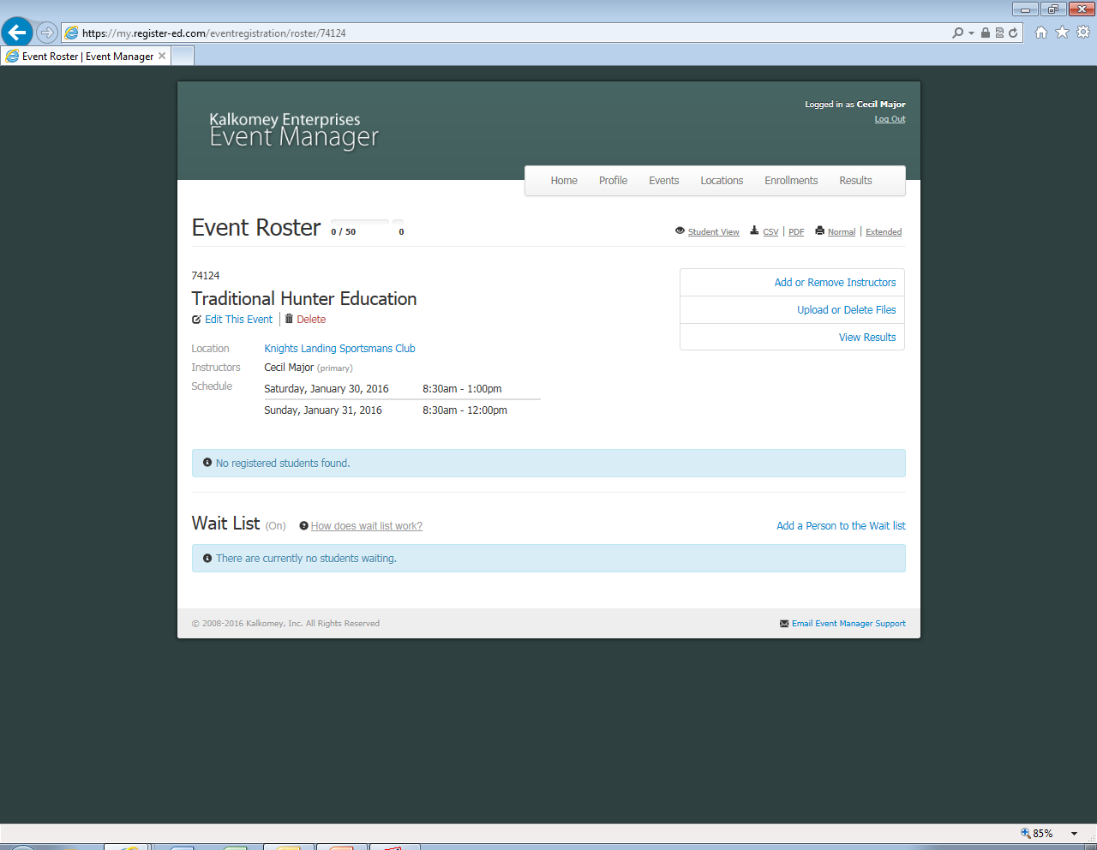
This is what your class roster looks like. Currently 0/50 students have signed up
Team Teach
To add other instructors to this class click here

Slide 24
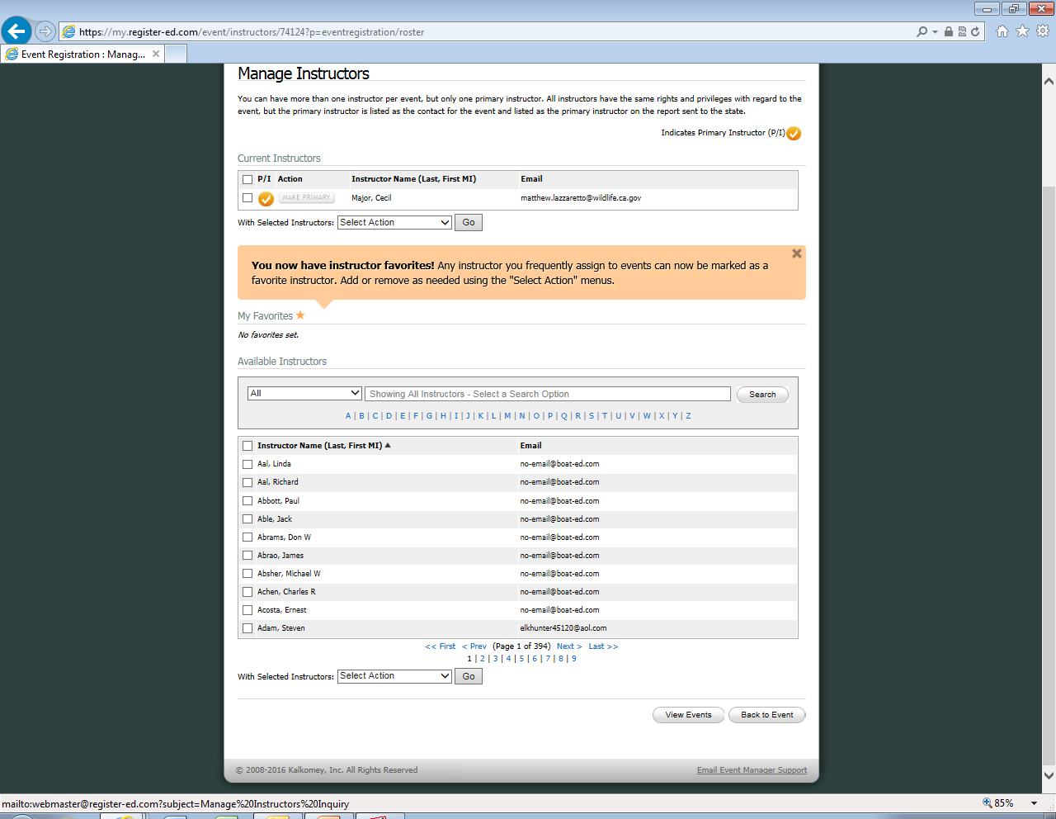
To Search for Instructors: First change “All” to “Name”.
Then, type in the instructors last name below and click search.

Slide 25
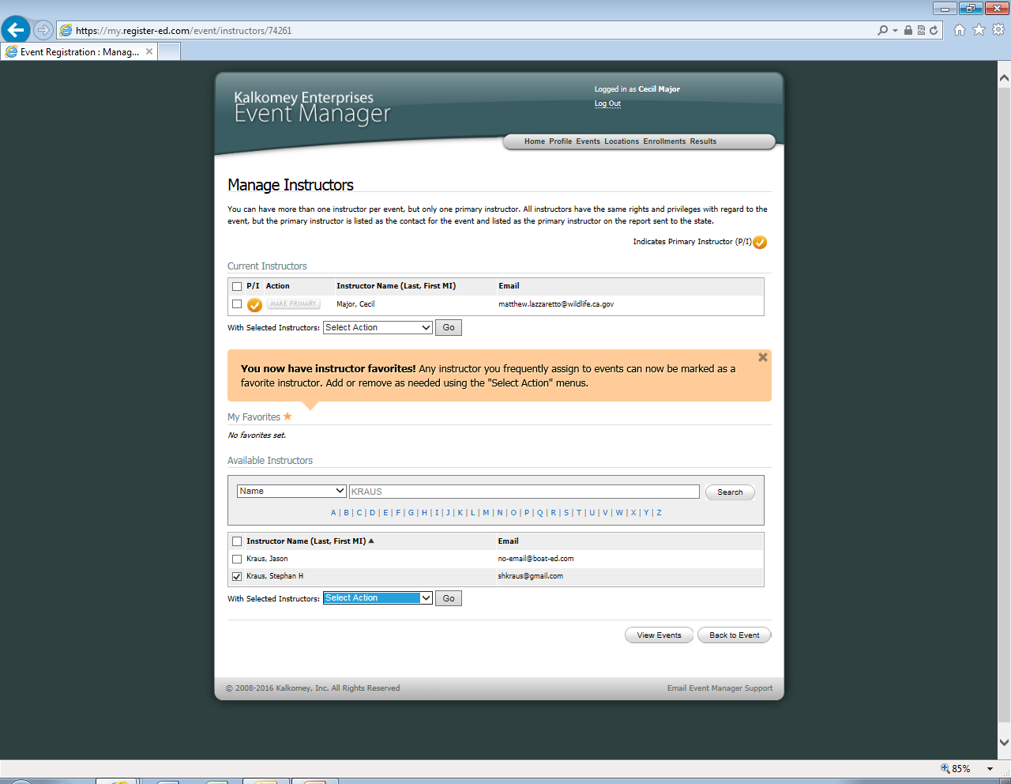
As you can see it will display a list with all instructors that meet your search criteria. I typed in “Kraus” and there are two results. I want to choose Stephan so I clicked on the little box to the left of his name.
After checking the box to the left of the instructors name, click on “Select Action”. This can be found at the bottom of the list of instructors names.

Slide 26
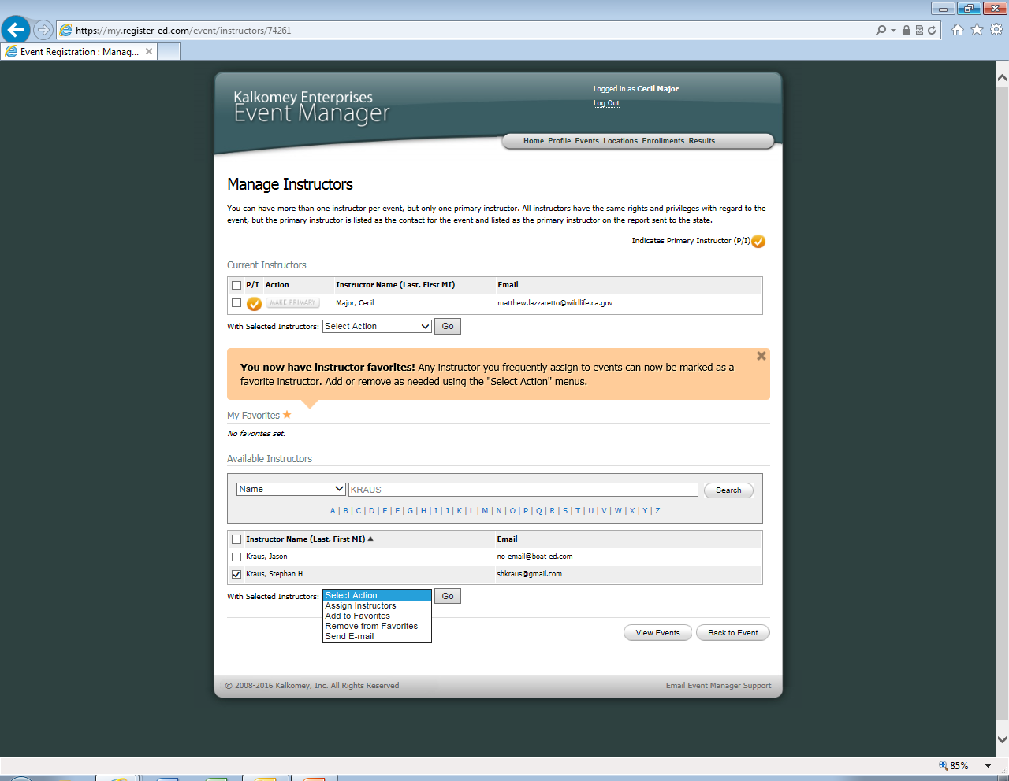
Once you click on select action a box will appear showing four different options. If you only want to team teach with this instructor for one class click “assign instructors”. If you teach with the instructor every class or almost every class click “Add to Favorites” then click “Go” which is found to the left side of the box.

Slide 27
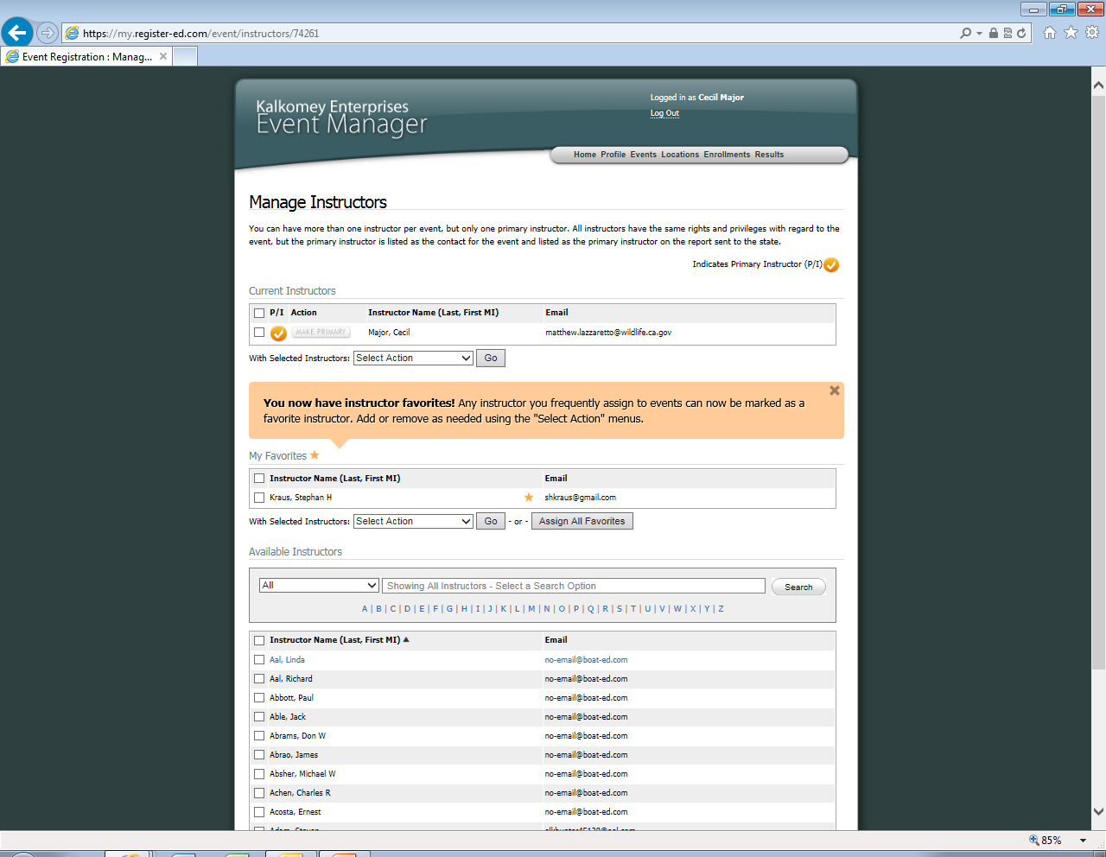
This is the “My Favorites” box, instructors put in this box will always be here when you create any new class. Once the instructor is in this box you never have to search for his/her name again. Multiple instructors can be in this box.
Why the “My Instructors” Box is nice
Once instructors are added to this box you can just hit the “Assign all” button which will automatic all the instructors you team teach with to your class.

Slide 28
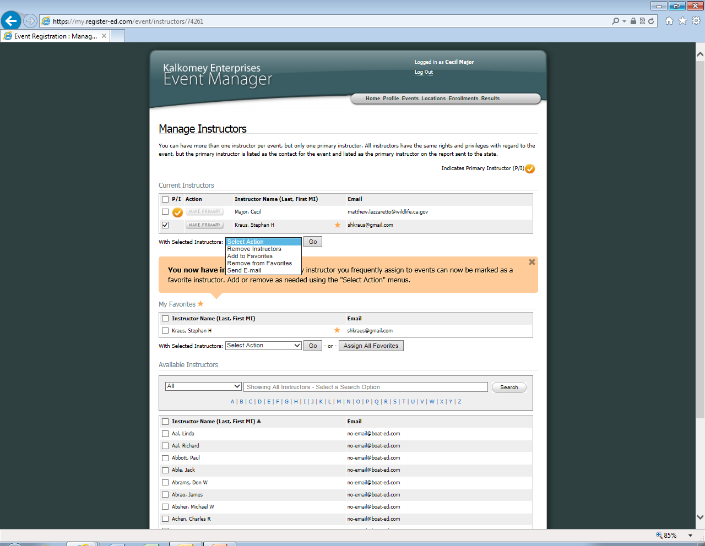
You may also remove instructors, you can do this by:
Check the box to the left of the instructors name you want to remove.
Click “Select Action”.
Click “Remove Instructors” (this only removes instructors that you have checked the boxes next to their names).
Then click “Go” which is to the right of the Select action box.
When you are done scroll down and click “back to event”.

Slide 29
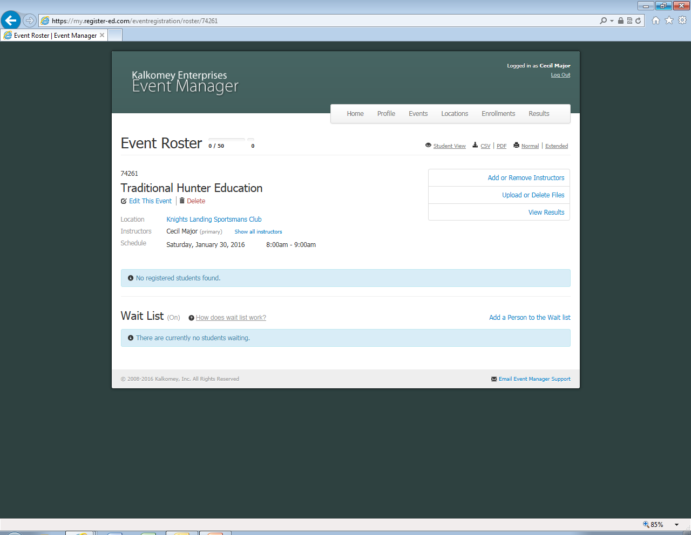
You are now done setting up your event!
When students register they will appear here.
Note: Coordinators must review and approve your event before it is posted to the live site. This is generally done within one to two business days. If you are in need of a quicker posting time, contact your coordinator.

Slide 30
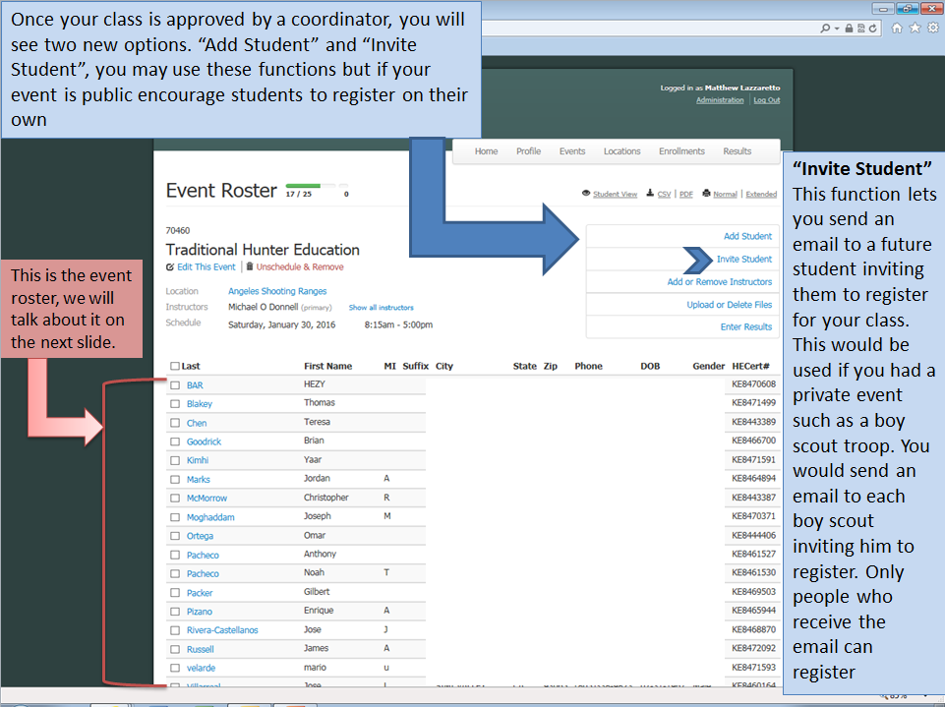

Slide 31
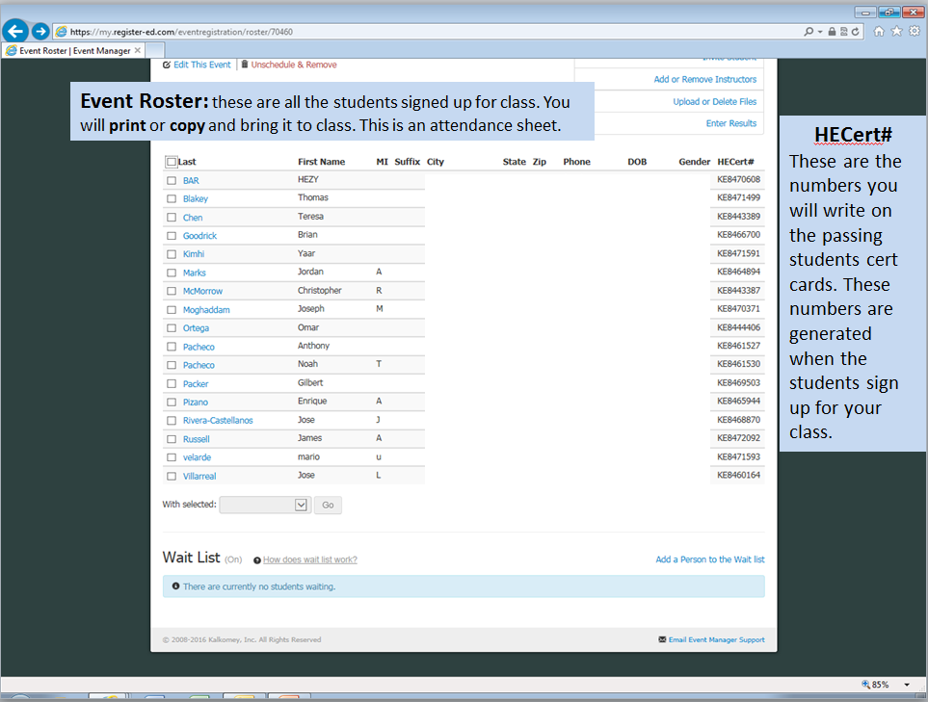

Slide 32
Class Date: What Instructor should Bring
Class Roster: refer to previous slide.
The new Certificate of Completions
Extra copies of Student Consent Form-for students who forget them. See next slide.

Slide 33
Student Consent Form
Three signature forms have now been combined into one form.
PARENT/GUARDIAN LIABILITY RELEASE –under 18
PARENT/GUARDIAN LIABILITY RELEASE –over 18
RESTRICTED FROM HANDLING FIREARM FORM
This form can be found on the Instructor resource page under “forms and supplies”.
It is also automatically attached to any class posting and students are required to bring it in.

Slide 34
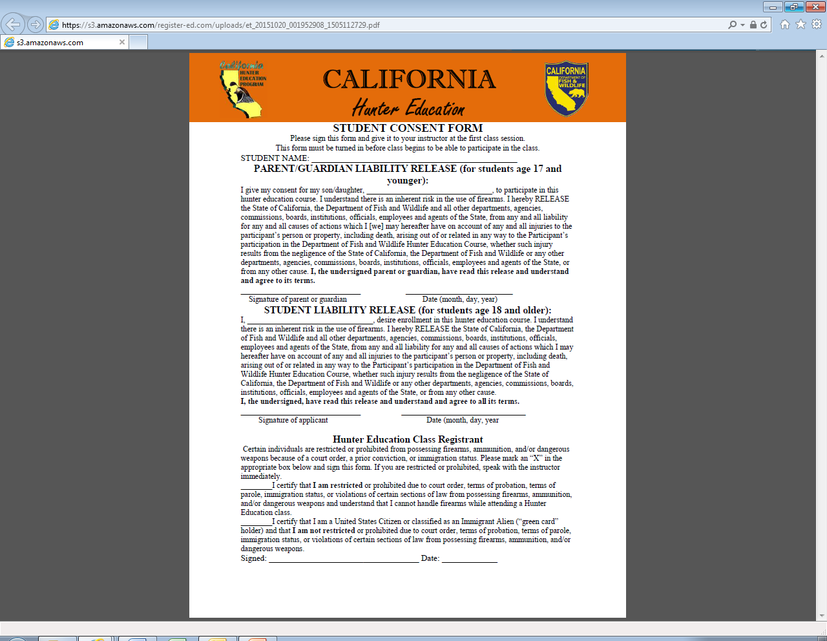
This is what the “Student Consent Form” looks like

Slide 35
What do Students Need to Bring?
Student consent form (Only thing new)
If its an online follow up class, students bring in their online voucher stating completion of course
Class fee

Slide 36
Completion of Class, What to do
Use student roster to issue passing students their certificates. (The KE number on far right of roster)
Record on roster who passed or failed. So that you will know when you get home
Make sure you have each student consent form. Please retain this form for 1 year.
YOU NO LONGER NEED TO SEND IN ANY MAIL TO THE 9th STREET HUNTER ED DEPARTMENT.

Slide 37
Student Roster
Last | First Name | MI | Suffix | City | State | Zip | Phone | DOB | Gender | HECert#
Adams | Morgan | L |  | SAUSALITO | CA | 94965 | (978)505-0000 | 11-07-20000 | Female | KE8452829
Arnheiter | Andrew | A |  | EL MACERO | CA | 95618 | (860)466-0000 | 07-07-2000 | Male | KE8455088
Arnheiter | Edward | D |  | EL MACERO | CA | 95618 | (860)466-0000 | 05-26-2000 | Male | KE8455084
Arnheiter | Edward | A |  | EL MACERO | CA | 95618 | (860)466-0000 | 03-27-2000 | Male | KE8455171
= Required information to fill out new cards are in orange.

Slide 38
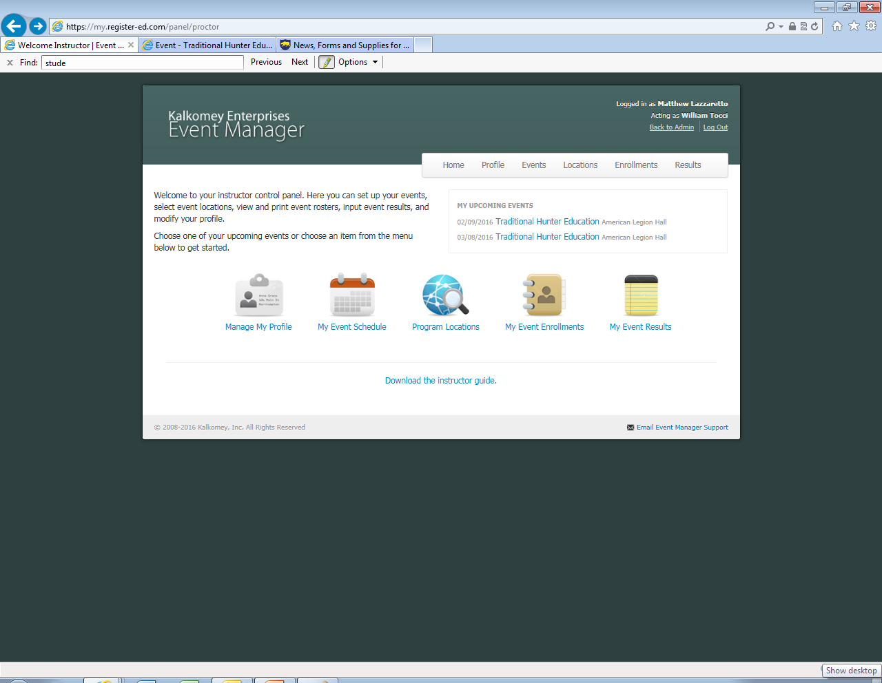
When you are done with the course and are available to enter results, log back into the Event Manager system. http://my.register-ed.com/login/login
After you log in click on the “My Event Results” box.

Slide 39
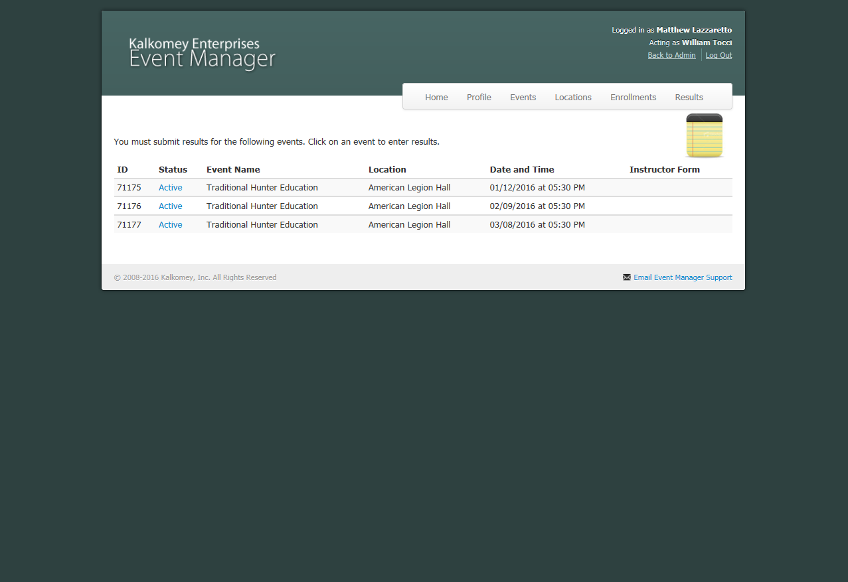
Click on “Active” blue icon next to the class that you want to enter results for.

Slide 40
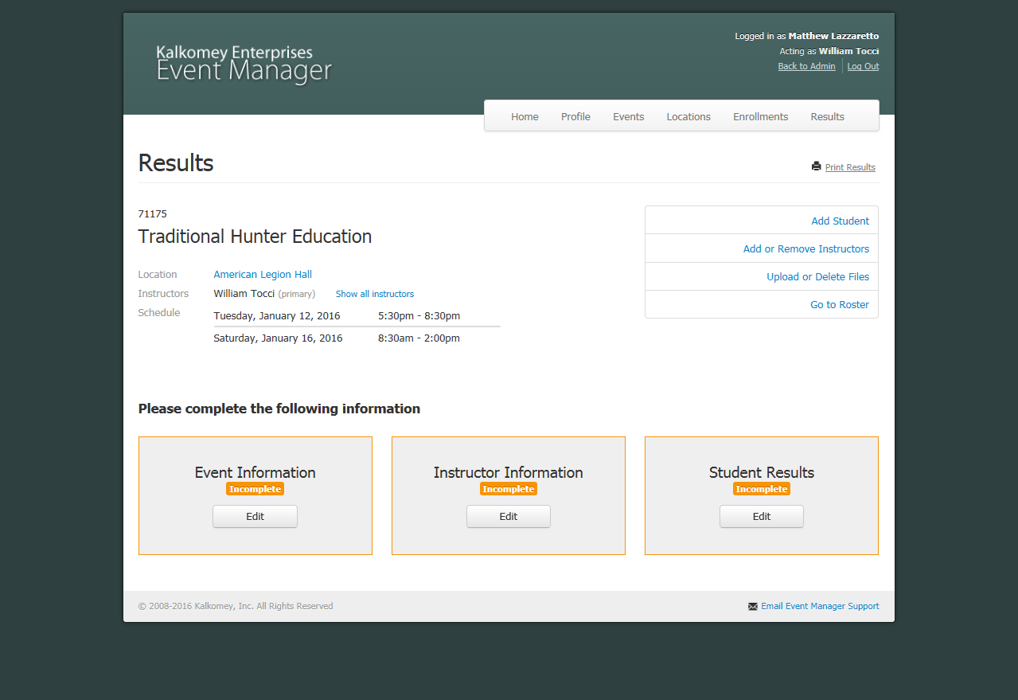
There are three fields that you need to fill out to complete the class however there is no specific order that they need to be completed in. click any of them

Slide 41
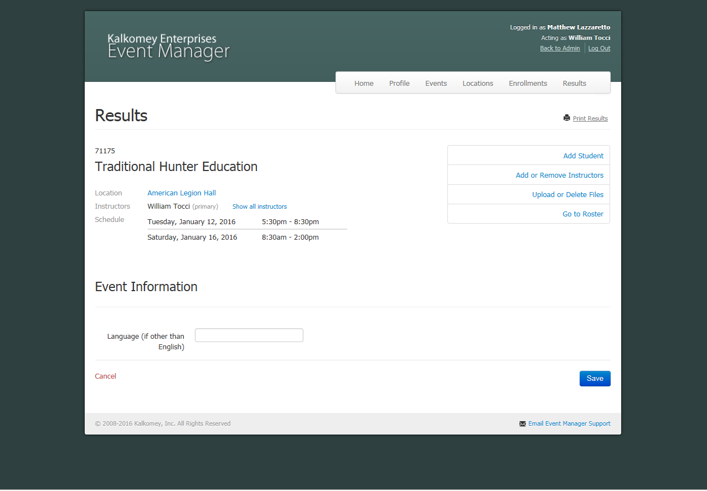
Event Information
This box is extremely easy to fill out, if you taught the class in English you just hit save. That’s it!
If not in English, indicate what language the class was taught in (above) then hit save.

Slide 42
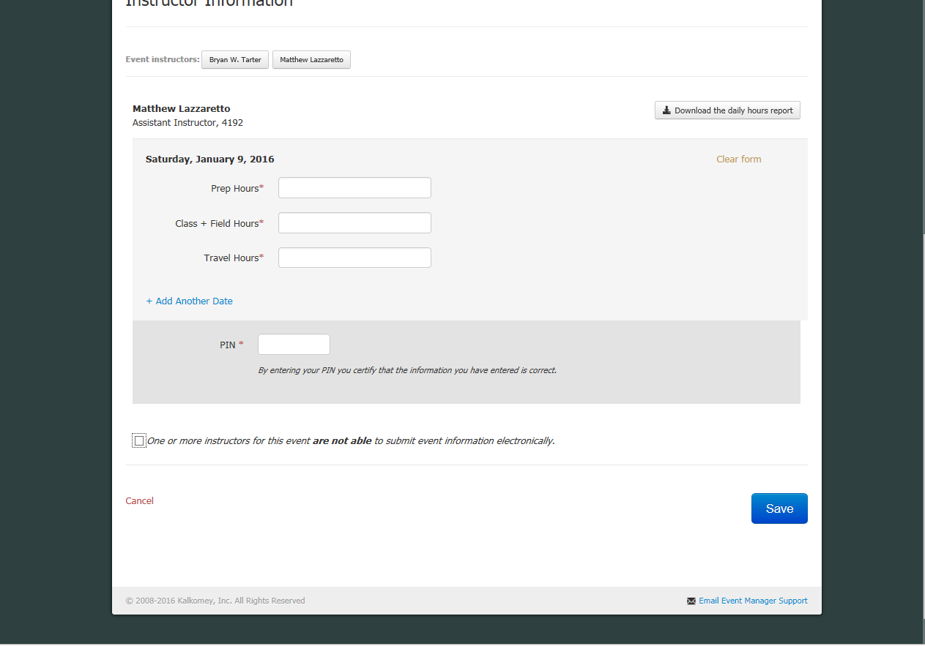
Enter the pin number you created earlier. It’s the 4 digit number that you created in the profile tab.

Slide 43
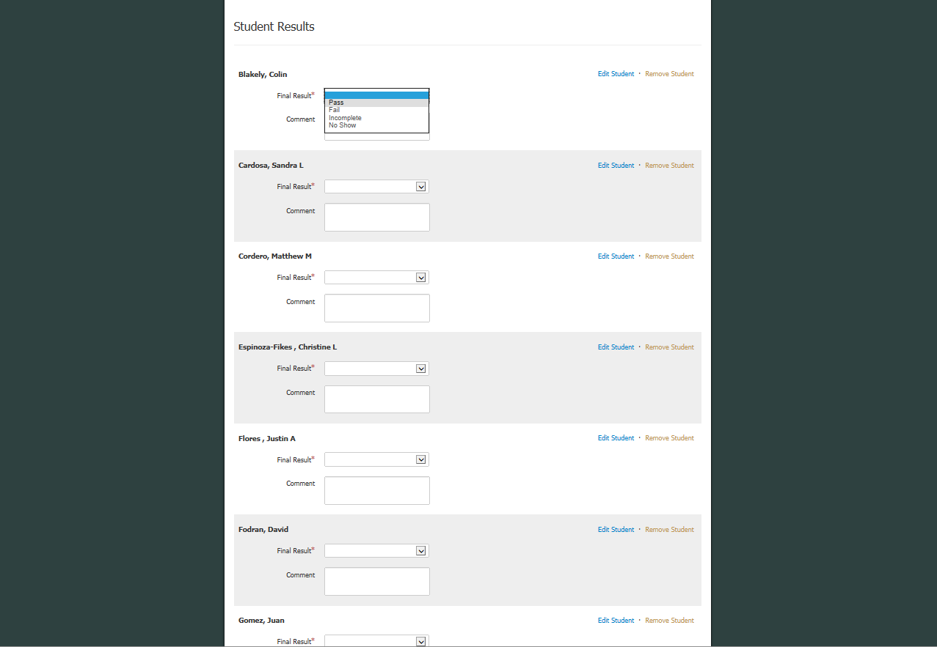
Student Results
This section will list all the students that
attended your class. Click the box next to the section titled “final result”.
Then indicate if the student passed by clicking “Pass” or failed by clicking “Fail”.
You may also make comments but they are not mandatory.

Slide 44
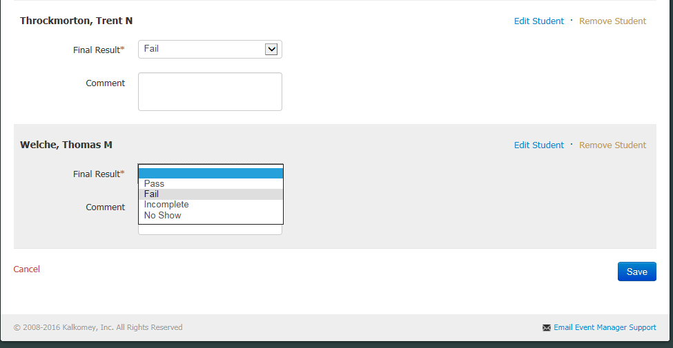
Incomplete means they attended part or all of the class but didn’t complete test.
No Show means that the student did not show up to the class.
After all results are filled out scroll to the bottom of the page and click the save button.

Slide 45
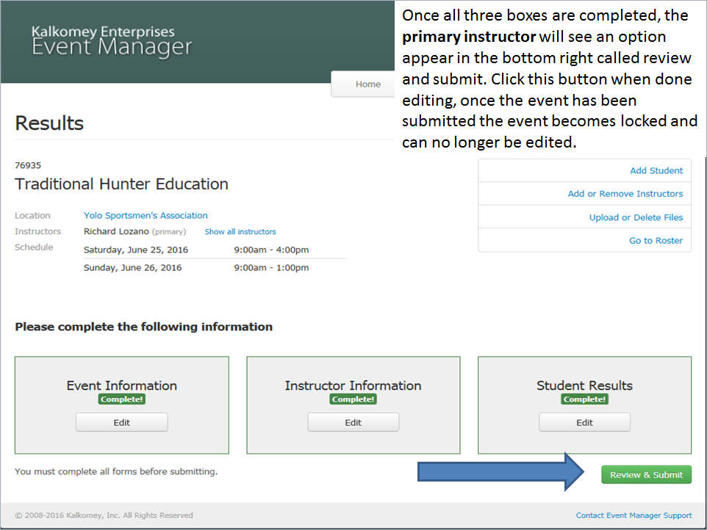
After clicking Review & Submit you will need to scroll down to bottom of page and select your coordinator then click Submit results.

Slide 46
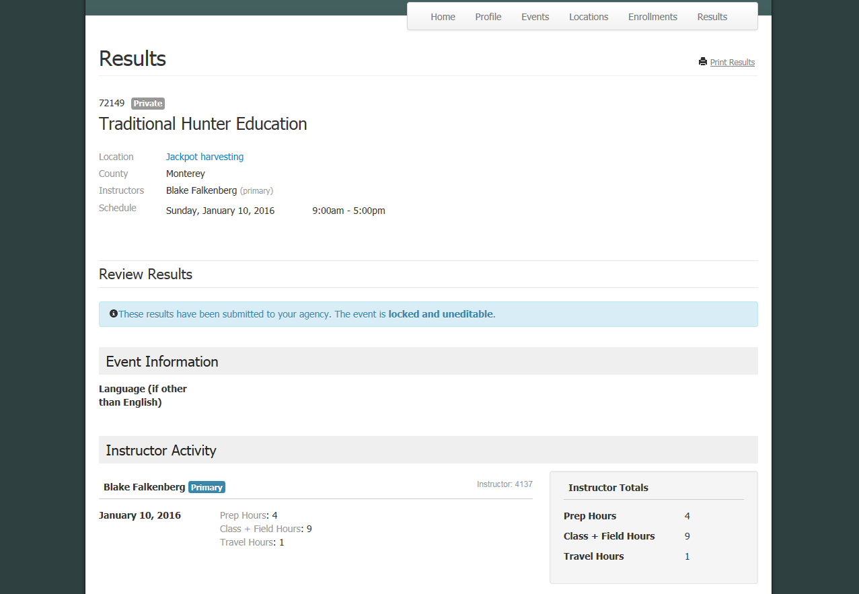
Confirmation page
You have now completed the whole process and are ready to teach your next class!

Slide 47
Walk Ins
Instructors discretion
Instructors may choose not to accept walk-ins
Walk-ins require instructors to do more work.

Slide 48
Walk-Ins (What to do)
Collect email addresses from students after the first day.
Log onto event manager and find the class you are teaching

Slide 49
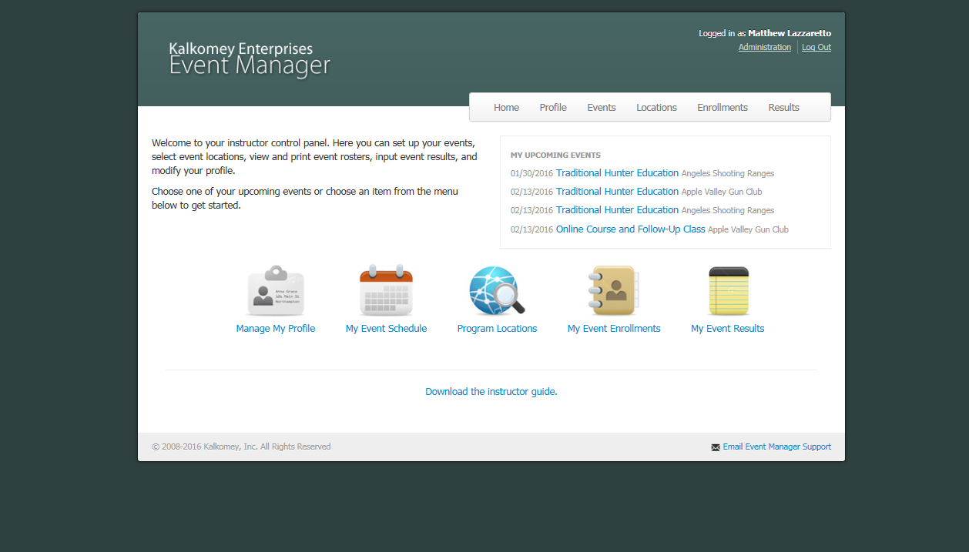
Click “Events”

Slide 50
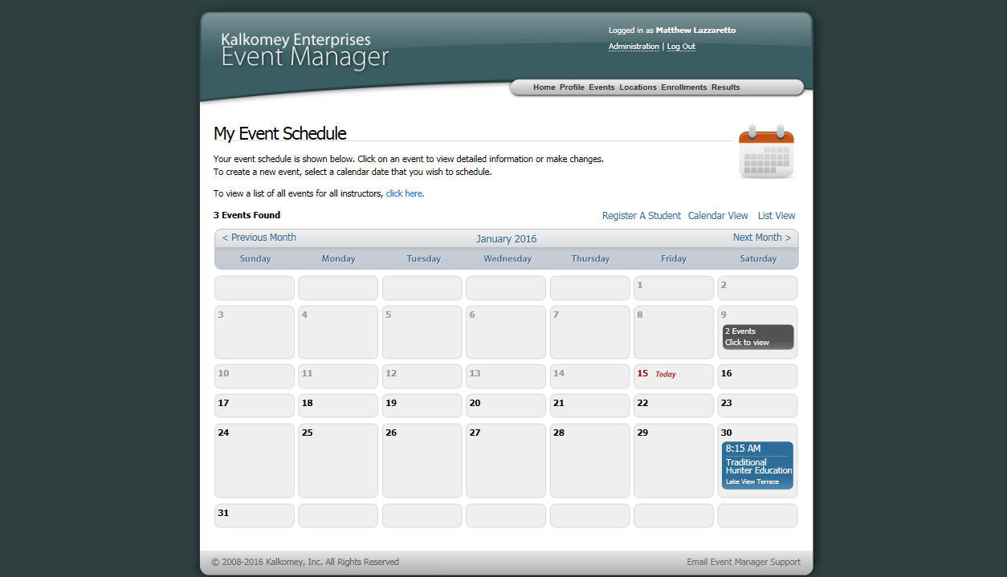
Find the event you need to add student to, and click on that event

Slide 52
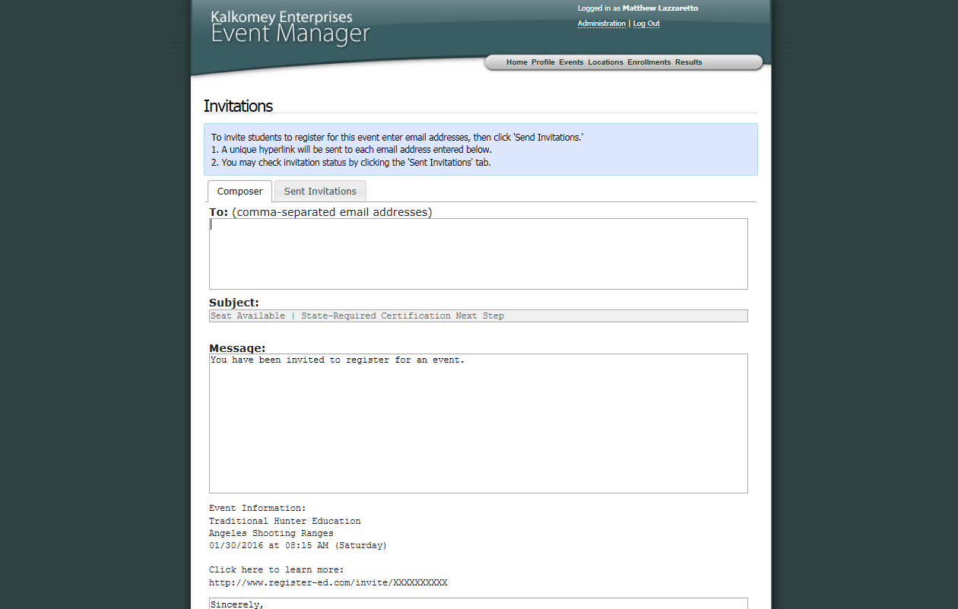
Enter all walk-in student’s email addresses then scroll down and click “Send Invitation”
Peter.Blake@wildlife.ca.gov

Slide 53
The student will then register for your class and be added to the student roster.
The night before your last class check and print an updated roster with the new students names added.
If the student does not register in time for the next class session you will withhold his passing certificate until the student completes the registration process.

Slide 54
Single Day Class Walk-ins
If they arrive early and have a smartphone, students can register using the phone.
If not, instructors must send students the email to register for their class.
Certificates will have to be mailed to student or picked up.

Slide 55
What Students See
Students find classes by going to
https://www.wildlife.ca.gov/Hunter-Education

Slide 56
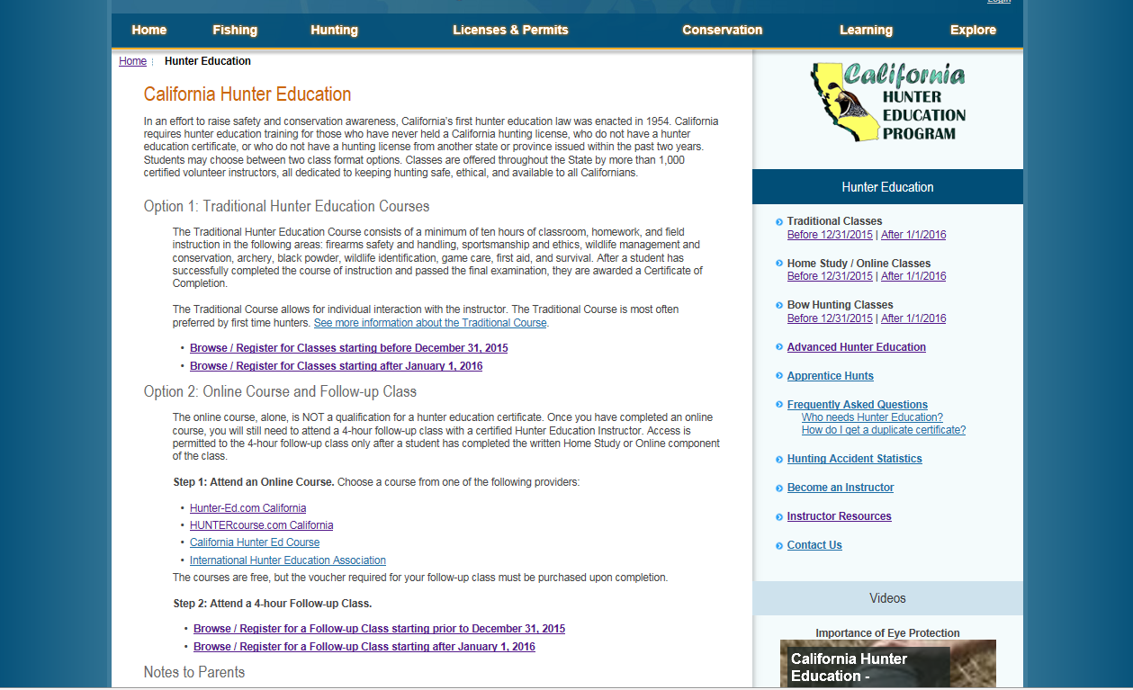

Slide 57
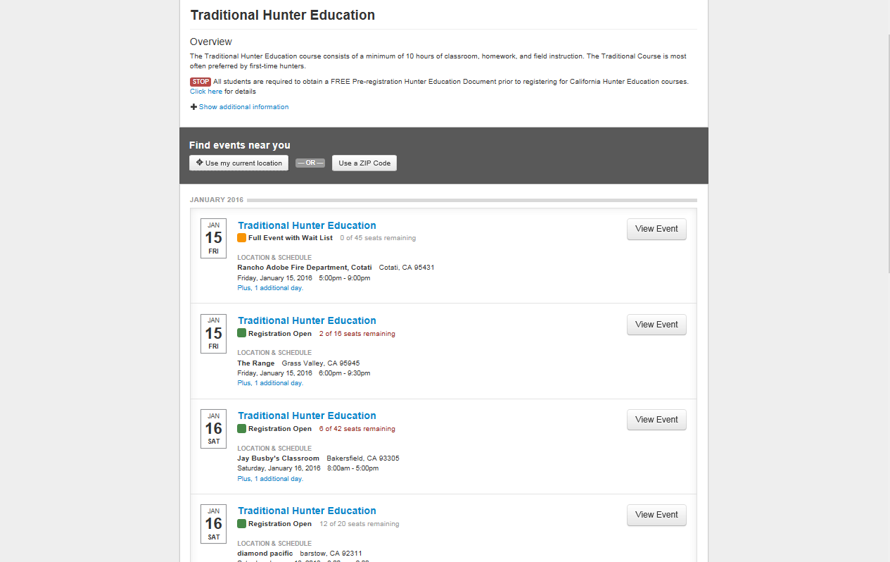

Slide 58
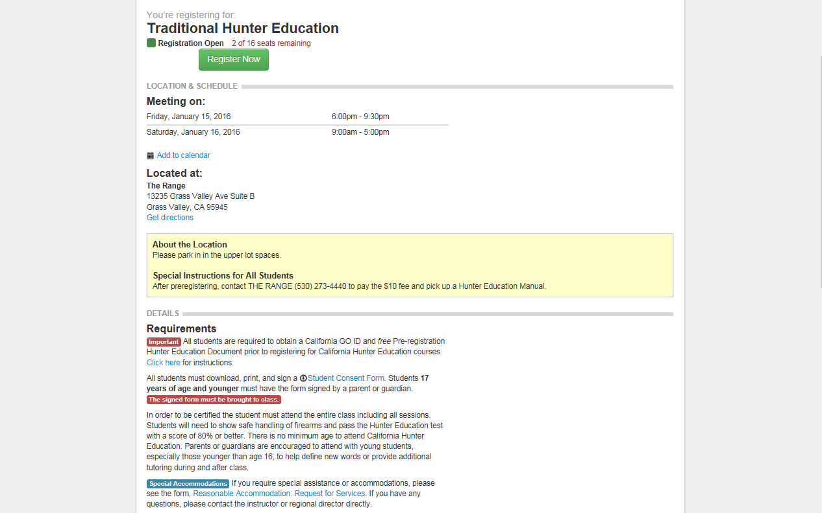
To register for a class students click this green “Register Now” icon.
Where students can get the consent form

Slide 59
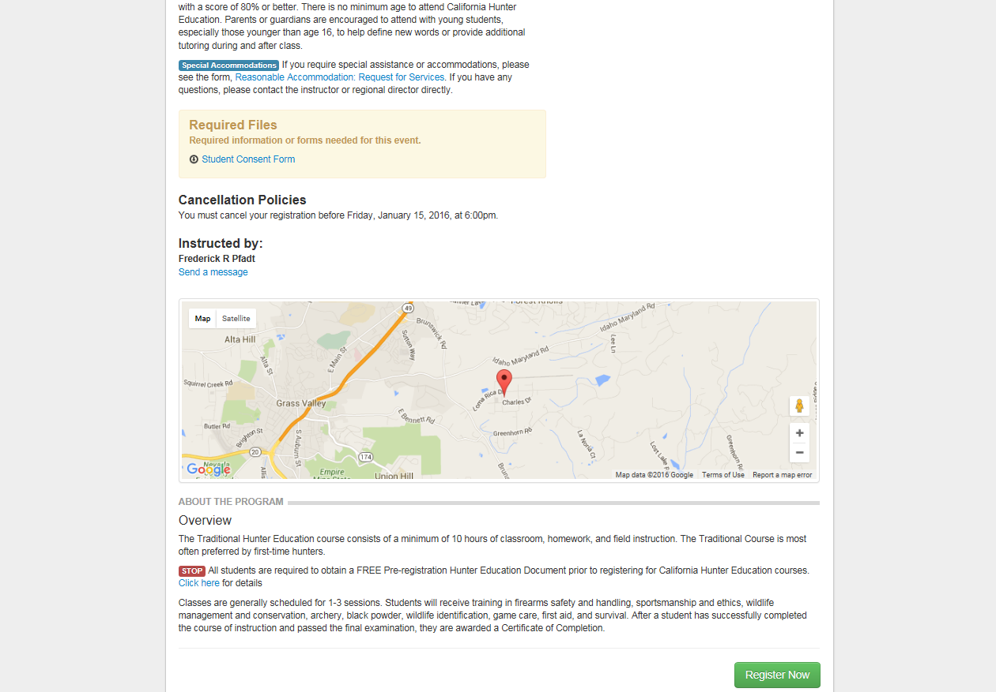
How students get in contact with you.

Slide 60
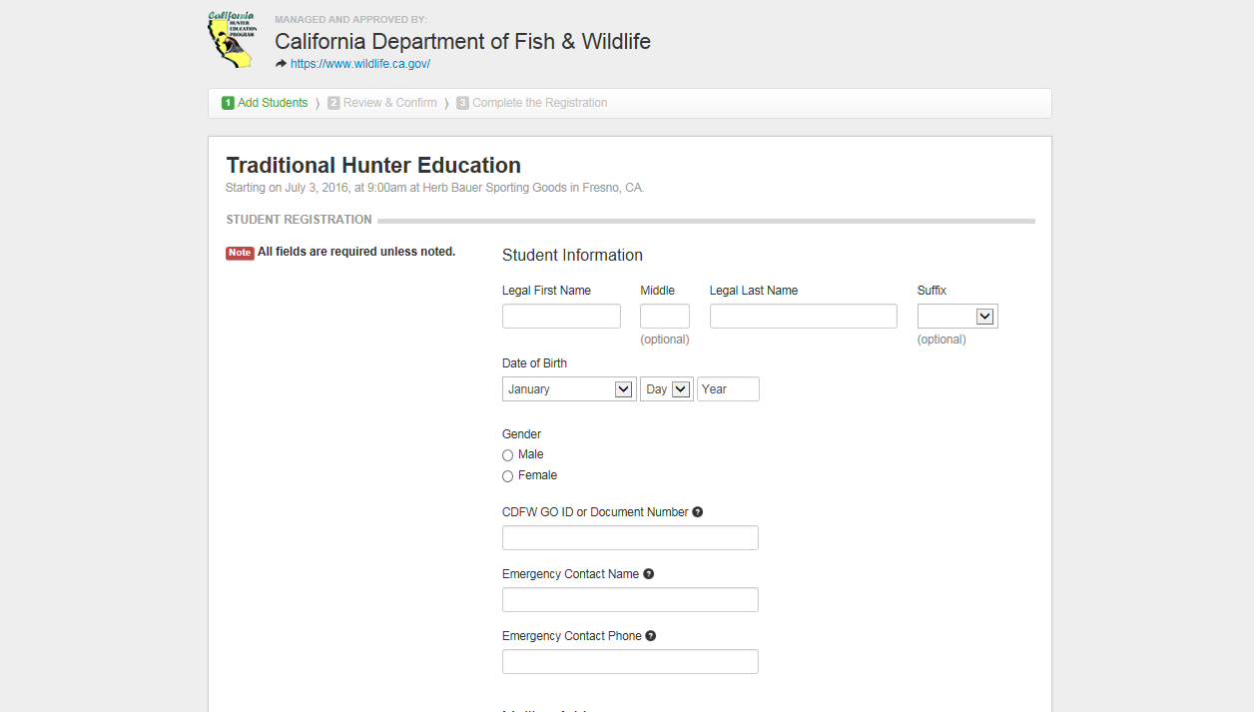
This is the box you will likely receive most questions about.
“CDFW GO ID or Document Number:”
Inform students that they can receive more information by clicking on the question mark next to the name.

Slide 61
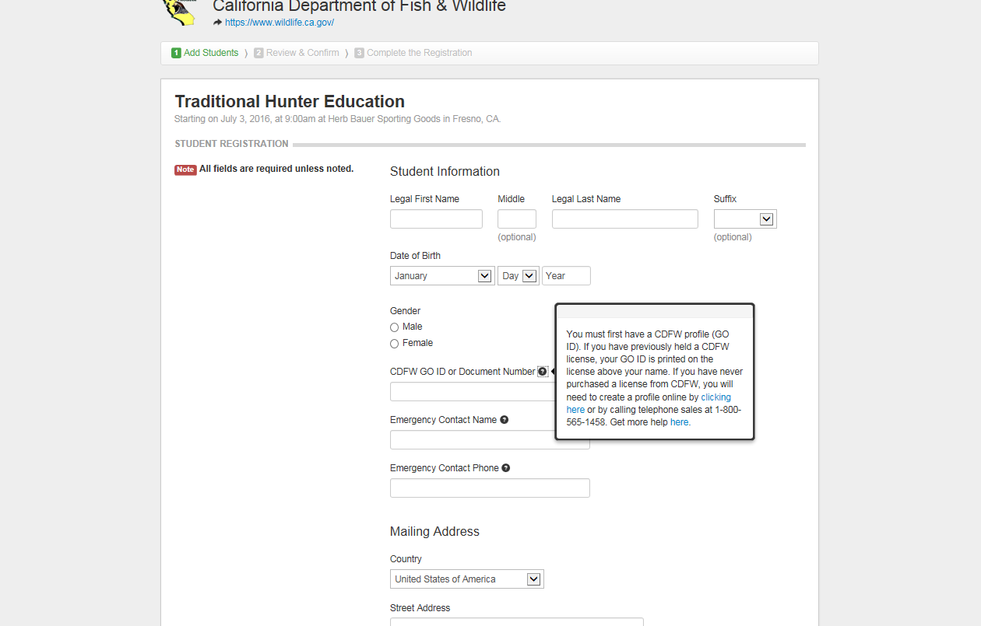
If the student has obtained a fishing license any year since 2010, they may use the GO ID or Document Number printed near the top of their license.
If they have not obtained a fishing license recently, tell the students to click this link.

Slide 62
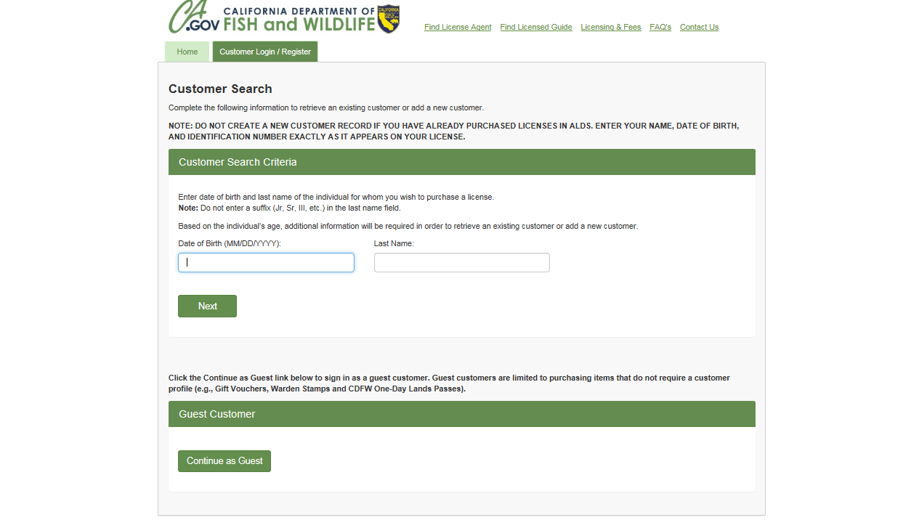
Student will be brought to this page to create or find their CDFW account.
Students will enter their DOB and last name
Then hit Next
03/15/1990
Lazzaretto

Slide 63
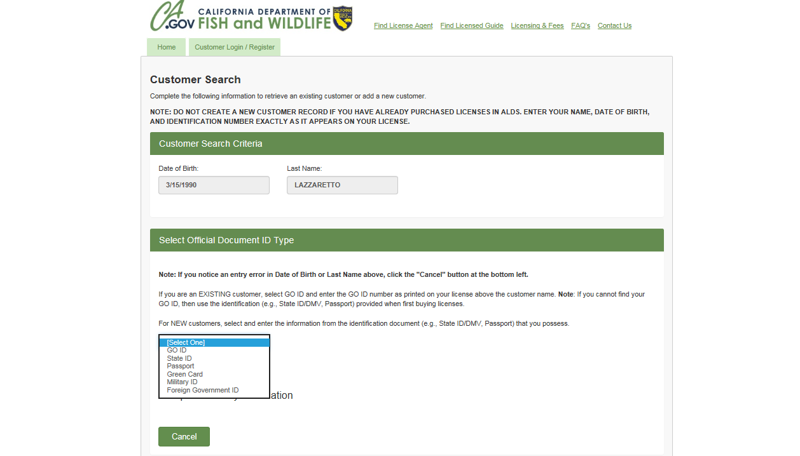
Select a Document ID Type

Slide 64
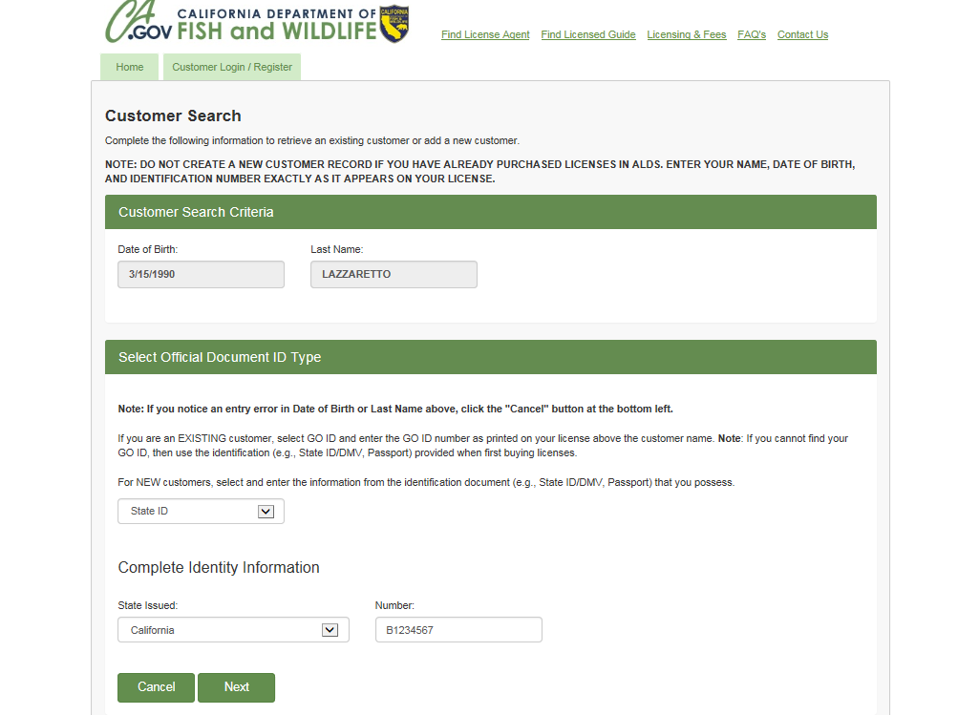
Fill out the required fields then hit next.

Slide 65
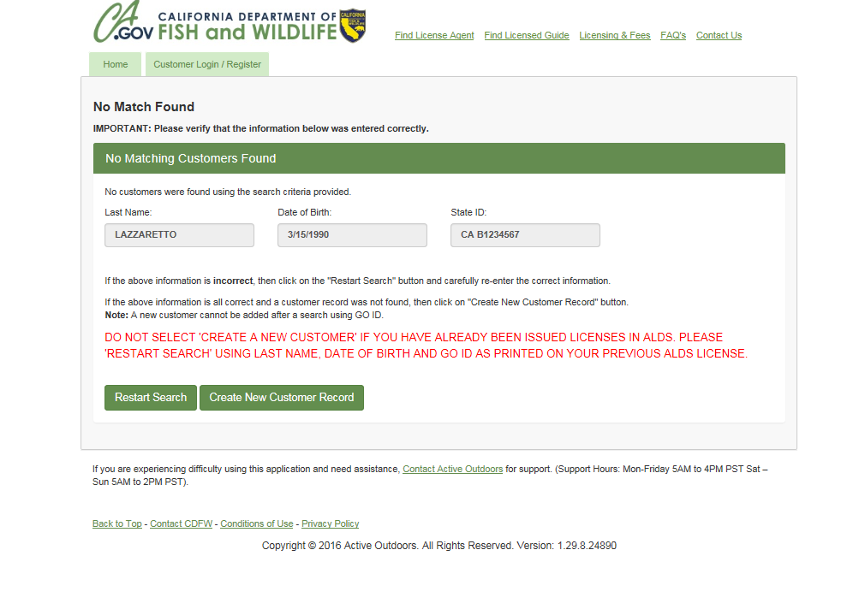
If there is not a matching customer record and you have verified that the information entered is correct, click “Create New Customer Record”.

Slide 66
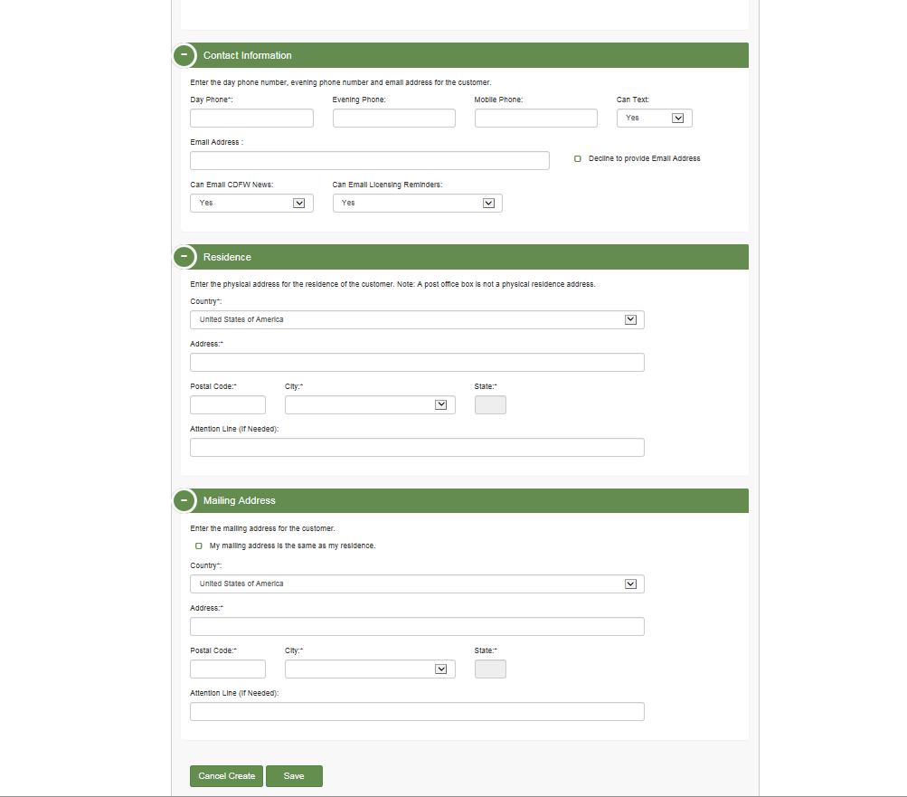
Fill out all fields marked with an asterisk, then scroll down and hit save.

Slide 67
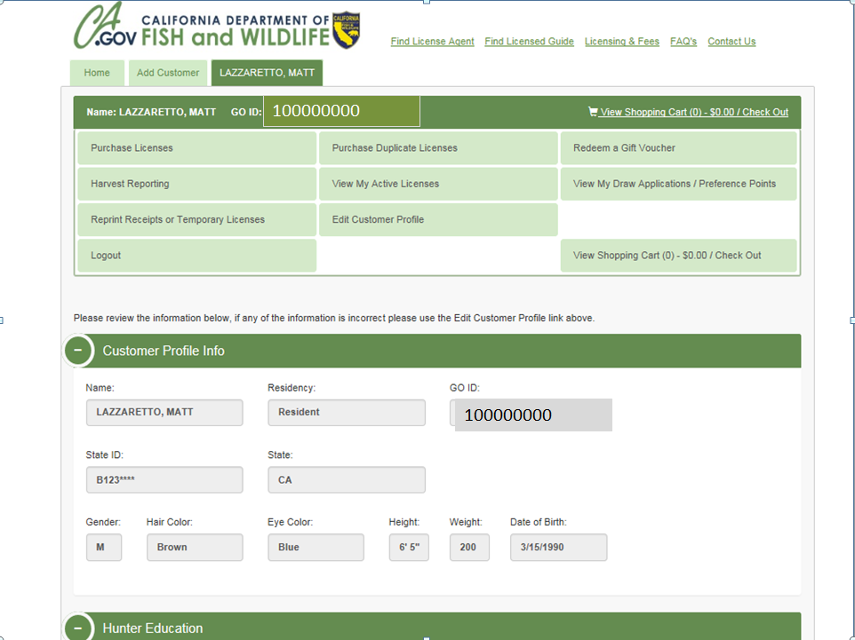
You now have a CDFW account and your GO ID can be found here.

Slide 68
If you are unable to help the student
Tell them to call 916-653-1235
(the Hunter Ed main line)

Slide 69
Any Questions?
Hunter Education Office
Email: HunterEducation@wildlife.ca.gov
Phone: 916-653-1235

